Slide 1

Gender Dysphoria: Ethical Concerns
in Promoting Ideology over Science
Paul W Hruz, M.D. Ph.D.
Associate Professor of Pediatrics and Cell Biology & Physiology
Division of Pediatric Endocrinology & Diabetes
Washington University School of Medicine
September 21,2019

Slide 2

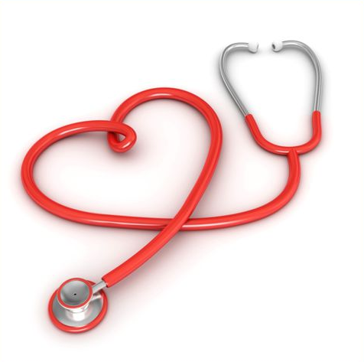
Disclosures
I have no financial disclosures relevant to this presentation
I am not representing Washington University or St Louis Children’s Hospital

Slide 3




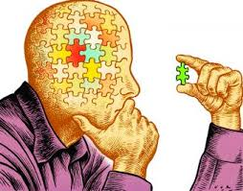

Identity

Slide 4

Mental Health Outcomes & Social Stress
Suicide
Addictions and substance abuse
Anxiety disorders
Mood disorders
Eating disorders
Intimate partner violence (i.e., domestic violence)
Childhood sexual abuse
J Adolescent Health 56: 489-495, 2016

Slide 5



Slide 6
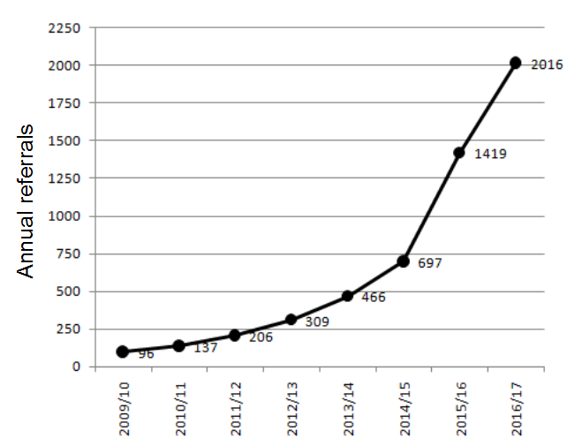
Referral Patterns to Gender Clinics
Source: Tavistock and Portman NHS Foundation Trust http://gids.nhs.uk/number-referrals (accessed 9-10-18)

Slide 7

Etiology
Twin Studies
  Monozygotic Twins-38% concordance of GD
  Dizygotic Twins- 0.34% concordance of GD
Potential causes or contributors include
  Parental psychopathology
  Family dynamics
  Adverse childhood events not limited to sexual abuse
  Social reinforcement
Increased incidence in children with autism
Social Contagion?
Notes:
The bottom line is that there currently is no clear and definitive answer to this question. The fact that most humans gender identity that agrees with their sex strongly supports a biological link between sex and gender identity. Gender discordance is the exception, not the rule. Identical twin studies do support a biological contribution to gender dysphoria as concordance rates, i.e. where one twin has GD the other also has GD, are much higher (~20%) than background rates (<0.1%). But if this was the whole story, one would expect 100% concordance in twin pairs who share the same genetic information and prenatal environment. Thus, there are likely other factors that contribute to the development of gender discordance/dysphoria. Environmental factors that have been investigated include dysfunction within family dynamics and phsychological trauma….Many questions still remain. Of particular concern is the potential for social reinforcement to initiate or at least perpetuate gender discordance as this is increasingly being advocated as a means to alleviate stress in affected individuals.

Slide 8
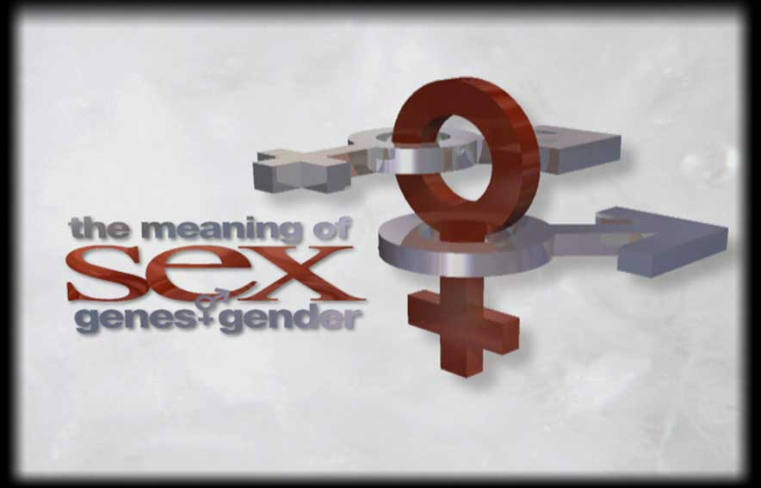
Basic Terminology
Sex
    Biological trait intrinsically oriented toward reproduction
    Male- Donor of genetic information (sperm)
    Female- Recipient of genetic information (eggs)
Gender
  Social and cultural expression of being masculine or feminine
  Gender Identity
    A person’s perception of being male or female
  Sexual Orientation
  Physical attraction and desire for sexual intimacy
http://www.hhmi.org/biointeractive/
Notes:
Providing clear definitions of what we are talking about is important, not only in our discussion today, but also in dialog with others about gender issues. Many scientists and physicians incorrectly use the term gender when they mean sex. For example, I have colleagues experimenting with rodents who refer to the “gender” of their mice, though I doubt they are referring to close observation of the social behavior of their animal colony. Similarly, when nearly all parents ask the question at the time of their child’s birth “Is it a boy or a girl?”, they are referring to sex, not gender. Yet medical forms have routinely changed to ask for gender rather than sex. If parents were truly interested in gender, they would have to wait quite a long time for an answer to their initial question. Some transgender advocates have gone as far as to say that gender IS sex or is the only real determinant of sex. The definition of sex I provide is objective and links form to function. I believe that the separation of sex from its procreative purpose is a major contributor to the problems we are talking about today.

Slide 9
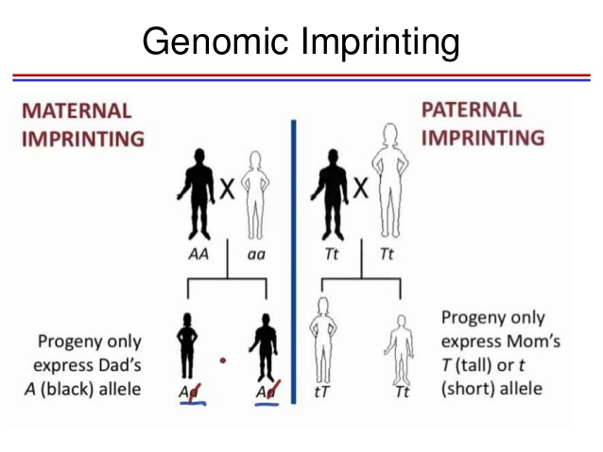
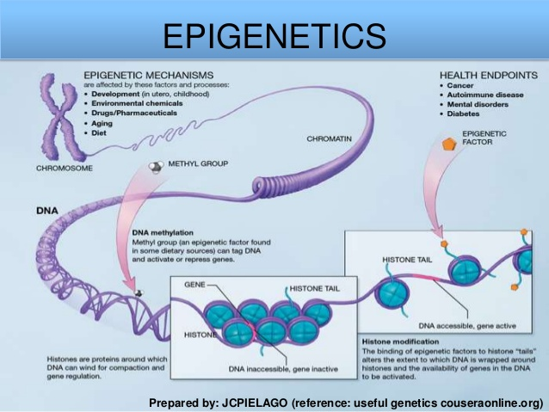
Sexual Differences are Present Throughout the Body

Slide 10

Approaches to Treatment
Traditional Approach
  Recognized as an objective mental disorder
  Encouragement to identify with sex
    Expectant waiting
    Family Therapy
  Recognition that the majority of children desist in transgender identity

Slide 11
Desistance of Gender Dysphoria
Nearly a dozen studies have been conducted over the past 40 years
  Many studies are relatively small and have methodologic weaknesses
  Reported desistance rates vary between 50-98%
Drummond et al (Dev. Psychol. 44:34-45, 2008)
  88% (22/25) of girls desisted
Steensma et al (JAACAP 52(6):582-589, 2013)
  70% (56/79) of boys and 50% (24/48) of girls had desistance
Singh (Doctoral Dissertation 2012)
  88% (122/139) of children desisted at early adult f/u

Slide 12
Approaches to Treatment
Current Paradigm
  Assertion that gender variation is “normal”
  Focus on alleviating dysphoria
  Pubertal suppression with start of normal puberty
  Cross-sex hormones at age 16 yrs
  Surgical Intervention (18 yrs)
    Bilateral mastectomy
    Removal of gonads
    Optional “bottom surgery”
Traditional Approach
  Recognized as an objective mental disorder
  Encouragement to identify with sex
    Expectant waiting
    Family Therapy
  Recognition that the majority of children desist in transgender identity

Slide 13



Clinical Practice Guidelines

Slide 14
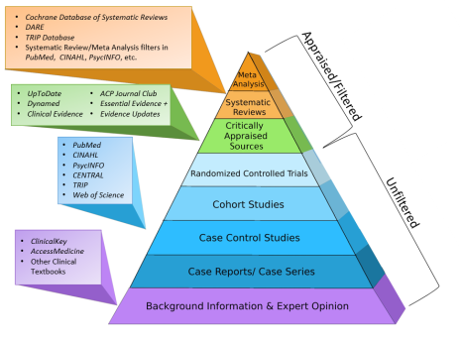
Scientific Evidence for Recommendations
High = Further research is very unlikely to change our confidence in the estimate of effect.
Moderate = Further research is likely to have an important impact on our confidence in the estimate of effect and may change the estimate.
Low = Further research is very likely to have an important impact on our confidence in the estimate of effect and is likely to change the estimate.
Very low = Any estimate of effect is very uncertain.
Evidence supporting transgender practice guidelines are poor to non-existent

Slide 15

Limitations of Existing Research
Few studies overall
Small sample sizes
Convenience samples
Uncontrolled design
Short duration
Retrospective
Observational

Slide 16

Social Affirmation
Name change
Pronoun usage
Cross-dressing
Bathroom and locker room use
Electronic Medical Record
Advocated at ages as early as 3 years

Slide 17
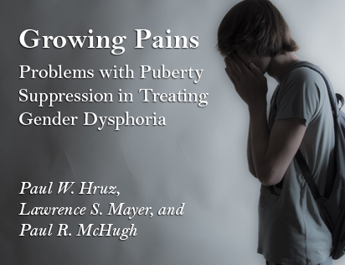
Pubertal Blockade
Interruption of a normal developmental process
No FDA approval for use in suppressing normally timed puberty
Adverse effect on bone density
Sterility when followed by cross-hormone therapy
Potential for altering desistance rates
  No published reports of desistance after Rx
  100% Persistence (DeVries et al. J Sex. Med 8(8), 2011)
New Atlantis 52: 3-36, 2017

Slide 18
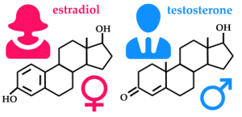
Known and Potential Risks of Cross-Sex Hormones
Infertility
Venous thromboembolism (MtF)
Polycythemia (FtM)
Osteopenia (FtM)
Cardiovascular Disease (FtM)
  Hypertension
  Increased BMI
  Insulin resistance
  Dyslipidemia
Acne vulgaris
Cancer
  Breast
  Ovarian
  Cervical
  Uterine
  Prostate
Wierckx et al. J Sex Med, 2012
Turrion-Merino et al. JAMA Derm, 2013
Bougeois et al Ann Endocrinol, 2016
Streed et al. Ann Intern Med, 2017
Maraka et al J Clin End Metab, 2017
Getahun et al. Ann Intern Med, 2018

Slide 19
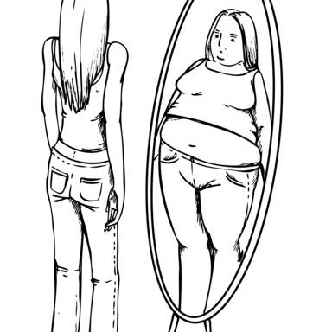
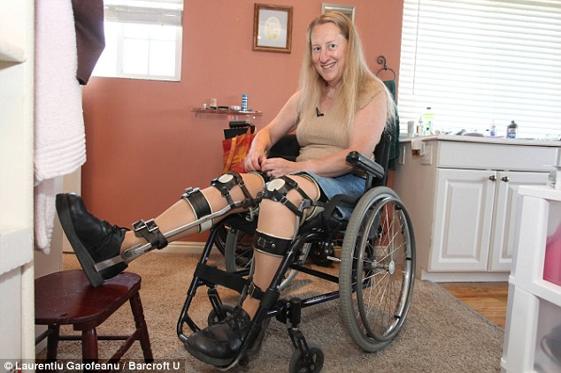
Short-Term Benefits
Alleviation of dysphoria
Improvement of depression
Slight increased anxiety
General satisfaction with interventions
Comparison to other conditions
  Body Dysmorphic Disorder
  Body Integrity Identity Disorder
  Anorexia nervosa
DeVries et al. J Sex Med 8(8), 2011
Olson et al. Pediatrics 137(3), 2016

Slide 20
Long-Term Outcomes
Ascheman et al. (Eur J Endocrinol 164(4):635-642, 2011)
  18.5 year f/u of 966 MtF and 365 FtM
  51% increase in suicide
Dhejne et al. (PlosOne 6(2): e16885, 2011)
  324 patients treated in Sweden (1973-2003)
  2.8-fold increase in psychiatric hospitalization
  4.9-fold increase in suicide attempts
  19-fold increase in completed suicide
  2.8-fold increase in overall mortality

Slide 21
Long-Term Outcomes- Suicide Risk
Adams, et al.; Transgender Health 2017

Slide 22

Walt Heyer
www.sexchangeregret.com/

Slide 23
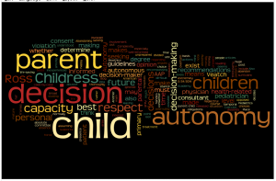
Ethics: Autonomy
Adolescents are more likely to:
  Act on impulse
  Misread or misinterpret social cues and emotions
  Get into accidents of all kinds
  Get involved in fights
  Engage in dangerous or risky behavior
Adolescents are less likely to:
  Think before they act
  Pause to consider the consequences of their actions
  Change their dangerous or inappropriate behaviors

Slide 24

Toward an Effective Response…
Compassion for the suffering experienced by people with gender dysphoria
Elimination of injustice due to prejudice, discrimination, bullying
Provision of quality evidence-based psychological support
Education on the physical, emotional, and spiritual nature of human sexuality
Need for high quality research including investigation of alternate approaches

Slide 25

Magisterial Guidance
Maintenance of biological reality (Fides et ratio)
Moral obligations and limits of medical treatment (USCCB ERDs)
Affirmation of human dignity (Evangelium vitae)
The art of accompaniment (Evangelii gaudium)
Acknowledgement of suffering (Salvifici doloris)
Goal of directing affected persons toward the summum bonum

Slide 26

Questions?

