Slide 1
Embryo Formation and Loss During the Use of Hormonal Contraception
Two Systematic Reviews
Cara Buskmiller, MD
Graduate Medical Education
Department of Obstetrics, Gynecology, and Women’s Health
Notes:
Date: Saturday April 6
Time: 8:00 AM
Duration: 45 minutes including questions
Audience: AAPLOG, students, +/- friends, exhibitors, stakeholders
Introductory remarks:
Thank you for that kind introduction.
Because we have only 45 minutes to review two large papers and for two periods of questions, we’ll dive right in to [title]
Birth control can be a sensitive topic in the pro-life world as we differ at times in perspectives and faith, but we’ll approach the topic together as pro-life advocates for human persons from conception until natural death.

Slide 2
Disclosure
Both studies reported were unfunded. The authors declare no potential conflicts of interest with respect to the research, authorship, and/or publication of this article.
No relevant financial disclosures outside of the reported publications.

Slide 3
Objectives
Walk through two systematic reviews on whether embryos are formed and lost during use of oral contraceptive pills (OCPs) and intrauterine devices (IUDs)
Review the physiology of normal and abnormal ovulation.
Describe how normal ovulation is determined in studies of OCPs, and implications for abnormal ovulation.
Examine how often abnormal ovulation occurs with OCPs and articulate what this means for embryos of OCP users.
Review mechanisms of action proposed for IUDs and methods of studying subclinical pregnancies in IUD users.
Assess quality of evidence for a post-fertilization mechanism of IUDs.
Suggest next steps in research to answer these vital questions.

Slide 4
Ovulation during use of oral contraceptive pills
Systematic Review of Abnormal Ovulation
Cara Buskmiller, MD
Graduate Medical Education
Department of Obstetrics, Gynecology, and Women’s Health
Notes:
Engagement notes:
Date: Friday, September 14
Time: 1400 (combined with embryo adoption)
Place: room 4?

Slide 5
Objectives
Walk through two systematic reviews on whether embryos are formed and lost during use of oral contraceptive pills (OCPs) and intrauterine devices (IUDs)
Review the physiology of normal and abnormal ovulation.
Describe how normal ovulation is determined in studies of OCPs, and implications for abnormal ovulation.
Examine how often abnormal ovulation occurs with OCPs and articulate what this means for embryos of OCP users.
Review mechanisms of action proposed for IUDs and methods of studying subclinical pregnancies in IUD users.
Assess quality of evidence for a post-fertilization mechanism of IUDs.
Suggest next steps in research to answer these vital questions.

Slide 6
What is the first study we’re walking through?
“Systematic Review of Ovarian Activity and Potential for Embryo Formation and Loss during the Use of Hormonal Contraception” ¹ by Harrison et al., published November 2018 in the Linacre Quarterly
Systematic review of 17 studies of oral contraceptive pills of various formulations which all used Hoogland criteria to grade ovulatory activity
Prompted by decreased E in formulations (responsible for much of ovulation prevention) without decreased number of positive pregnancy tests, and concern for postfertilization mechanisms when an egg can be released.²⁻⁵
Harrison et al 2018
Notes:
1: Bitzer and Simon, 2011
2: ESHRE 2001
3: Benagiano et al 2000
4: Puri et al 2000
5: Katkam et al 1995

Slide 7
How do we know when ovulation happens?
In abstract: egg release from a dominant (Graafian follicle), following recruitment by FSH of a cohort productive of estrogen.
In practice and research: confusing and inconsistently assessed⁶
Threshold progesterone level^{7,8}
Visualization of stigma of ovulation in surgery (historical gold standard)^{9,10}
Visualization of follicular rupture by ultrasound (current gold standard)^{11,12}
Human chorionic gonadotropin (marker for implantation)
Van Heusden et al 2002
Landgren et al 1980
Croxatto et al 1998
D’Hooghe et al 1996
Liukkonen et al 1984
Check et al 1990
Notes:
6: van Heusden et al 2002
7: Landgren et al 1980
8: Croxatto et al 1998
9: D’Hooghe et al 1996
10: Katz 1988
11: Liukkonen et al 1984
12: Check et al 1990
Threshold P:
Langren et al 1980 proposed (in 68 normal women, levels were all >13 at some point, but no correlation done w/ other markers of ovulation). 5 nmol/L is from IVF literature about when embryos are most likely to survive.
But cases exist of pregnancy w/ low P: 0.79ng/mL (2.51nmol/L)
Croxatto et al 1998: 5/9 of cycles demonstrated that follicular rupture would be considered anovulatory based on endocrine criteria such as P
Emphasize two separate processes (related): follicular rupture, progesterone elaboration
But people continue to state that follicular rupture + poor P = anovulatory cycle (no evidence to say either way!!)
S.O.:
There are false negs: D’Hooghe et al 1996: 13/138 laparoscopies had egg recovery w/o S.O., and others have seen pregnancies w/o S.O.
U/S:
50% decrease was arbitrary; multiple issues with not catching follicle at peak size (artifiial decrease in 50%)
3/25 patients in one study (Liukkonen et al 1984) had O.S. w/o follicular rupture
5.4% preg rate in one study of these pts (Check et al 1990)

Slide 8
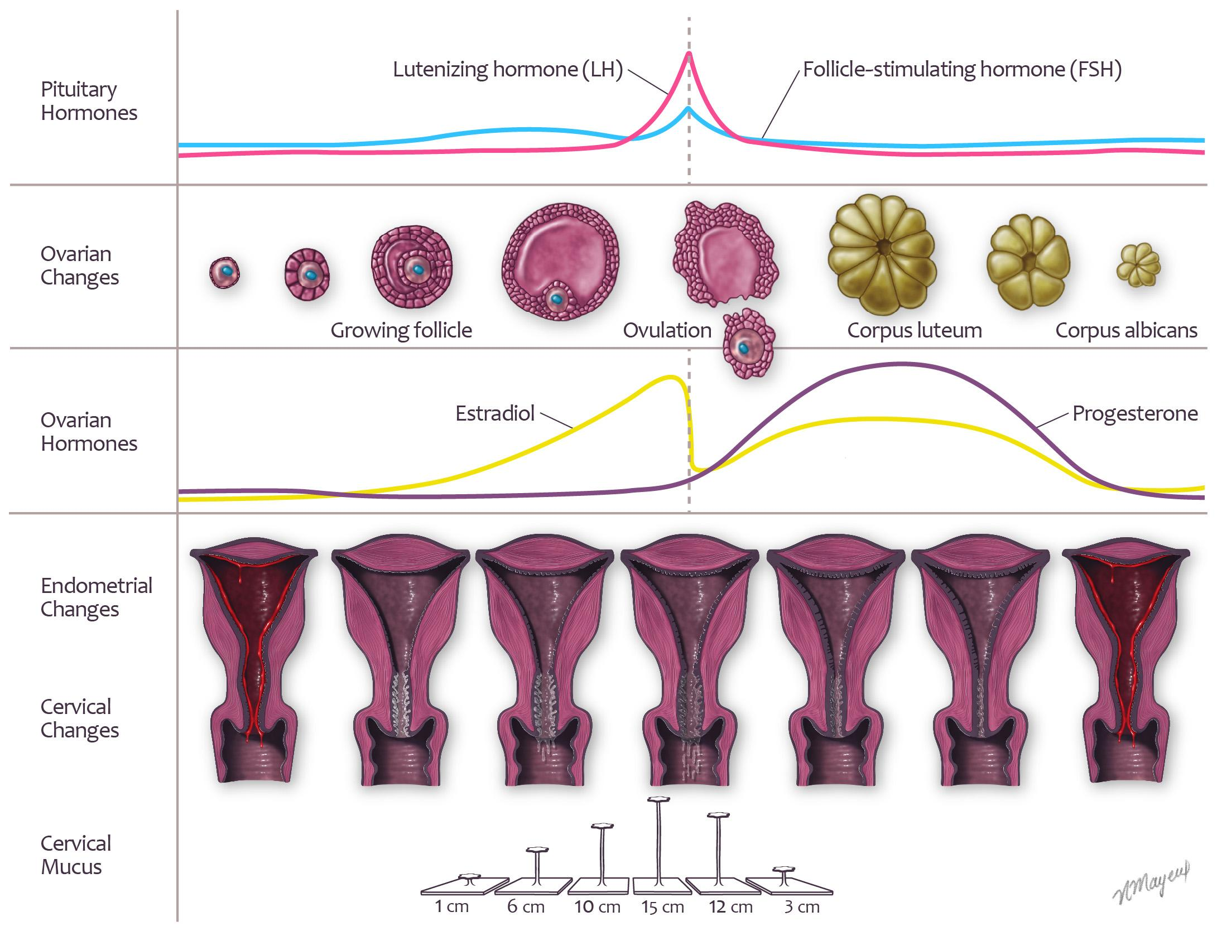
Image credit: Stone and Buskmiller, used with permission
Notes:
In infertility treatment, especially with ovulation induction that requires an intact HPO access, like clomid, you need enough E to make a useful follicle, not only to get an egg but to get a good enough CL to make some P. Otherwise you end up supplementing P, or empirically giving P.

Slide 9
What are the Hoogland criteria?
Hoogland Ovulation
Dominant follicle >13mm
US documentation of decrease in follicle size by 50% or more within 2-4 days (“follicular rupture”)
E > 0.1nmol/L in follicular phase
P > 5nmol/L in luteal phase
Hoogland LUF
Dominant follicle >13mm
US documentation of decrease in follicle size by less than 50% or not within 2-4 days, nor not occuring at all (“no follicular rupture”)
E > 0.1nmol/L in follicular phase
P > 5nmol/L in luteal phase
Hoogland Active FLS
Dominant follicle >13mm
Follicular rupture or no follicular rupture
E > 0.1nmol/L in follicular phase
P < 5nmol/L in luteal phase
Hoogland Non-Active FLS
Dominant follicle >13mm
Follicular rupture or no follicular rupture
E < 0.1nmol/L in follicular phase
P > 5nmol/L in luteal phase
Hoogland and Skouby 1993
Harrison et al 2018

Slide 10
How often does Hoogland ovulation occur with OCPs?
Ovulation: 1.7%
LUF: 1.1%
Active FLS: 24%
Nonactive FLS: 5.6%
Van der Does et al 1995
Spona, Elstein, et al 1996
Spona, Feichtinger et al 1996
Rossmanith et al 1997

Slide 11
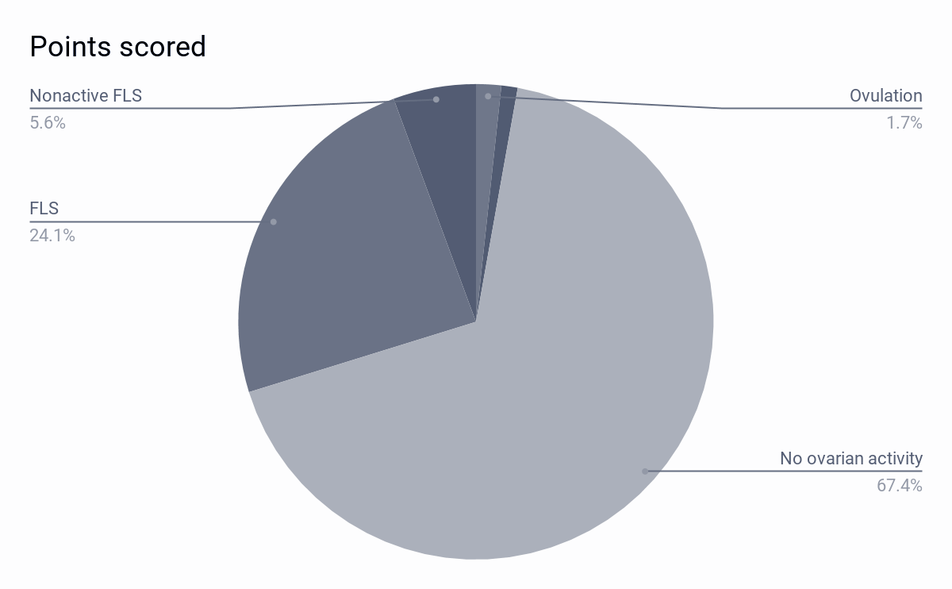
How often do follicles > 13mm occur with OCPs?
A third of the time (32%)
Harrison et al 2018

Slide 12
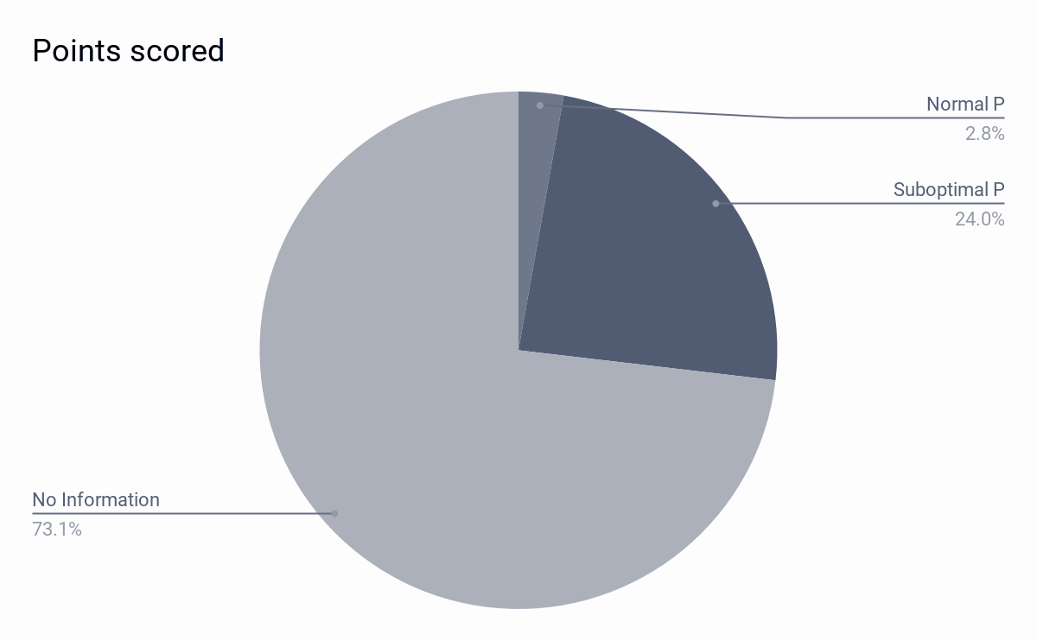
How often do follicles > 13mm, with suboptimal P, occur with OCPs?
Often (30%)!
Harrison et al 2018

Slide 13
What are the strengths of this study?
This is the first systematic review of the contraceptive literature comparing the results of Hoogland scoring in multiple studies with various hormonal contraceptive formulations

Slide 14
What are the weaknesses of this study?
Hoogland criteria have high false-negative rates for egg release, and systematic reviews are only as strong as the evidence they examine.
Notes:
First bullet: study is unable to arrive at an accurate estimate of ovulation rates, embryo survival rates, and/or embryo demise rates

Slide 15
What should we take away from this study?
Hoogland criteria are the most often-used standard for grading ovarian activity in contraceptive studies, and the criteria do not allow for ovulation and subsequent luteal phase deficiency
The most common type of ovarian activity in OCP users is dominant follicular rupture with inadequate progesterone production to support any embryo formed

Slide 16
What are the next steps?
Find a better marker for ovulation
Assess embryo formation in contraception users (markers of fertilization)
Assess embryo demise in contraception users
Examine personal practice in light of this research as a pro-life physician
Include this information in informed consent
Notes:
First bullet: low false negative rates, high pos pred value (would need to be near 100% neg predictive value to confirm exclusively prefertilization MOAs)

Slide 17
Ovulation during use of oral contraceptive pills
Questions and Answers
Cara Buskmiller, MD
Graduate Medical Education
Department of Obstetrics, Gynecology, and Women’s Health
Notes:
Engagement notes:
Date: Friday, September 14
Time: 1400 (combined with embryo adoption)
Place: room 4?

Slide 19
Postfertilization effects during use of intrauterine devices
Systematic Review of Subclinical Pregnancy
Cara Buskmiller, MD
Graduate Medical Education
Department of Obstetrics, Gynecology, and Women’s Health
Notes:
Engagement notes:
Date: Friday, September 14
Time: 1400 (combined with embryo adoption)
Place: room 4?

Slide 20
Objectives
Walk through two systematic reviews on whether embryos are formed and lost during use of oral contraceptive pills (OCPs) and intrauterine devices (IUDs)
Review the physiology of normal and abnormal ovulation.
Describe how normal ovulation is determined in studies of contraception, and implications for abnormal ovulation.
Examine how often abnormal ovulation occurs with OCPs and articulate what this means for embryos of OCP users.
Review mechanisms of action proposed for IUDs and methods of studying subclinical pregnancies in IUD users.
Assess quality of evidence for a post-fertilization mechanism of IUDs.
Suggest next steps in research to answer these vital questions.

Slide 21
What is the second study we’re walking through?
“Systematic Review of Post-fertilization Effects and Potential for Embryo Formation and Loss During the Use of Intrauterine Devices” by Buskmiller et al., submitted March 2019 to the Linacre Quarterly
Systematic review of postfertilization effects of IUDs including 23 studies of beta hCG and several studies of other ways of identifying pregnancy loss during IUD use
Originally planned as a section of the previous review, but overwhelming literature demonstrating a different problem prompted a separate effort and thesis statement.

Slide 22
How do we know when fertilization happens?
In abstract: a series of steps which produce from two gametes an embryo (zygote)
In practice and research: confusing and inconsistently assessed
Beta subunit of human chorionic gonadotrophin (bhCG)
Early pregnancy factor (human chaperonin protein 10, Hsp10)
Pregnancy-specific binding globulin (PSBG, PAPP-C, SP1, PSβG, TSβG)
Direct visualization of embryos in tubes
Cole 2010
Cole and Gutierrez 2009
Cole, Khanlian, and Muller 2009
Morton et al 1974
Chen et al 2016
Rosen et al 1979

Slide 23
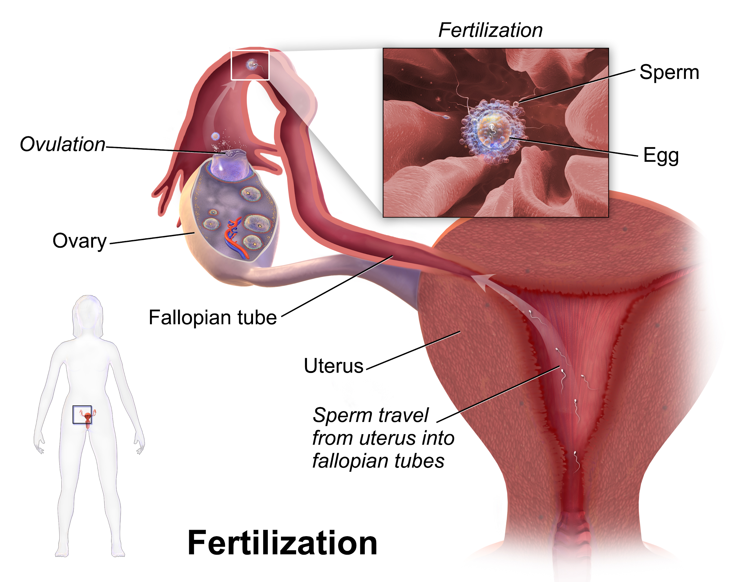
Image credits: Blausen.com, Ttrue12 Wikimedia Commons
Notes:
Blausen.com staff (2014). "Medical gallery of Blausen Medical 2014". WikiJournal of Medicine 1 (2). DOI:10.15347/wjm/2014.010. ISSN 2002-4436. - Own work
By Ttrue12 - Own work, CC BY-SA 3.0, https://commons.wikimedia.org/w/index.php?curid=19679961

Slide 24
What makes a good quality study of bhCG in IUD users?
Testing one IUD type at a time
A control group
Clear inclusion and exclusion criteria, especially including robust demonstration of fertility
Multiple samples per woman per cycle
Robust determination of luteal phase
Exclusion of anovulatory cycles with progestin IUDs
Good research practice (reporting funding and conflicts of interest, peer review, methods, attrition)
Buskmiller et al 2019
Notes:
The key for this slide is not that the numbers go down, but that the rate doesn’t disappear, and it’s the same order of magnitude.

Slide 25
How often do IUD users have positive bhCG but no clinical pregnancy?
Considering all available studies: 7.6%
Considering good-quality studies: 4.5%
23 studies, see Table 3
in Buskmiller et al 2019
Notes:
The key for this slide is not that the numbers go down, but that the rate doesn’t disappear, and it’s the same order of magnitude.

Slide 26
How often do IUD users have positive PSBG but no clinical pregnancy?
Only two studies
3-6% of the time
Does not correlate perfectly with bhCG
Seppala et al 1978
Yikorkala et al 1980
Notes:
May want to admit it’s because we didn’t thoroughly review it?

Slide 27
How often do IUD users have positive Hsp10 but no clinical pregnancy?
One one study
26% of the time
Outlier in the present systematic review
Smart et al 1982
Notes:
By like an order of magnitude.

Slide 28
What about direct visualization of embryos in fallopian tubes?
Four reports of embryos found in fallopian tubes of IUD users
Single study attempting to conclude the matter (Alvarez et al 1988)
Hurst et al 1980
Clewe et al 1971
Dickman et al 1965
Zamboni et al 1966
Alvarez et al 1988
Notes:
By like an order of magnitude.

Slide 29
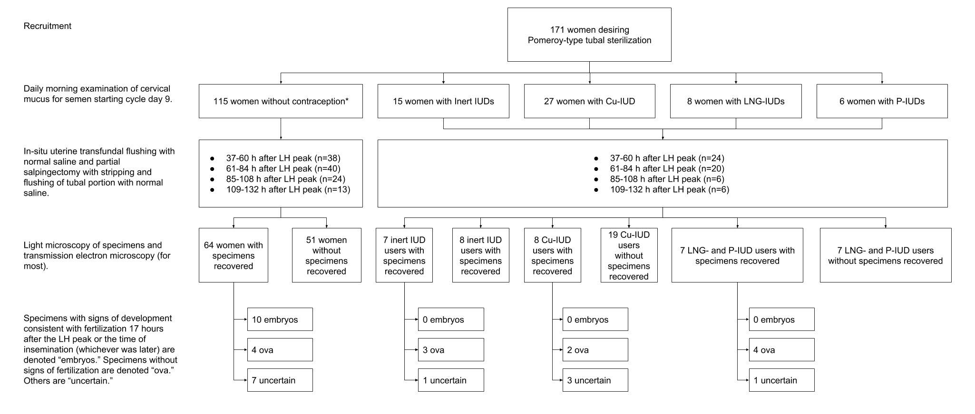
Image credit: Figure 2 Buskmiller et al sub. 2019

Slide 30
What are the problems with Alvarez et al?
Assumes a “straw man” (that if there is a post-fertilization mechanism, it is the only one)
Flushed tubal portions in Pomeroy-type tubal ligations, not complete tubes after salpingectomy
Made assumptions on the time of fertilization
Used appearance alone to determine whether fertilization occured (no FISH available)
Alvarez et al 1988
Buskmiller et al sub. 2019
Notes:
The paper is an important pilot study which determines, with small numbers of women using Cu-IUDs and LNG-IUDs, that eggs and perhaps embryos can be found in tubes, although more information (such as time to embryo destruction in an IUD-bearing uterus and a definitive test for paternal DNA in specimens to avoid disagreement over histological appearance) would be necessary to design a definitive study.

Slide 31
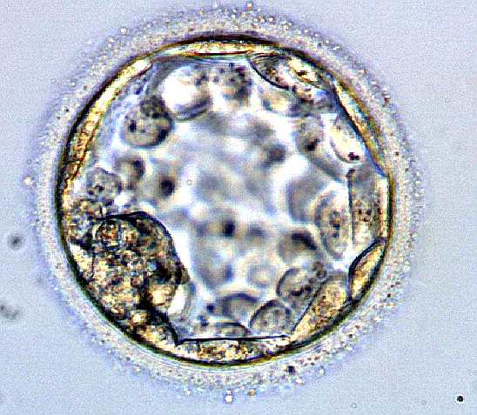
What can we take from the fact that IUDs are used as emergency contraception?
IUDs work to prevent clinical pregnancy even 5 days after ovulation
Potentially affecting 4- or 5-day embryos (blastocysts)
Rivera et al 1999
Gemzell-Danielsson and Berger 2013
Image: NinaSes, Wikimedia Commons
Notes:
Image credit: NinaSes [CC BY-SA 4.0 (https://creativecommons.org/licenses/by-sa/4.0)]

Slide 32
What can we take from the natural history of IUPs in IUD users?
Composite risk of 36.8% if IUD removed, 63.3% if retained (SAB, IUFD, IUGR, PTL, PPROM)
Preterm delivery makes up a large part of this (18% in retained, 14% in removed)
Also increased risk of abruption and chorioamnionitis (independent of PTL)
Multiple high-quality reviews confirm findings
Ozgu-Erdinc et al 2014
Kim et al 2010
Ganer et al 2009
Brahmi et al 2012

Slide 33
What can we take from the altered IUP:ectopic ratio in IUD users?
Logically, means there is some location-related difference between the way IUDs work and the way other contraceptives work.
Locations such as the fallopian tube (motility) and endometrium (decreased receptivity) are affected with IUDs
Suggests concern for endometrial selection events (other possibilities exist)
Backman et al 2004

Slide 34
What are the strengths of this study?
First quality assessment of bhCG assays
Breadth of scope concerning many ways of assessing occult pregnancy loss
Supplies unbiased information about biological realities that some patients and providers likely find concerning

Slide 35
What are the weaknesses of this study?
Any systematic review is as strong as its data and methods
Data is moderate, with few high-quality studies
Not all databases searched for all topics
Notes:
First bullet: study is unable to arrive at an accurate estimate of ovulation rates, embryo survival rates, and/or embryo demise rates

Slide 36
What should we take away from this study?
Good-quality evidence exists for embryo formation without subsequent clinical pregnancy in IUD users
Post-fertilization mechanisms should be prioritized in descriptions of IUDs’ mechanisms of action
It is time to revisit these studies using modern methods (randomized controlled trials, fluorescence in situ hybridization for paternal DNA in cells from fallopian tubes), or revisiting Hsp10 or PSBG
Notes:
If the previous half of the talk made you think, this half should scare you, because there is much more evidence at our disposal for embryo formation and loss.

Slide 37
What are the next steps?
Find a better marker for fertilization
Assess causality of IUDs in pregnancy loss, since this review only establishes associations.
Examine personal practice in light of this research as a pro-life physician
Include this information in informed consent
Notes:
First bullet: low false negative rates, high pos pred value (would need to be near 100% neg predictive value to confirm exclusively prefertilization MOAs)

Slide 38
Postfertilization effects during use of intrauterine devices
Questions and Answers
Cara Buskmiller, MD
Graduate Medical Education
Department of Obstetrics, Gynecology, and Women’s Health
Notes:
Engagement notes:
Date: Friday, September 14
Time: 1400 (combined with embryo adoption)
Place: room 4?

Slide 39
Acknowledgements
Coauthors, especially Donna Harrison, MD, and Patrick Yeung, MD, Lester Ruppersberger, DO, and Monique Chireau, MD.
MaterCare for generous invitation and gracious sponsor for financial support..
Catholic Medical Association, for similar mentorship and examples.
Conscience in Residency, a community of like-minded trainees who provided support and engagement.

