Slide 1
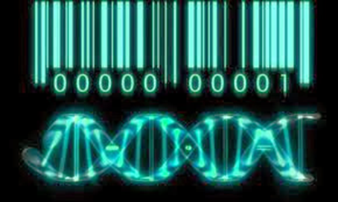
Eugenics 21st Century style
Andrzej Kochański

Slide 2
Journal of Medical Ethics

Slide 3
Science and eugenics
Why eugenics is not science?
We do not have sufficient understanding of human biology to allow us to judge the value of genes, which in existing societies produce disease.

Slide 4
Genomic science or eugenics ?
Fetus as a patient
Human genome, embryo

Slide 5
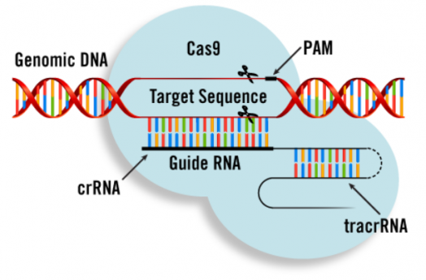
Gene editing

Slide 6
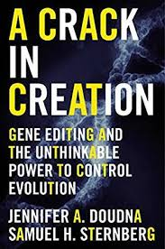
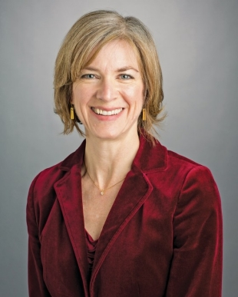
Jennifer Doudna about CRISPR

Slide 7
Biobanks
Identifiability, privacy, stigmatisation, discrimination, poor health systems, poor literacy levels

Slide 8
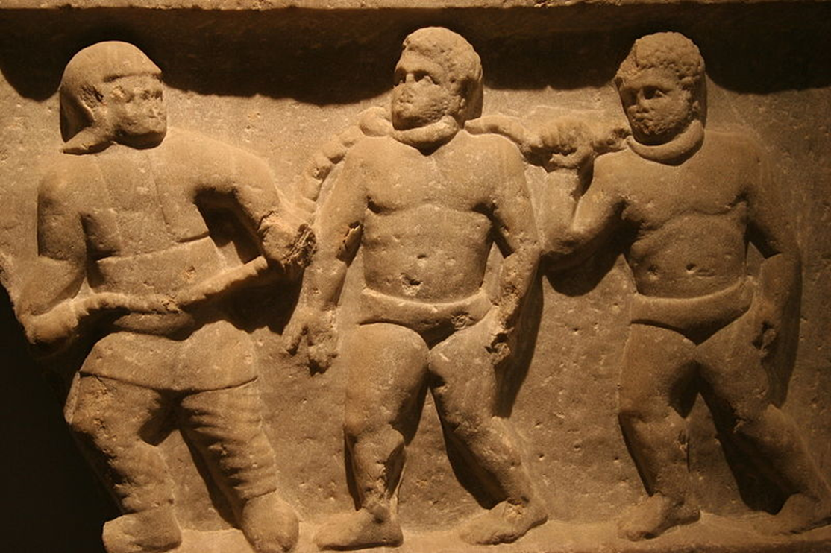
Ethics of inclusion ?

Slide 9

Africa- unknown genetic diversity

Slide 10
Our bioethics …
Not protecting human genome
Not protecting human embryo
Not protecting fetus

Slide 12
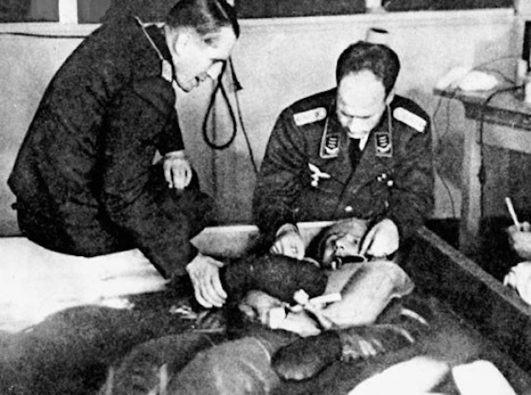
The Nuremberg Code- post factum ethics, developed in response to the horrors of human experimentation done by Nazi physicians (not updated, not regularly reviewed)

Slide 13
Post factum ethics

Slide 14
Compliance with ethical guidelines. This study was conformed to ethical standards of Helsinki Declaration

Slide 15
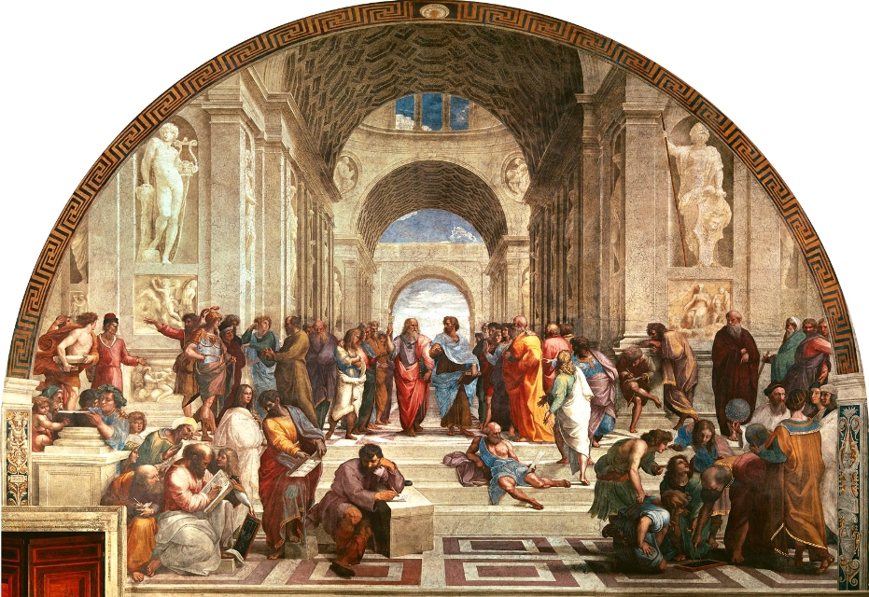

Slide 16
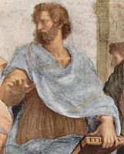
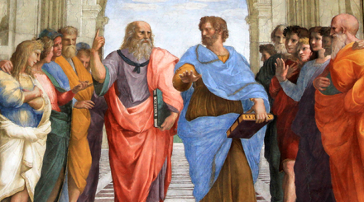

Slide 17

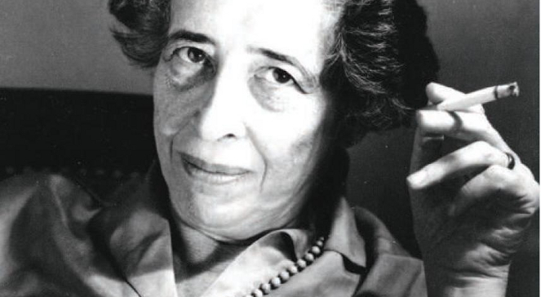
The various preconditions for totalitarian movements

