Slide 1
The Politics of Assisted Suicide in the Medical Community
Matercare International Conference
20th Sept 2019
Dr Gordon Macdonald
Chief Executive, Care Not Killing

Slide 2
Background
20 years working as a lobbyist at the Scottish Parliament - Appointed as Chief Executive of CNK in April 2019
Care Not Killing - established in 2006 as a coalition of 40 organisations, but now an independent organisation
End of Life Care Europe (ELCE) - established in 2013 in partnership with the Euthanasia Prevention Coalition

Slide 3
Dangers of Euthanasia and Assisted Suicide
Pressure on vulnerable people
Elder abuse
Increasing numbers
Euthanasia without explicit consent
Slippery slope – extension to include other conditions
Changes to the medical culture and the doctor/patient relationship

Slide 4
Westminster
3 Bills by Lord Joffe 2003-6: Last Bill defeated 148 votes to 100
Coroners and Justice Bill in 2009 – amendment defeated by 194 votes to 141
Lord Falconer’s Assisted Dying Bill ran out of time in 2014
Rob Marris - Bill in 2015 defeated by 330 votes to 118
July 2019 – a parlaimentary debate and an attempt to launch an inquiry into assisted suicide, but blocked by the Prime Minister’s office

Slide 5
Elsewhere
Scottish Parliament: first proposal in 2006
MacDonald Bill in 2010 - defeated by 85 votes to 16
Harvie Bill in 2014 - defeated by 82 votes to 36
Guernsey Requette in 2018 - defeated 24 votes to 14
Falkland Islands Bill in 2018 - passed by 4 votes to 3.
Extension of the law in Canada to include those not terminally ill

Slide 6
Current Threats
The withdrawal of CANH following the ‘Y’ judgement
The Government of Jersey’s inquiry into assisted suicide
A new Bill in the Scottish Parliament is planned for 2020/2021
A probable Private Members Bill at Westminster in either 2019 or 2020.
Australia, New Zealand, Italy, Ireland

Slide 8
RCP Survey
36,000 members, 6,685 members responded
Required a 60% supermajority to retain the status quo of opposition to legalising assisted suicide
Potential court case under charity law and a forthcoming investigation of the RCP’s process by the Charity Commission.
84.3% of palliative care doctors opposed legalising assisted suicide, 80.9% opposed a change in the RCP’s position.

Slide 9
RCP Survey
What should the College’s position be on ‘assisted dying’?
2014 2019
Opposed 44.4% 43.4%
In Favour 24.6% 31.6%
Neutral 31.0% 25%

Slide 10
RCP Survey
Do you support a change in the law to permit ‘assisted suicide/dying’?
2014 2019
Yes 42.5% 40.5%
With doctor assistance (32.3)
Without doctors (10.2)
No 57.5% 49.1%

Slide 11
RCP Survey
Would you personally be prepared to participate actively in ‘assisted dying’?
2006 2014 2019
No 59.4% 58.4% 55.1%
Yes 18.9% 21.4% 24.6%
Don’t know 19.4% 20.1% 20.3%

Slide 12
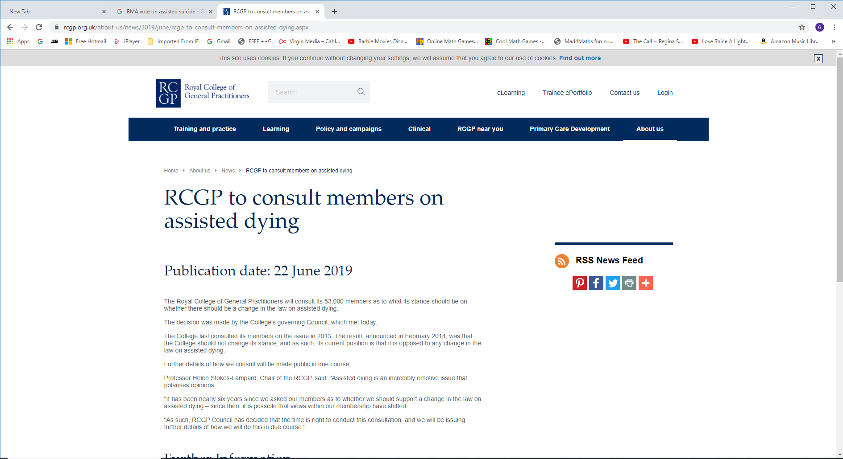

Slide 13
RCGP Survey
53,000 members
2013 survey
77% voted for the RCGP to oppose a change in the law
18% voted to move to a position of neutrality
5% voted to adopt a position of being in favour of a change in the law

Slide 14
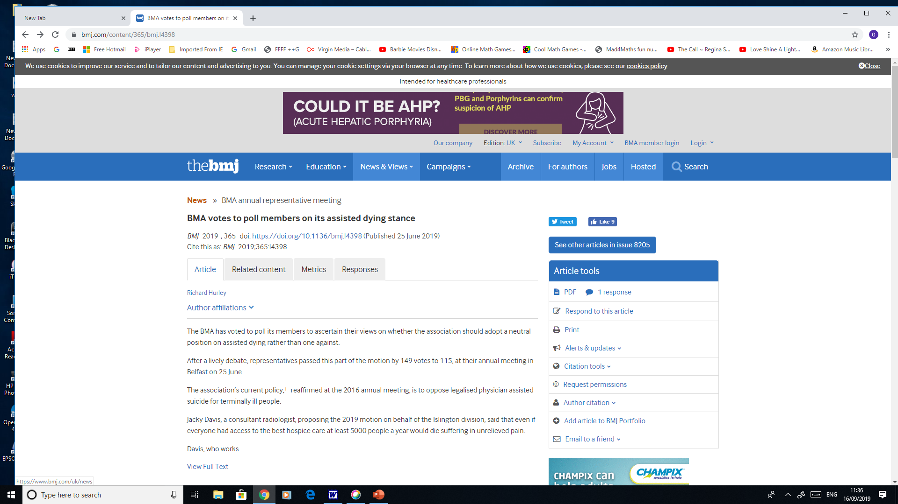

Slide 15
The BMA’s Policy Positions
1950-2005 – BMA opposed to euthanasia
2005 – BMA ARM adopts a neutral position
2006-2019 – BMA opposed to assisted suicide and euthanasia
2019 – BMA ARM votes to ballot its members on moving to a neutral position
2020 - BMA ARM will consider the results of the poll

Slide 16
Key Developments/Dates
RCP Poll (Feb-Mar 2019)
RCGP Council’s Decision to poll members (June 2019)
BMA ARM’s decision to poll members (June 2019)
RCP Court cases (Mar 2019, Oct 2019)
RCGP poll of members (Autumn 2019)
BMA poll of members (Winter/Spring 2020)
Likely Bills in Westminster and Scottish Parliaments in 2020/21.

Slide 17
Conclusions
There have been incremental shifts in the views of doctors on assisted suicide (AS), but levels of opposition remain high.
The largest group of doctors personally oppose AS and want medical bodies to oppose its legalisation. Neutrality is the least favoured option.
Most of the increase in support for AS among doctors has come from people who were previously neutral/undecided.
Surveys of the membership of medical bodies often coincide with attempts to legislate in Parliament. Neutrality on the part of medical bodies will influence public debate and be used to pressurise politicians to change the law

Slide 18
Definitions – the battle for the language

Slide 19
Redefine the euphemisms
‘Assisted dying’ - treating the symptoms that distress the patient
Autonomy - helping someone to make legitimate choices
Compassion - being there for the patient and easing their distress
Dying with Dignity – dying a natural death in the presence of loved ones with distressing symptoms adequately treated

Slide 20
Definitions
Euthanasia is where someone intentionally kills a person whose life is felt not to be worth living
Euthanasia can be voluntary, non-voluntary or involuntary
Assisted suicide is where someone (eg. a doctor) helps someone else to end their own life

Slide 21
Euthanasia does not include...
Stopping or not starting a medically useless treatment
Pain relief when the intention is to kill the pain but not the patient (double effect)
Refusal of medical treatment by a competent patient

Slide 22
Deconstructing arguments for legalising euthanasia and assisted suicide
Personal choice
Unbearable pain
Quality of Life
Wasting Resources

Slide 23
Arguments for PAS and euthanasia
Autonomy – It’s my choice’
Compassion – ‘My suffering is unbearable’
Economics – ‘Care costs too much’

Slide 24
Compassion - death with dignity?
Are the symptoms untreatable?
Have all referral avenues been sought?
Are the symptoms medical?
Is it more about the patient than the illness?

Slide 25
Autonomy - a right to die?
Rights for patients imply reciprocal duties for doctors
Many ‘free’ requests for euthanasia are not freely made
Rights granted to some undermine rights granted to others
Limits to freedom in a democratic society

Slide 26
Economics - we can’t afford it
‘As soon as he goes beyond 60-65 years of age man lives beyond his capacity to produce, and he costs society a lot of money... euthanasia will be one of the essential instruments of our future societies.'
(Jacques Attali, L'Avenir de la vie)

Slide 27
The key arguments against euthanasia
A change in the law would place vulnerable people under pressure to request early death – therefore it should not be changed for a few persistent cases
Requests for euthanasia are extremely rare when patients needs fully met – therefore we need good palliative care
The current law is clear and right and works – it tempers justice with mercy

Slide 29
1. Vulnerable people will feel pressure
Any change in the law to allow assisted suicide or euthanasia would place pressure on vulnerable people to end their lives for fear of being a financial, emotional or care burden upon others. This would especially affect people who are disabled, elderly, sick or depressed.
Carers, relatives and health professionals would also feel pressure to participate

Slide 30
Select Committee Conclusion – 1994
'We concluded that it was virtually impossible to ensure that all acts of euthanasia were truly voluntary and that any liberalisation of the law in the United Kingdom could not be abused. We were also concerned that vulnerable people - the elderly, lonely, sick or distressed - would feel pressure, whether real or imagined, to request early death.’
(Lord Walton of Detchant, February 1994)

Slide 31
Economic pressure/elder abuse
70% of elder abuse occurs in families and 12% is financial
30 to 50 per cent of total lifetime health care expenditures occur in the last six months of life
£5,000 for chemotherapy; £1,000 per week for palliative care; £5 for a glass of barbiturate
Do we want assisted suicide/euthanasia to be a ‘healthcare option’?

Slide 32
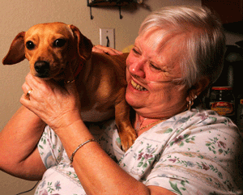
Barbara Wagner in Oregon

Slide 34
2. The slippery slope is inevitable
Autonomy and compassion arguments can be applied widely
Logical ‘mission creep’ using equality law
- Terminally ill to chronically ill
- Adults to children
- Mentally competent to mentally incompetent
Proposed safeguards don’t work and aren’t safe

Slide 35
Slippery Slope or Incremental Extension
We see all of the following:
An increase in the number of cases
Spread to new categories of people
A change in the public conscience

Slide 36
Oregon
Assisted suicide legalised in 1997 for mentally competent adults with < 6 months to live
The law has been amended to allow doctors to waive the 15 day waiting period which was in place to protect depressed people who might change their mind
In 2018, 54% of people who opted for assisted suicide in Oregon cited the fear of being a burden on family, friends and caregivers as their reason for doing so
<

Slide 37
Oregon
In 2017, the suicide rate among the general population was 45% higher than the US national average.
5% psychiatric evaluations; 1 in 6 depressed
Self-reporting with no surveillance
The number of assisted suicides per annum has increased from just 16 in 1998 to 168 in 2018

Slide 38
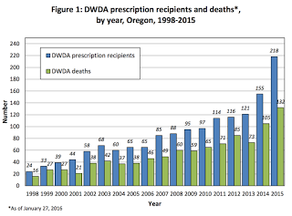

Slide 39
Belgium
The number of cases has increased from 24 in 2002 to 2,357 in 2018
Officially only doctors can conduct euthanasia, but nurses do so illegally and 50% of these have killed without consent
One third of cases are involuntary
50% of cases are unreported
Euthanasia patients have been used as organ donors
Has passed a law allowing euthanasia for minors
Distressing personal cases – Ann G, Nancy Verhelst, Verbessum twins

Slide 40
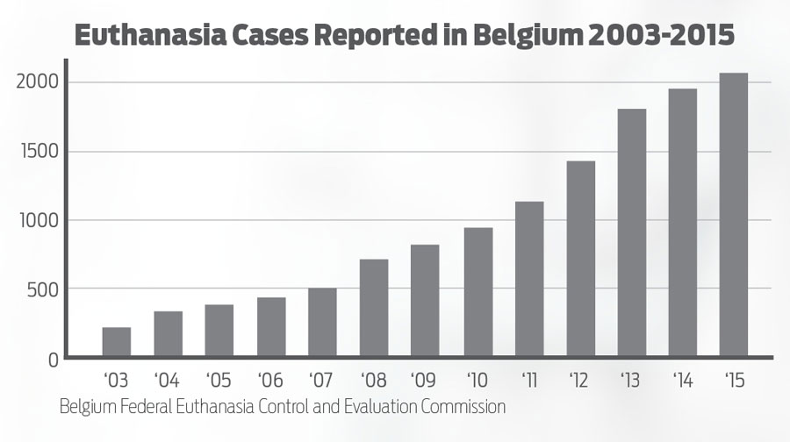
Numbers – Belgium

Slide 42
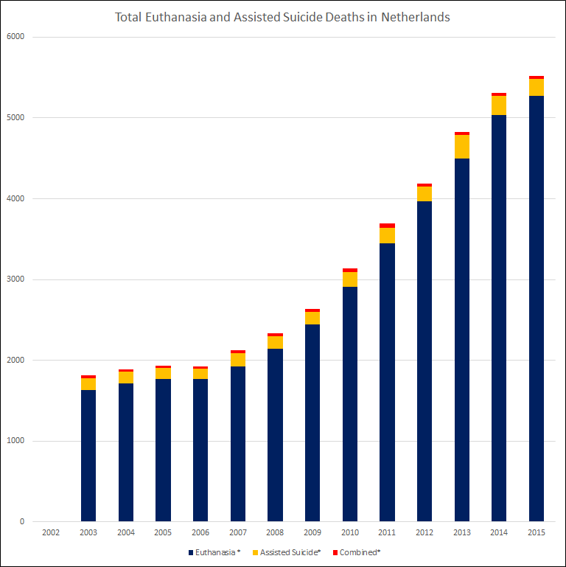

Slide 43
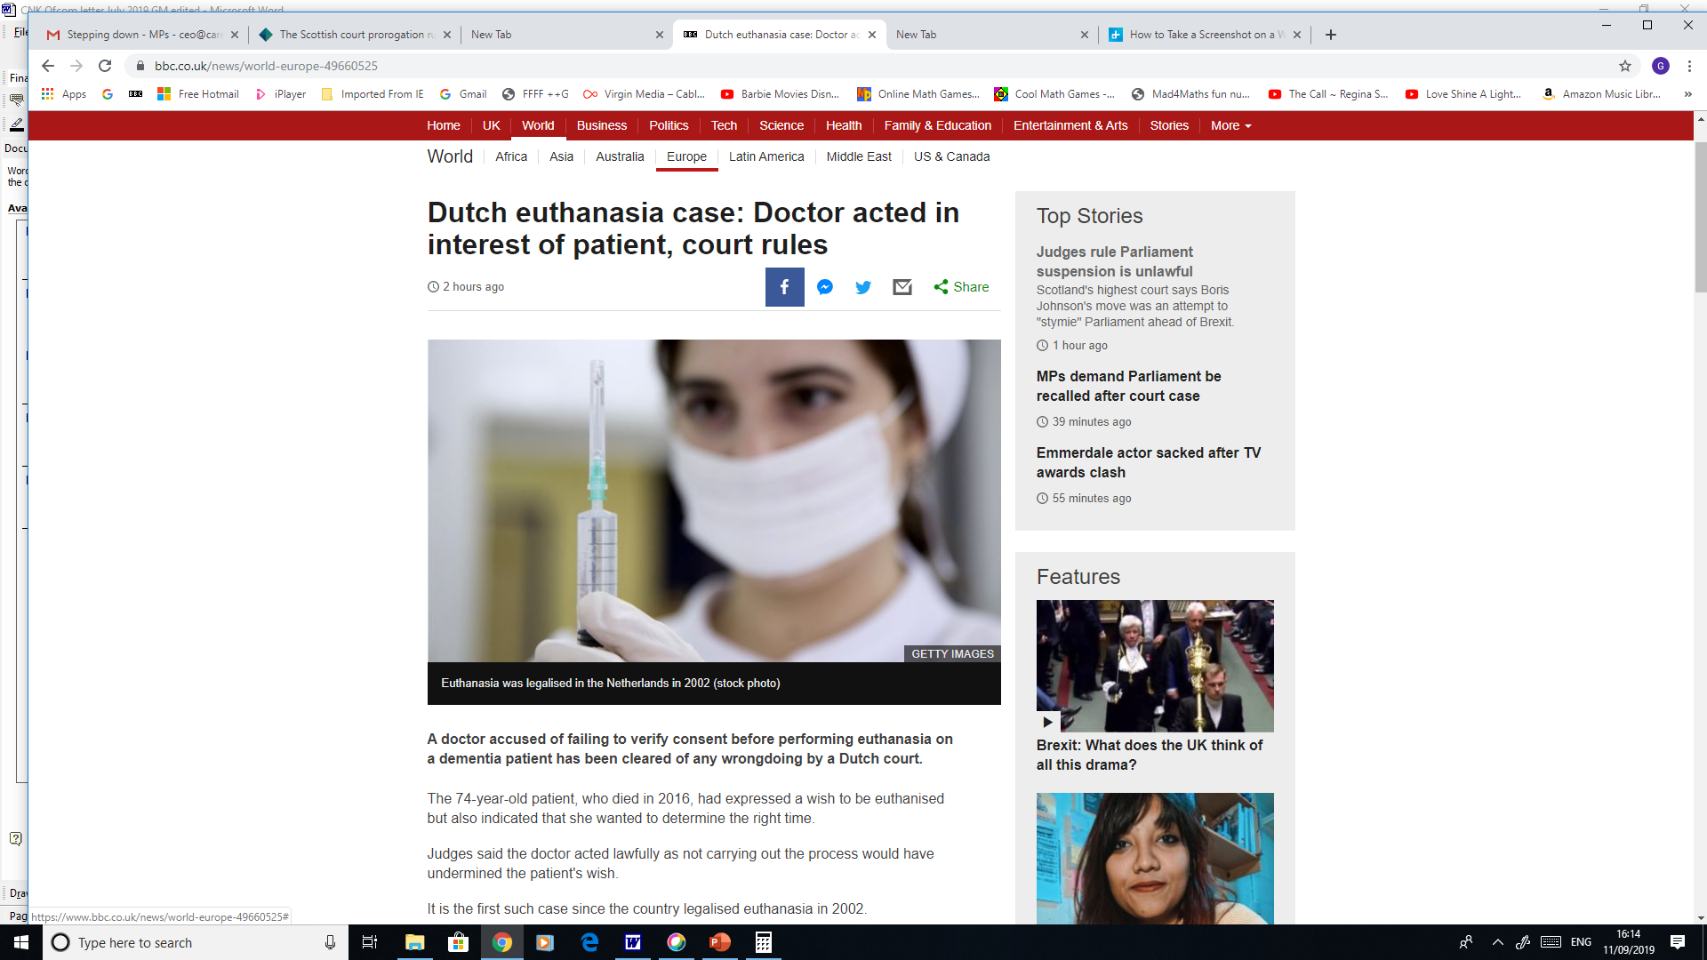

Slide 44
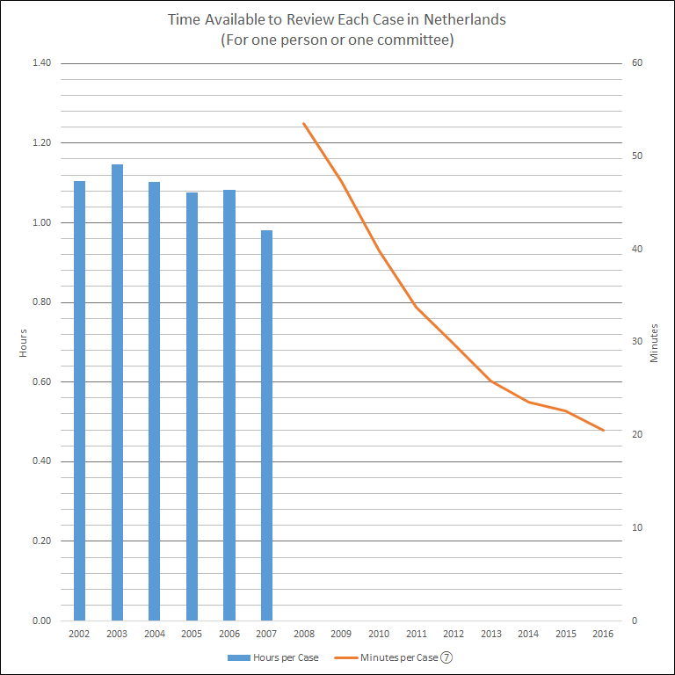

Slide 45
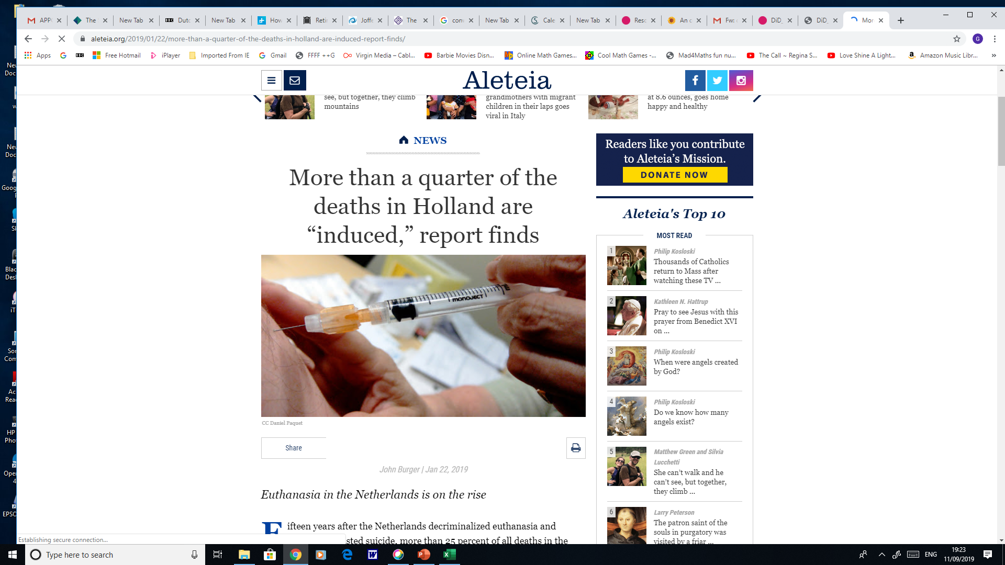

Slide 46
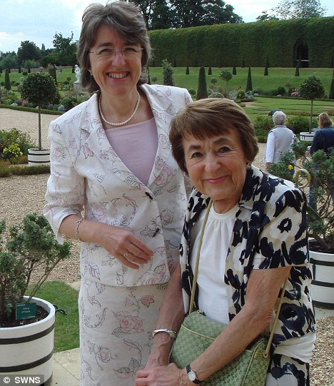
3. Good Palliative Care is better
Mum wanted to die, but convincing her to live gave us both a gift beyond measure...
(Baroness Ilora Finlay; Daily Mail 19 March 2010)

Slide 47
Symptoms can be relieved
Pain, nausea and other distressing symptoms can be treated
Less than ten in 20,000 dying patients have ongoing requests for ‘assisted dying’
It’s about the person not the disease
You can kill the pain without killing the patient

Slide 48
The real reasons are not medical
In Oregon the most common reasons for wanting assisted suicide are:
decreasing enjoyment of life (90.1%)
loss of autonomy (88.7%)
loss of dignity (74.6%)
We should not be providing lethal injections for what are in reality spiritual problems!

Slide 49
4. The law against assisted suicide works well
Strong deterrent
Discretion in sentencing
Discretion in prosecuting
‘Stern face and kind heart’

Slide 50
There is actually very little demand
The number of British people travelling abroad to commit assisted suicide or euthanasia is very small (about 20-25 per year) compared to numbers in countries that have legalised assisted suicide or euthanasia. With an ‘Oregon’ law we would have 1,200 deaths a year and with a ‘Dutch’ law 13,000.

Slide 51
There are limits to freedom
In a free and democratic society there are limits to personal freedom. That is why we have laws!
We are not entitled to freedoms which endanger the reasonable freedoms of others

