Slide 1
Made to Live Child Euthanasia: The Expansion of Euthanasia Once Legalized September 20, 2019
A

Slide 2
Made to Live

Slide 3
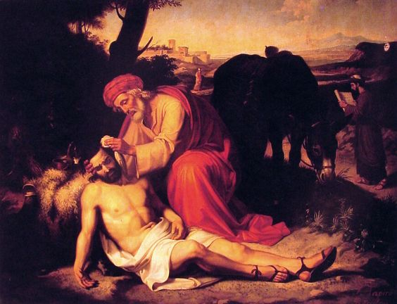
The Good Samaritan
Medium:
Oil on Canvas
The Good Samaritan
Medium:
Oil on Canvas
Josep Tapiró i Baró (17 February 1836, Reus - 4 October 1913, Tangier) was a Catalan painter; best known for his watercolor portraits from Morocco. The Good Samaritan –Oil on canvas

Slide 4
WHY ARE EUTHANASIA & ASSISTED SUICIDE NOT MEDICAL TREATMENTS
Jesus’ teaching in the parable of the Good Samaritan about our obligations to others
Medicine has a mandate to heal but not to hasten death by lethal injection (euthanasia) or prescribing a lethal substance to be ingested (assisted suicide).
Hippocrates: “I will neither give a deadly drug to anybody if asked for it, nor will I make a suggestion to this effect.”

Slide 5
WHY EUTHANASIA & ASSISTED SUICIDE ARE NOT MEDICAL TREATMENTS
Doctor the healer becomes doctor the executioner.
The continuum of palliative care does not include euthanasia & assisted suicide and euthanasia & assisted suicide are not part of palliative care.

Slide 6
Made to live A Physician’s Case Against Assisted Suicide & Euthanasia
I am involved in a legal battle against both the
Quebec and Canadian governments which have passed laws legalizing euthanasia and assisted suicide.
I will care. I will cure sometimes, alleviate suffering always. But I will not kill.
This is my commitment as a physician in caring for my patients.

Slide 7
Made to live A Physician’s Case Against Assisted Suicide & Euthanasia
I am not obligated to euthanize but obligated to refer.
Referral is like writing a prescription and knowing that a person will be killed.
The Nuremberg principles which followed World War 2 showed that referral is equivalent to participating in euthanasia and makes one as guilty as one who commits euthanasia.
Some people falsely believe that since they will not sign up for assisted suicide or euthanasia it will not affect them or their families.

Slide 8
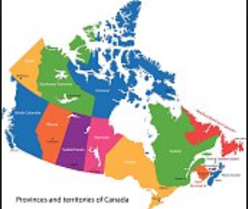
QUEBEC'S AND CANADA’S EUTHANASIA LAWS & CANADIAN LAWS: ARE CHILDREN NEXT?
Euthanasia in Quebec's was passed on June 5 2014 is modeled after the 2002 Belgian law.
Euthanasia and Assisted Suicide was passed by the Canadian Parliament and received Royal Assent on June 17, 2016.
.

Slide 9
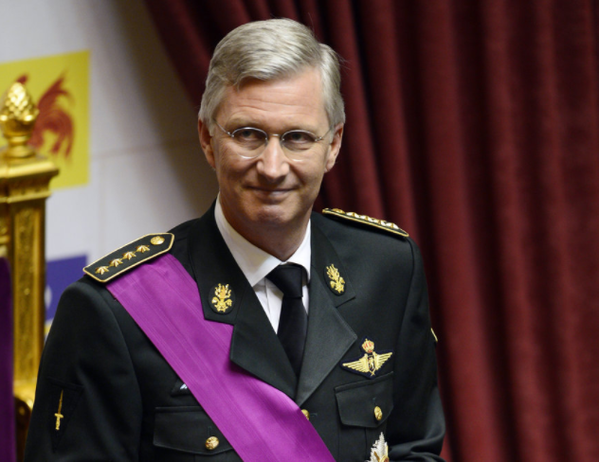
QUEBEC'S AND CANADA’S EUTHANASIA & ASSISTED SUICIDE LAWS: ARE CHILDREN NEXT?
In February 13, 2014, the Belgian legislature extended the law to children without age limit.
Prior to the Belgian law being enacted, our family sent the video letter to the King of Belgium “From a child to a King.”

Slide 10
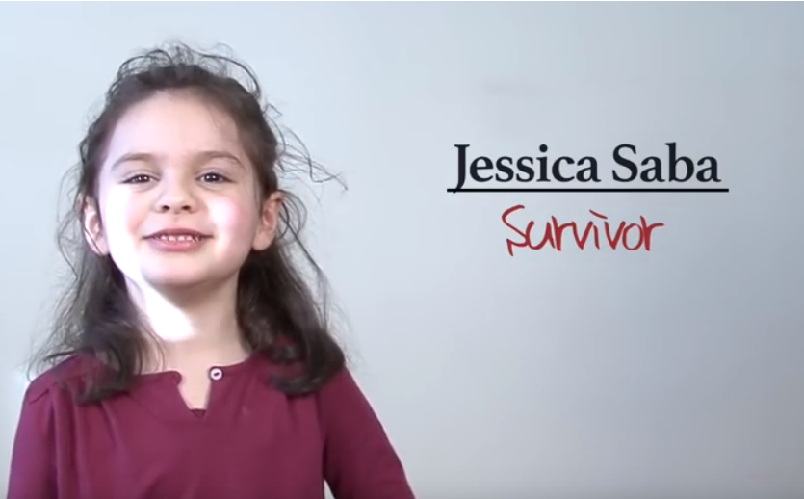
Plea from a child to a King : Stop Child Euthanasia by @CoalitionMD
http://coalitionmd.org/en/plea-from-a-child-to-the-king-of-belgium-stop-child-euthanasia-video-by-coalitionmd/
https://www.youtube.com/watch?v=ESQljzA3GB8

Slide 11
EXTENSION OF EUTHANASIA & ASSISTED SUICIDE TO CHILDREN: QUEBEC & CANADA
After passing Bill C-14, the Canadian Parliament mandated submitting a report extending euthanasia and assisted suicide to children and other groups including mental disorders.
On December 12, 2018 Canadian Council of Academies submitted their report which did not make specific recommendations but suggests a bias towards including childhood euthanasia : “….is to ensure that they are listened to. Thus, it has been argued that, rather than denying healthcare choices to groups frequently labelled as vulnerable, society must provide the accommodations to ensure that everyone is protected not only from exploitation, but also from being ignored and excluded.”

Slide 12
Made To Live

Slide 13
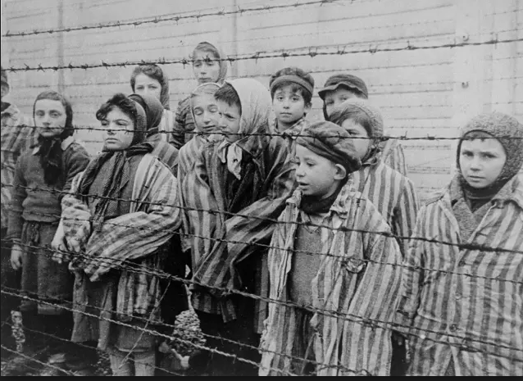
Life less worthy than life
I am absolutely convinced that the gas chambers of Auschwitz, Treblinka, and Maidanek were ultimately prepared not in some Ministry or other in Berlin, but rather at the desks and lecture halls of nihilistic scientists and philosophers.” ― Viktor E. Frankl

Slide 14
Life less worthy than life
Two German professors, Binding a jurist and Hoche a psychiatrist, medicalized euthanasia in their book “The Permission to Destroy Life Unworthy of Life” which was published in 1920.
Those considered “unworthy of life” included “not only the incurably ill but large segments of the mentally ill, the feebleminded, and retarded and deformed children….And they stressed the therapeutic goal of that concept: destroying life unworthy of life is “purely a healing treatment” and a “healing work.”

Slide 15
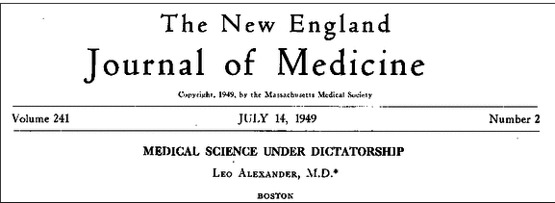
Life less worthy than life
Euthanasia and assisted suicide is a decline in medical ethics. It dehumanizes and devalues life.
It attributes worth on the basis of usefulness of the human person.
Leo Alexander, was a consultant to the Secretary of War during the Nuremberg Trials.
In his classic New England Journal of Medicine article of 1949, he stated that there was a gradual change “in the basic attitude of the physicians.
It started with the acceptance of the attitude, basic in the euthanasia movement, that there is such a thing as life worthy to be lived.

Slide 16
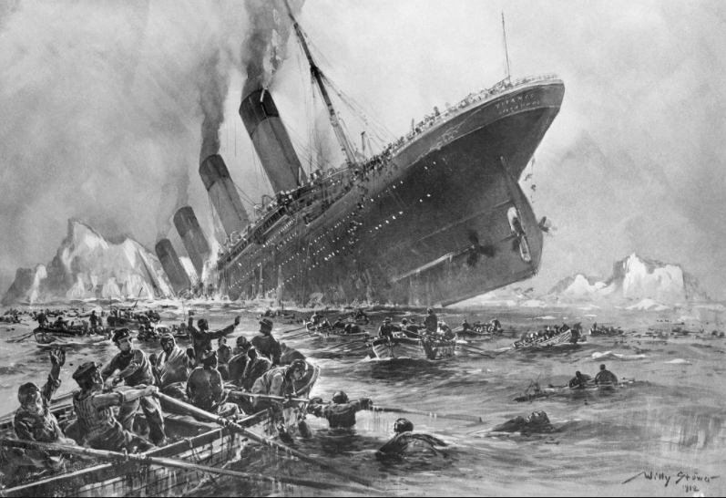
Limited lifeboats
Euthanasia or assisted suicide has been promoted by some bioethicists with a “utilitarian” model of human life.
In other words, if you are productive and useful to society, then you should live. Otherwise you are better-off dead.
Tom Koch, a Canadian bioethicist, describes this utilitarian view of many modern bioethicists:
According to this neo-liberal concept, society has limited resources like the limited number of lifeboats on the sinking Titanic.
Only the strongest who can fight and make it into lifeboats will survive. Thieves of Virtue-When Bioethics Stole Medicine.

Slide 17
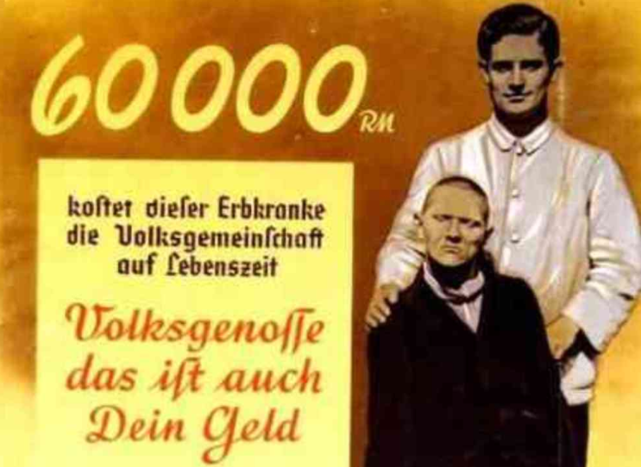
Selling Death
Euphemisms and marketing: “Dying with dignity” “Compassionate Choices” “Medical Aid in Dying”
Medicalizing euthanasia: Physicians required to do the killing-If a doctor kills then it is medical
Polls: Surveys with skewed questions—if a person is 99 years old and terminal with horrible suffering with only a few days left to live

Slide 18
Selling Death
Co-opting the victim: “voluntary act”
Legalizing euthanasia: If it is legal it must be OK
Media glamourizing assisted suicide and euthanasia described as a “Beautiful death.”
Lobbying by pro-assisted suicide groups on legislatures to enact laws
Apathy by public: “It does not concern me.”
Apathy by church: “We are not political.”

Slide 19
Selling Death
Falsifying the numbers: “only a tiny handful”
Extreme language: "horrible agonizing death”
False claims: “if a person is not allowed assisted suicide or euthanasia, they may throw themselves off a bridge”
False certainty of death: “Physicians know who will die in next 6 months”

Slide 20
Selling Death
False certainty of diagnosis: “It is certain that this person has a serious and incurable disease”
Attacking the opponents: “If you are against euthanasia and assisted suicide, then you are for suffering”
Falsely identifying assisted suicide/euthanasia as “progressive”

Slide 21
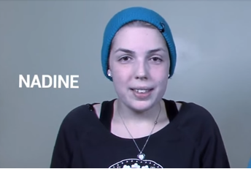
CHILD EUTHANASIA IN CANADA
Some proponents for doctor assisted suicide and euthanasia in Canada are recommending extending euthanasia to some of its most vulnerable citizens including children who are “mature minors” and the depressed.

Slide 22
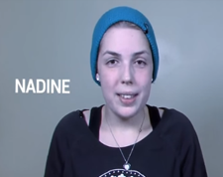
CHILD EUTHANASIA IN CANADA
. Provincial-Territorial Expert Advisory GrChildren possibly as young as 11 or 12 could see their lives ended prematurely without parental consent or prior notificationoup on Physician-Assisted Dying (mandated by Ontario Minister of Health and Long-Term Care and Attorney General).
The case of Nadine illustrates the serious consequences of enacting such a provision.

Slide 23
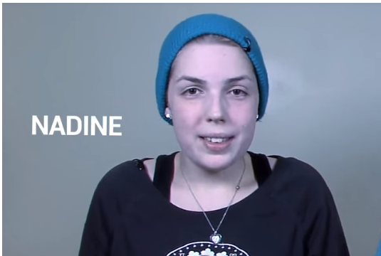
NADINE’S STORY
Nadine was diagnosed at 14 with an aggressive form of leukemia. She underwent multiple chemotherapies and a failed bone marrow transplant. She was told that she had little chance to survive. She states that without the loving support of her family, she would have given up. Today at 20, she is well and happy to be alive.
https://www.youtube.com/watch?v=5-_3wHtTJQg&t=22s

Slide 24
ERRORS IN PREDICTING— THROWING AWAY LIVES NEEDLESSLY
People including children will be encouraged to throw away their lives needlessly. This is because prognosis or predicting life expectancy is an inexact science as proven in the case of Nadine.

Slide 25
ILLOGIC OF CHILD EUTHANASIA
“Mature children’ do not have the psychological or cognitive ability to reason like adults—that is why they cannot drive, vote, enter into civil contracts or get married.

Slide 26
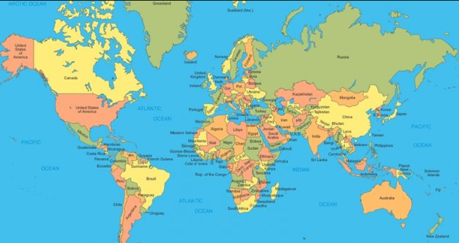
EUTHANASIA OF CHILDREN VIOLATES UNITED NATIONS CONVENTIONS
Euthanasia of children violates the United Nations Convention of the Rights of the Child that guarantees children rights including "right to life", "the survival and development of the child", "adequate medical services", and "protection against all forms of neglect and cruelty".

Slide 27
EUTHANASIA OF CHILDREN VIOLATES UNITED NATIONS CONVENTIONS
Children have the right to the best quality of life and adequate health care that includes high quality palliative care.

Slide 28
EUTHANASIA OF CHILDREN VIOLATES UNITED NATIONS CONVENTIONS
On February 12, 2014 the International World Congress on Pediatric Palliative Care declared that not only "Euthanasia is not part of children's palliative care and is not an alternative to palliative care….the answer to a child's suffering is more and better palliative care services and not the ending of a child's life.“

Slide 29
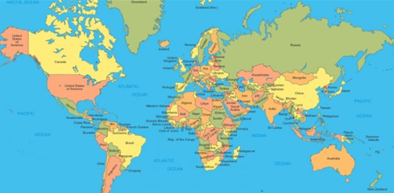
EUTHANASIA & ASSISTED SUICIDE CONTRAVENES INTERNATIONAL CONVENTIONS, HEALTH NORMS & PRACTICES
Euthanasia is denounced by the World Medical Association representing 9 million doctors in 114 countries

Slide 30
WORLD MEDICAL ASSOCIATION
“Euthanasia, that is to say the fact to end the life of a patient by a deliberate act, even at his own request or that of is relatives, is unethical.” WMA, 2013.

Slide 31
WORLD MEDICAL ASSOCIATION
This does not prevent the physician from respecting the will of the patient to allow the natural process of death to follow its course in the terminal phase of the disease and encourages "doctors to refuse to participate in an act of euthanasia, even if the national law authorizes it or decriminalizes it in certain situations.” WMA, 2013

Slide 32
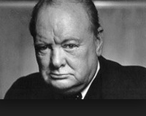
INABILITY TO HAVE WORKABLE SAFEGUARDS
“Those who fail to learn from history are doomed to repeat it.” Sir Winston Churchill
Safeguards for terminating a person’s life are never safe.
This is an illusion to convince individuals and society to accept euthanasia and assisted suicide.

Slide 33
INABILITY TO HAVE WORKABLE SAFEGUARDS
There exists a real danger of expansion.
Canadian euthanasia law could expand to end lives of children of children born with disabilities. In the Netherlands, the Groningen protocol was adopted in 2005, and this protocol allows euthanasia for newborns and young children who are "without hope of a good quality of life." BMJ, 2006.

Slide 34
EXPANSION IN BELGIUM
It was recently reported that a 9 and 11 year old were euthanized in Belgium. The “11-year-old euthanized last year had cystic fibrosis. This congenital respiratory disease is incurable and fatal, but modern treatments enable many patients to enjoy high quality of life well into their 30s or even beyond. Median life expectancy for new CF cases in the United States is now 43 years, according to the Cystic Fibrosis Foundation.” Children are being euthanized in Belgium, Opinion, Charles Lane, The Washington Post August 6 2018.

Slide 35
EXPANSION IN BELGIUM
100 Belgian patients who had a psychiatric diagnosis and requested euthanasia between October 2007 and December 2011. The patients included the depressed, those with personality disorders and autism. None had life threatening or life ending illness. 35 euthanasia deaths were carried out. BMJ 2015
A 24 year old depressed woman in Belgium was granted the right to be euthanized in 2015:
http://europe.newsweek.com/healthy-24-year-old-granted-right-die-belgium-329504

Slide 36
EXPANSION IN THE NETHERLANDS
Criteria for euthanasia has been extended from adults who were terminally ill to the depressed, those tired of life and children
42 people in the Netherlands were euthanized for a psychiatric disorder without any life ending physical illness. The majority of these people were depressed. Treatment-resistant major depressive disorder and assisted dying BMJ 2015

Slide 37
EXPANSION IN CANADA
When first announced the legislation was supposed to be for “only a handful of people.”
Between 2016-2019 approximately 7000 deaths.
Recent Quebec Superior Court decision removing the criterion of dying.
If enacted by the legislator this would allow euthanasia for physical or psychological suffering for anyone with a handicap, condition or illness.
Discussions underway to open euthanasia for those with mental illness, memory loss and children.

Slide 38
PALLIATIVE CARE AS A SOLUTION FOR END OF LIFE CARE
Quality medical care includes providing palliative care -- which is different from euthanasia. Doctors can reduce the suffering of end-of- life patients’ with palliative care.
Problem is 70% of Canadians do not have access to quality palliative care.

Slide 39
PALLIATIVE CARE AS A SOLUTION FOR END OF LIFE CARE
The World Health Organization defines palliative care as: “An approach that improves the quality of life of patients and their families facing the problems associated with life-threatening illness, through the prevention and relief of suffering by means of early identification and impeccable assessment and treatment of pain and other problems, physical, psychosocial, and spiritual” http://www.who.int/cancer/palliative/definition/en/

Slide 40
PALLIATIVE CARE AS A SOLUTION FOR END OF LIFE CARE
People who receive quality palliative care report less suffering, better quality life and improved survival. The goal is to prevent and relieve suffering and provide optimal quality of life for both patients and families confronting serious illnesses. Studies demonstrate that people who receive palliative care early on, live happier and longer lives.

Slide 41
PALLIATIVE CARE AS A SOLUTION FOR END OF LIFE CARE
The classic study in the New England Journal of Medicine compared patients with metastatic non–small cell lung cancer who received early palliative care along with standard cancer care to those who received cancer care without palliative care. Those who received palliative care had better quality of life with less depression, and longer median survival of almost 3 months. Temel JS et al. Early palliative care for patients with metastatic non-small-cell lung cancer. N Engl J Med 2010; 363:733.

Slide 42
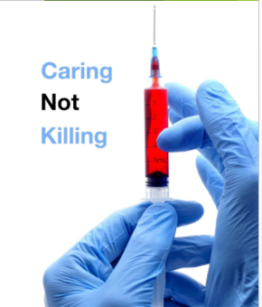
CONCLUSION
The evidence is clear—euthanasia and assisted suicide is not the solution for end of life care.
People need to be cared for and not killed.
Once euthanasia is legalized for people with terminal conditions, it quickly expands to those with years to live including the depressed, those with disabilities and children.

Slide 43
CONCLUSION
People who require medical care could be forced to end their lives prematurely by euthanasia or assisted suicide because of lack of health care, lack of social, psychological or financial supports
People have a right to have their medical condition treated at the end of life and not their lives ended prematurely and intentionally.

Slide 44
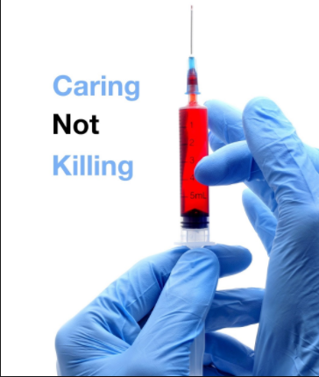
RECOMMENDATIONS
Real medical care including palliative care (excluding euthanasia and assisted suicide) must be adopted as the best practice for end-of-life care.
Euthanasia and assisted suicide must be excluded as a form of end-of-life care.
States and countries practicing euthanasia and assisted suicide must stop these practices and declare them as illegal.

Slide 45
WHAT CAN WE DO?
Speak to friends, family, politicians
Invite speakers to your communities to educate them about the dangers of euthanasia and physician assisted suicide.
Be informed-go to the website:
coalitionmd.org and madetolive.com(under contruction)
Contact me: pauljsaba@gmail.com

Slide 46
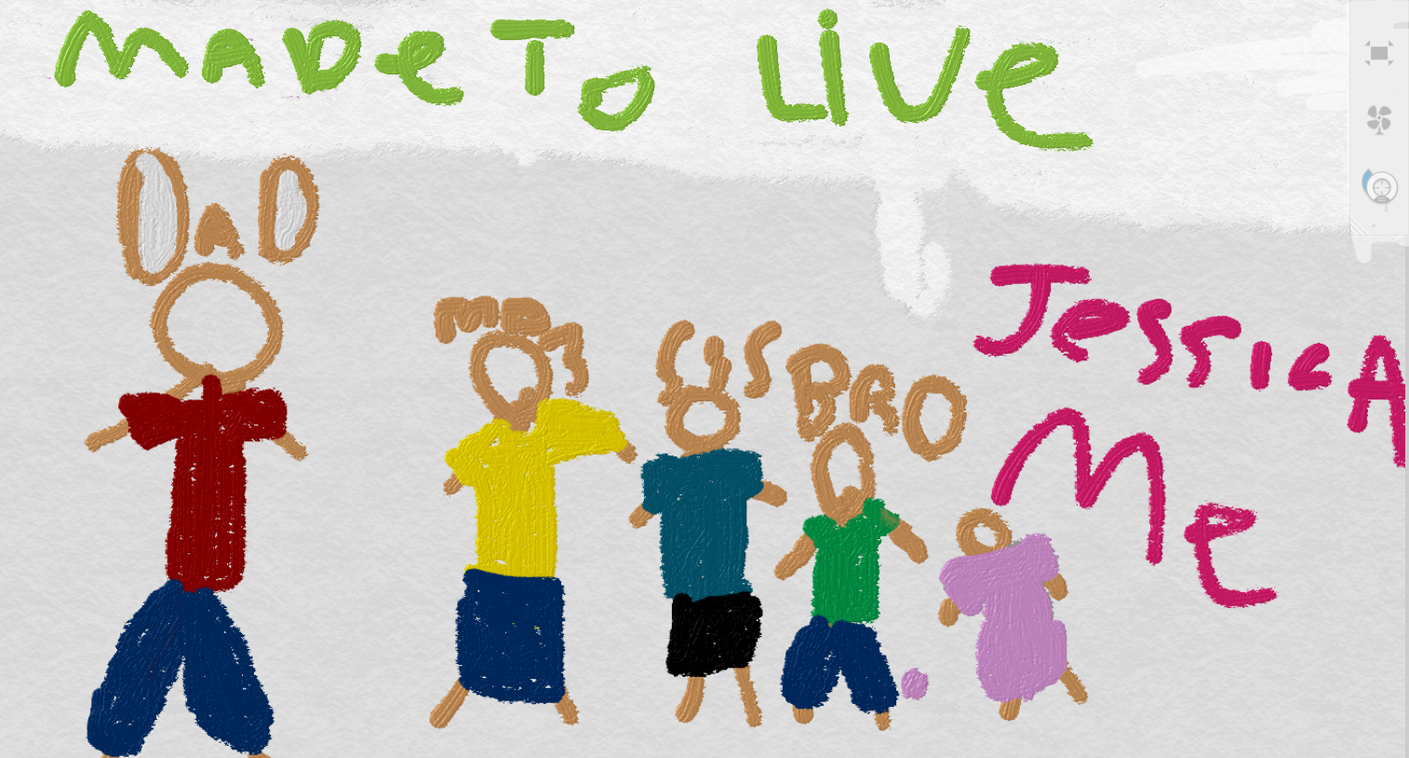
Made To Live

