Slide 1
Natural Cycles Fertility App gets FDA Approval to Prevent Pregnancy
MCI 14th International Conference
Rome, Italy
19th September, 2019
Flinders Medical Centre
Flinders University

Slide 2
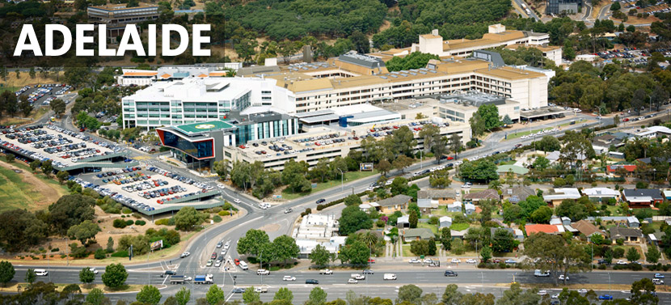

Slide 3
Flinders Medical Centre
Founded 1976
Major public tertiary and teaching hospital, 663 beds
Co-located with Flinders University and Flinders Private Hospital (130 beds)
Multi-faith chapel and separate small chapel with Blessed Sacrament

Slide 4
Conflict of Interest - Nil
Acknowledgements – Susan Williams

Slide 5
Scope of this Presentation – 3 sections Background
What is Natural Cycles?
Underlying philosophy.
How does it work?
Cost and instructions.

Slide 6
Scope of this Presentation – 3 sections Marketing
Development and certification.
FDA approval.
Market uptake.
Reactions.
Company response to unexpected pregnancy.

Slide 7
Scope of this Presentation – 3 sections Future
Will it wither?
Whither can it go?
Aps for proven FABM.
Performance of FABM aps.

Slide 8
BACKGROUND

Slide 9
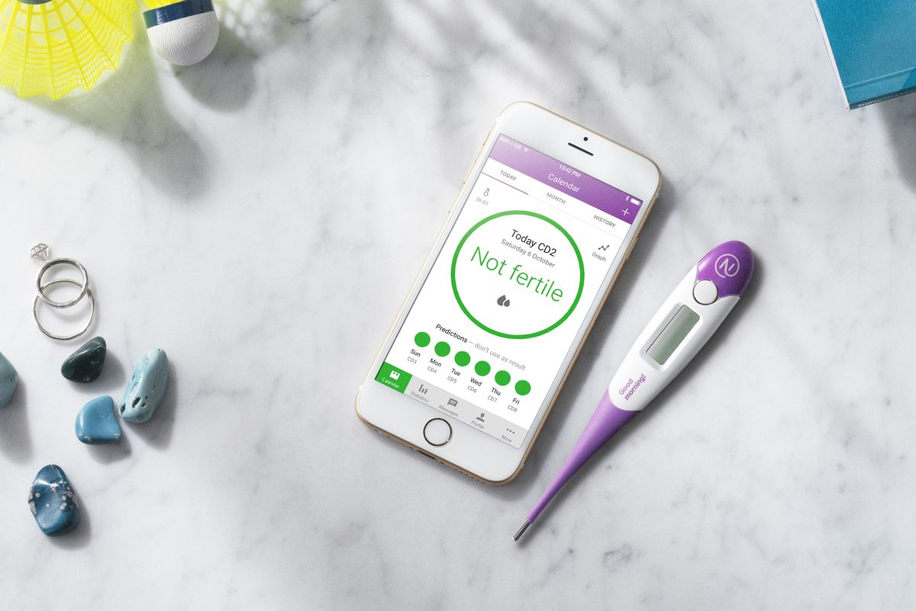
What is it? A Fertility Awareness app designed by two Swedish physicists, Elina Berglund (PhD in particle physics) and her husband Raoul Scherwzil (CEO).

Slide 10
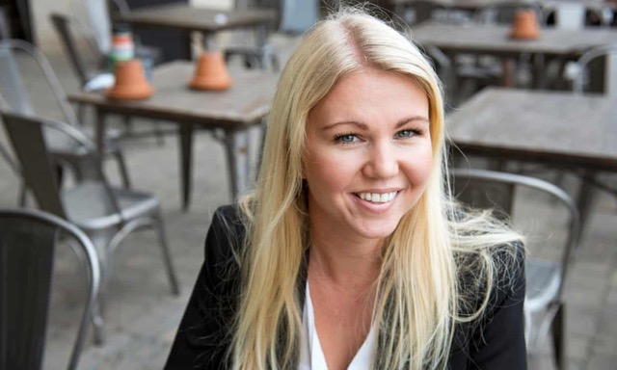

Slide 11
UNDERLYING PHILOSOPHY
“The app fills a gap in the market, spotted by Berglund when she felt fed up with the limited options on offer other than hormonal contraception.” Emma Lundin, The Guardian, 8/11/16.
“I’m still surprised that there hasn’t been such a product before. I have been thinking about this since I was a teenager, because I didn’t feel well from taking the pill.” Berglund, 2016
“Sweden is supposed to be the most gender-equal country, but I think when it comes to contraception … the burden is very much on the woman.” Natural Cycles is “more of a couple’s thing – the woman measures her temperature and the man sometimes has to wear a condom.” Berglund, 2016

Slide 12
UNDERLYING PHILOSOPHY
The ideal app user: “a woman in a stable relationship who is planning
to have children at some point, and who would like a break from
hormonal contraception ahead of trying.” Berglund, 2016
Prof KD Danielsson, Karolinksa Institutet, Stockolm (hired for product
research), 2018:
“Not a good option” for women who “absolutely want to avoid a
pregnancy,” those with irregular menstrual cycles or who “lack the
motivation to stay on top of their cycles.” Latter accounts for 45%
drop-out rate (sign up but fail to keep to their thermometer
schedule).

Slide 13
UNDERLYING PHILOSOPHY
Marketed on iTunes app store page as “digital birth control” or “Hormone-Free Contraceptive App” (Australia)
Approx. half of the app’s subscriber growth comes from Facebook and Instagram marketing (Lundin, 2016)
One of their investors and influencers is Sweden’s biggest lifestyle blogger, Isabella Löwengrip, of Blondinbella (Lieber, 2018)
Eventually wants to “partner with health care professionals”

Slide 14
How does it work?
It is based on the user’s daily basal temperature (lowest temperature of the day, first thing in the morning), and calculates her fertile window using a proprietary algorithm.
The couple can choose to abstain during that window to avoid pregnancy, or to have intercourse to achieve pregnancy.

Slide 15
Cost and Instructions
For US$79.99 a year, users are sent a basal thermometer, or pay US$9.99 a month and use their own. (basal thermometer is more sensitive than others).
Users get feedback once their temperature information is loaded on the app: green indicates the user is not ovulating and “therefore does not need contraception”, while red means the user is ovulating and “should not have unprotected sex”.
The app tells users that it takes between one and three cycles for its recommendations to be consistent.

Slide 16
MARKETING

Slide 17
Development and Certification
mobile app launched in 2014.
Dec 2015: Swedish Medical Products Agency banned the app from calling itself preventivmedel (“contraception”) -> marketed as a “fertility monitoring device,” a “tool that can be used to plan or prevent pregnancies.”
app was clinically tested and approved as a medical device in Europe by Tüv Süd (German inspection and certification agency) February,2017
allowed the UK’s Medicines and Healthcare products Regulatory Agency (MHRA) to recognize the app as a medical product in 2017.

Slide 18
Development and Certification
manufacturer conducted two rounds of clinical trials
2nd trial collected data from over 4,000 women aged 18-45 and
showed a perfect use effectiveness rate of 99.5% and a typical use
effectiveness of 93% (equivalent to the pill: 99.7% and 92.5%, per
CDC).
FDA approval August 2018

Slide 19
UNITED STATES FOOD AND DRUG ADMINISTRATION
FDA APPROVAL
Historic- first time FDA allowed an app to market itself as a
contraceptive.
FDA is establishing criteria and guidelines to pave the way for a
new category of digital contraception apps.
“This new app can provide an effective method of contraception if it’s used carefully and correctly.” Terri Cornelison, FDA.
“Women should know that no form of contraception works perfectly, so an unplanned pregnancy could still result from correct usage of this device.” FDA

Slide 20
FDA APPROVAL (cont.)
Natural Cycles is part of growing “femtech” sector (technology aimed at women’s health) projected to become a US $50 billion market by 2025.
Period trackers are one of the fastest-growing categories, with apps like Clue, Glow, Period Tracker, Kindara, and Eve offering services like period calendars and push notifications for taking medicine.
These apps track menstrual cycles and calculate ovulation windows- none have received approval status of Natural Cycles.

Slide 21
Uptake
By February, 2017, over 150,000 women in 161 countries were using the app, and by August 2018 there were over 900,000 users.
Company’s aim is to have app registered as a medical device in every country (Scherwitzl, CEO, 2018).

Slide 22
Reactions
“This is good news for the FABM industry as a whole, as it gives a more official place to FABMs within the family planning and women’s health sector.” Anna Migeon, 2017, Co-founder of Natural Womanhood

Slide 23
Reactions
Business Insider (online magazine with >70 million readers/mth) had an extensive report in 2017 featuring uninformed views whjch questioned the efficacy and applicability of FABM.
Examples:
(a) The effectiveness of Natural Cycles is “way better than traditional
fertility-based awareness methods, which have an average failure rate
of 24% according to the CDC”.
(b)”Natural Cycles is inarguable one of the best forms of fertility-based
awareness birth control that exists.”
(c)”…for women with variable cycle length…fertility awareness-based
methods are generally a bad option, according to Planned Parenthood.”

Slide 24
REACTIONS – PROF STREICHER
Prof L Streicher, ObGyn, Northwestern University, 2018:“This isn’t science; this is craziness. We’ve already developed good, safe, reliable methods of contraception that are available to us. This app is completely taking women back in time.”
Streicher alleged the company is spreading inaccurate information, telling users “when they can have unprotected sex”, when “women can get pregnant at several points during their cycle.”
“Sperm live longer than most people realize. Hearty sperm can hang out for 72 hours, while an egg can be viable anywhere from 48 to 72 hours. Women also get into trouble when they see blood and think it’s their period, and they can then get pregnant at any time. You can’t promote not using contraception.” Streicher, 2018.

Slide 25
Company response to unexpected pregnancy
January 2018, Swedish hospital reported that 37 women requested abortion after conceiving while using Natural Cycles app
“There is always a statistical chance of unintended pregnancy, since no method is 100 percent effective. The effectiveness of Natural Cycles (93%) is supported by clinical evidence.”
Company’s reasons for 7% annual pregnancy rate range “from having unprotected sex on a red day, to the app wrongly attributing a green day, or failure of the method of contraception chosen on a red day.”

Slide 26
Company response to unexpected pregnancy
Kotz, FDA, 2018: “An increase in the absolute numbers of unintended pregnancies is expected with a growing number of users.”
“Because the user base of the app will most definitely grow, and the effectiveness rate is 93 percent, unwanted pregnancies are inevitable.” Lieber, 2018.

Slide 27
FUTURE

Slide 28
Will it wither or whither can it go?
A product marketed as “The first and only contraceptive app.”
Developed without appropriate medical input
Is a refinement of the rhythm method - doesn’t use the most reliable indicator of fertility ie cervical mucus
Based on and promotes the contraceptive mentality
In long term, predict it will do harm to reputation and uptake ofauthentic FABM, where apps are an electronic aid to professional instruction

Slide 29
Whither can it go?
>No doubt, there will be more “me too’s”
>There are better-researched options of FABM (modern NFP) like Sympto-Thermal, Billings and Creighton Model System:
All evidence-based methods with extensive clinical trials that have also been evaluated by international organizations such as WHO.
Have similar effectiveness rates.

Slide 30
Whither can it go?
Also beneficial in health literacy.
Women learn to track their signs and to interpret the data in order to calculate the fertile window on their own
Relationship benefits for couple eg Creighton’s S.P.I.C.E .
Have worldwide networks of instructors that can assist couples in the interpretation of their charts

Slide 31
Whither can it go? (cont)
There are specific apps that electronically record data for already proven FABM eg NFP Charting Online (Billings compatible), Fertility Pinpoint (Billings approved), FertilityCare™ App (Creighton 2018)
Aust Council of NFP (Sympto-Thermal) doesn’t have approved app but SmartLoving marriage preparation website teaches Sympto-Thermal on-line with SmartFertility and recommends apps

Slide 32
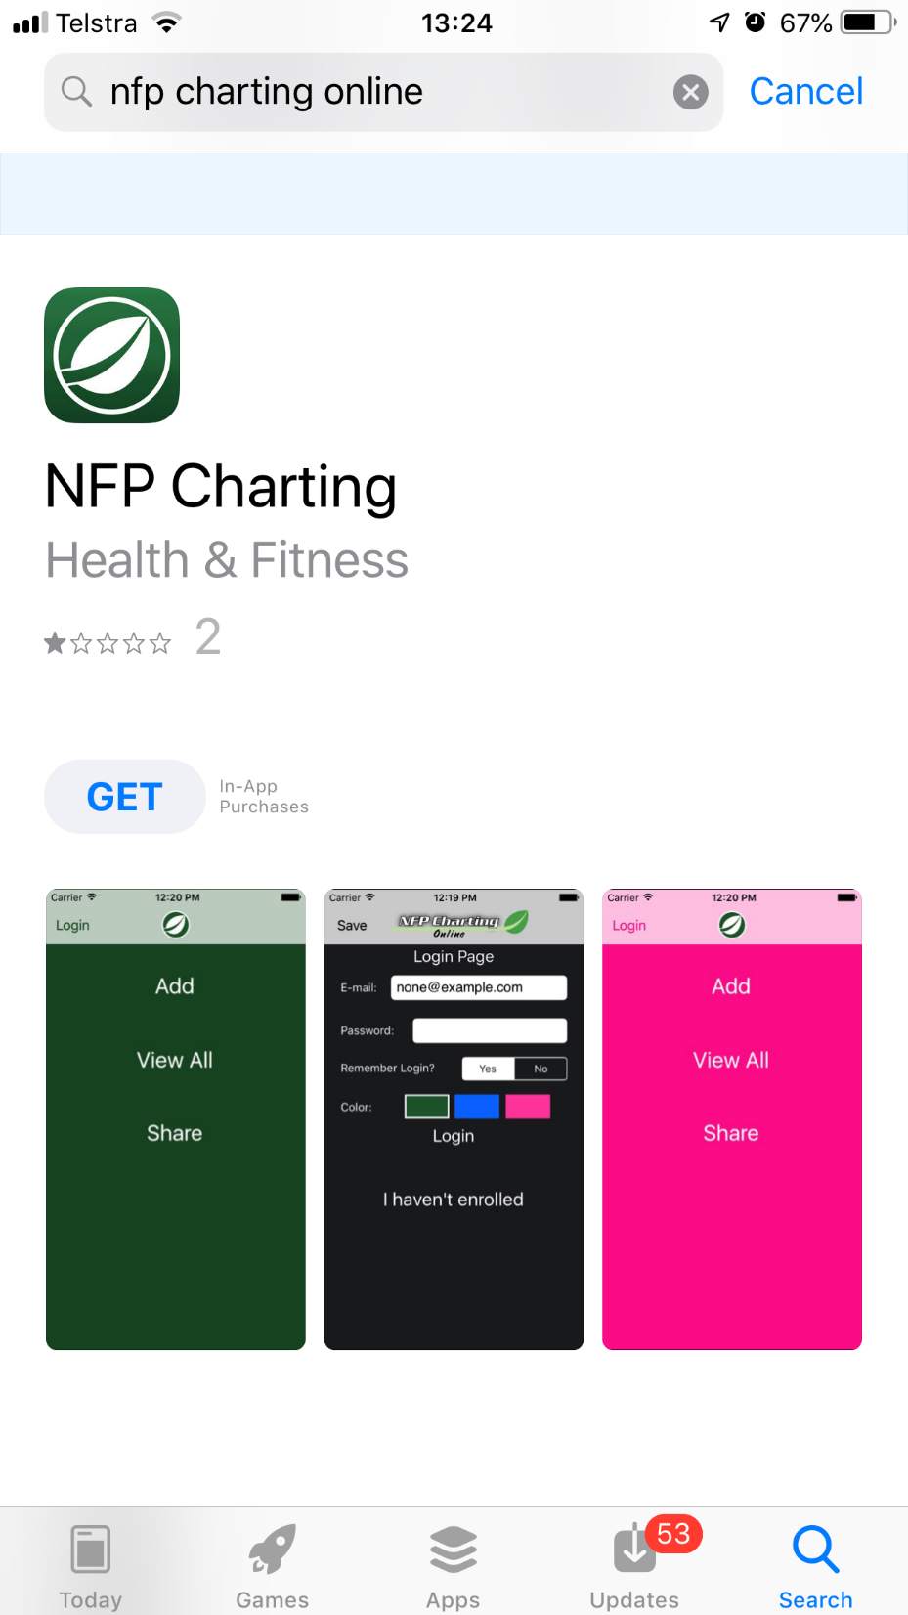
NFP Charting Online
Couple can designate teacher(s)
Chart on phone or computer
Teacher can logon, see chart, get 2nd opinion and send feedback
Couple can email chart for advice
Works well, looks old-fashioned but colours show patterns well
Couple pay US$2/mth, free for teachers

Slide 33
Fertility Pinpoint
Cloud-based
Looks more modern but not as teacher friendly and doesn’t print off as nicel
Billings preferred and approved
Economical with some of payment going to Billings

Slide 34
FertilityCare™ App (Official Creighton Model App)
Cloud-based, secure, auto updates
Available from Saint Paul VI Institute’s Publication Department (not App stores)
Available to any Practitioner of good standing affiliated with an FCCA (FertilityCare Centers of America)
US$4.99/month and a one-time registration fee of $10
Seamlessly weaves observations, charting and instructions, as well as support and guidance

Slide 35
Performance of Fertility Awareness-based Method Apps Marketed to Avoid Pregnancy
Using a 10-criteria rating system to evaluate 95 apps for avoiding pregnancy, Duane et al ranked Natural Cycles 15th out of 30 apps which predicted days of fertility.
Duane M, Contreras A, Jensen ET, White A. The Performance of Fertility Awareness-based Method Apps Marketed to Avoid Pregnancy. The Journal of the American Board of Family Medicine. 2016, 29: 508-511.
DOI:https://doi.org/10.3122/jabfm.2016.04.160022

Slide 36
Performance of Fertility Awareness-based Method Apps Marketed to Avoid Pregnancy
Only six apps had either a perfect score on accuracy or no false negatives:
Ovulation Mentor (Billings Ovulation Method)
Sympto.org (symptothermal method)
iCycleBeads (Standard Days Method)
LilyPro (symptothermal method)
Lady Cycle (symptothermal method)
myNFP.net(symptothermal method)
Nb: FertilityCare™ App still under development in 2016.

Slide 37
Duanne et al concluded that relying solely on an app to use an FABM, without appropriate training in the method, may not be sufficient to prevent pregnancy.

Slide 38
Conclusion:
Natural Cycles is the first and only FDA-approved contraceptive app. While it has proven efficacy, equivalent to the combined oral contraceptive, there are shortcomings in it’s underlying philosophy, design and marketing

Slide 39
Thankyou!

Slide 40
References:
Lieber C. The FDA just approved a “digital birth control” app for the first time: the controversy, explained. Chavie.Lieber@Vox.xom. Aug 14, 2018. https://www.vox.com/2018/8/14/17684392/natural-cycles-birth-control-app-fda
Lundin E. Could an algorithm replace the pill? The Guardian, Australian Edition. 8th November, 2016. https://www.theguardian.com/lifeandstyle/2016/nov/07/natural-cycles-fertility-app-algorithm-replace-pill-contraception
https://www.fertilitycareapp.com/app_features_and_faqs
Duane M, Contreras A, Jensen ET, White A. The Performance of Fertility Awareness-based Method Apps Marketed to Avoid Pregnancy. The Journal of the American Board of Family Medicine. 2016, 29: 508-511. DOI:https://doi.org/10.3122/jabfm.2016.04.160022

