Slide 1
Navigating the course with Faith and Courage: Challenges facing Catholic Healthcare Professionals in the UK
Dermot Kearney
President Catholic Medical Association (UK)

Slide 2
Conscience & Issues requiring Catholic Healthcare Attention
Two main issues
Practices that represent direct challenges to conscience when Catholics are expected or asked to participate – Abortion, Contraception, IVF, MAID, Gender Reassignment Therapy…
Practices not necessarily infringing on the rights of Catholics but are so contrary to justice and morality that Catholics and others need to take a stand – MAID, Abortion, IVF, Human Embryo Experimentation, Court decisions regarding withdrawal of treatment…

Slide 3
“Our lives begin to end the day we become silent about things that matter…”
Martin Luther King Jnr
“A man dies when he refuses to stand up for that which is right. A man dies when he refuses to stand up for justice. A man dies when he refuses to take a stand for that which is true…”
8th March 1965: Selma, Alabama

Slide 4
“Which of these…, do you think, proved himself a neighbour to the man…”
Luke 10:36

Slide 5
Catholic Medical Association (UK) Mission Statement
We teach
We guide
We protect
We spread the Gospel
We conform ourselves to the Image of Him Who carried His Cross and Who died upon it

Slide 6
Foreseeable Greatest threats to Catholics in Healthcare in UK
Threats to Conscientious Objection
NICE Guidelines & Possible Decriminalisation of Abortion
New GP contracts relating to contraception
Continuing threat of Assisted Suicide / Euthanasia Legislative changes
Transgender ideology – test cases
Continuing concerns over judgements in Court on life issues

Slide 7
Who can we trust? Parliament / Lawmakers?
Abortion Act 1967
Gender selection abortion
Extending abortion to Northern Ireland
?? Decriminalisation of abortion
Assisted suicide / Euthanasia attempts
Same sex “marriage”

Slide 8
Who can we trust? The Courts / Judiciary?
Janaway 1989 - ‘no person shall be under any duty, whether by contract or by any statutory or other legal requirement, to participate in any treatment authorised by this Act to which he has a conscientious objection.’
Glasgow Midwives case 2014
Abortion clinic protest barring orders / buffer zones
Nigerian mother and coerced abortion 2019
Tony Bland case 1993
Mental Capacity Act 2005 - ‘An act done, or decision made, under this Act for or on behalf of a person who lacks capacity must be done, or made, in his/ her best interests.’
Charlie Gard, Alfie Evans, ? Tafida Raqeeb

Slide 9
“It may be true that the law cannot make a man love me but it can keep him from lynching me and I think that is pretty important…”
Martin Luther King Jnr
December 18, 1963

Slide 10
Who can we trust? Doctors / Healthcare Professionals?
Royal College of Obstetricians & Gynaecologists
- Decriminalisation of abortion
- Opposition to abortion pill “reversal”
- Forthcoming NICE guidelines on “termination of pregnancy”
Royal College of Physicians
- RCP poll on “medical assistance in dying” 2019
Royal College of General Practitioners – contraception, abortion pill reversal
British Medical Association – supportive of abortion, due to vote on MAID
Royal College of Nurses & Midwives – support decriminalisation, neutral on MAID
General Pharmacological Council – attempt to suppress conscience rights

Slide 12
Decriminalisation of Abortion in the UK: a survey among doctors
Dr Dermot Kearney
Consultant Cardiologist University of Newcastle Medical School &
President Catholic Medical Association (UK)

Slide 13
Figure 3 The way the question is asked can have a major influence on the response

Slide 14
RCP Poll 2019 – What should the RCP’s position be on whether or not there should be a change in the law to permit assisted dying?
Opposed – 43.4% (44.4% in 2014)
In favour – 31.6% (24.6% in 2014)
Neutral – 25.0% (30% in 2014)

Slide 15
RCP Poll 2019 – regardless of your support or opposition to change, if the law was changed to permit assisted dying, would you be prepared to participate actively?
No – 55.1% (58.4% in 2006)
Yes – 24.6% (21.4% in 2006)
Don’t know – 20.3% (20.1% in 2006)

Slide 16
Dignity in Dying
Dignity in Dying … have identified the opposition of medical Royal Colleges as a key obstacle in achieving their goal, saying to supporters: “we’ll only succeed in changing the law when medical organisations stop blocking change.”
Exposing the anti-choice networks trying to deny doctors a voice, 20th March 2019
Other signatories include Dr Dermot Kearney and Dr Adrian Treloar. Kearney is the current president of the Catholic Medical Association UK,³⁰ another member organisation of Care Not Killing, while Treloar is listed as a Council Member of the CMA.³¹

Slide 17
Who can we trust? The public? The media?
Apathy
Ignorance (absence of awareness)
Very little support for pro-life movement
Media portrayals
Discussion shows
Major broadcasting networks

Slide 18
Irish response to disasters
“The situation is really desperate but sure it’s not all that serious…”
(Situation hopeless…but not serious)

Slide 19
Responses
Raise issues & promote discussion – surveys at QEH…
Education
Witness – including wearing symbols / Invitation to discuss, learn
Personal Spiritual Development
Submissions to regulatory bodies & Parliament – when appropriate
Challenge status quo / sacred cows (RCOG, RCP, BMA…) respectfully
Participate where appropriate (GMC, media shows, newspaper articles…)

Slide 20
Positive factors
Conscience protection – stipulation of Abortion Act of 1967
- but will it last with “decriminalisation”?
Parliamentary votes to date on assisted suicide:
- 1997 (234 against, 89 for – 72% against)
- September 2015 Marris Bill (330 against, 118 for – 74% against)
Court of Appeal last minute reprieve in “coerced abortion” case 2019
Glasgow Midwives Case
- Criticism of the Health Authority and recommendation for “reasonable accommodation”
General Pharmacological Council backdown on conscience rights for pharmacists
General Medical Council stance on protection of conscience rights of doctors

Slide 21
Positive factors
Small but growing support for Pro-life activities
Home Secretary decision on peaceful protest barring orders
Ashers bakery Appeal decision
People of Northern Ireland with political support opposition to extending abortion
We can not despair
We know the final result
Examples from Mother Teresa, Saint Bernadette, early Church martyrs

Slide 22
“Neither do I condemn you,” said Jesus. “Go away and don’t sin any more.”
John 8:11

Slide 23
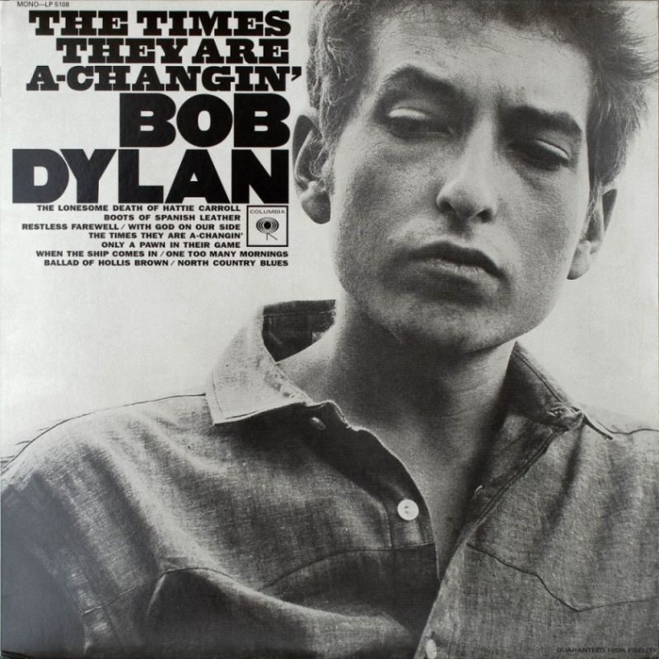

Slide 26
Additional Unused Slides

Slide 27
UK Parliament votes on “assisted suicide” bills The Suicide Act 1961 makes it an offence to encourage or assist a suicide or a suicide attempt in England and Wales. Anyone doing so could face up to 14 years in prison.
September 2015 – Marris Bill defeated 330 to 118 (74% against)
December 1997 – Ashton Bill (Doctor Assisted Dying Bill, proposed by Labour MP Joe Ashton) - defeated 234 to 89 (72% against)

Slide 28
Conscience – narrow definitions
Janaway 1989
Glasgow Midwives 2014
General Pharmaceutical Council 2017
Mental Capacity Act 2005
Bland case 1993
Mr Y case 2018

Slide 29
Abortion
Extension to Northern Ireland
Decriminalisation with alternative regulation by medical profession (RCOG)
Resistance to abortion “reversal” therapy
NICE guidelines
Peaceful protests and banning orders
Tax-payer funding
Funding and supporting overseas abortion and contraception

Slide 30
Assisted Suicide & Euthanasia
Multiple attempts through parliament
Mental Capacity Act definition of Best Interests
Tony Bland Case and definition of what constitutes medical therapy
Dignity in Dying
RCP poll with subsequent RCGP and BMA polling to take place

Slide 31
Lord Falconer’s current Assisted Dying Bill [HL Bill 6, 2014-15] received its first reading in the House of Lords on 5 June [HL Hansard 5 Jun 2014 Vol 754 Column 21] and is scheduled for its second reading on 18 July. It is identical to the Bill he presented on 15 May 2013 in the previous parliamentary session and its purpose is: “[t]o enable competent adults who are terminally ill to be provided at their request with specified assistance to end their own life; and for connected purposes”
There have been five earlier attempts to modify the provisions of the Suicide Act 1961:
Lord Joffe’s Assisted Dying for the Terminally Ill Bill, introduced in 2004;
two separate amendments by Patricia Hewitt and by Lord Falconer to the Coroners and Justice Bill 2008-09;
Dame Joan Ruddock’s unsuccessfully attempt to secure a government consultation on putting the DPP Guidance on a statutory basis during a backbench debate on 27 March 2012; and
Lord Falconer’s Assisted Dying Bill [HL] 2013-14 which did not proceed beyond its first reading on 15 May 2013.

Slide 32
Attempts to introduce changes to law in UK Parliament
In 1969, a Bill was introduced into the House of Lords by Lord Raglan. In 1970, the House of Commons debated the issue. Baroness Wootton introduced a Bill to the Lords in 1976 on the matter of "passive euthanasia".
On 10 December 1997, a vote was taken in the House of Commons on the issue of introducing a Doctor Assisted Dying Bill, proposed by Labour MP Joe Ashton. The bill was defeated by 234 votes to 89.
Between 2003 and 2006, Labour peer Lord Joffe made four attempts to introduce bills that would have legalized assisted suicide and voluntary euthanasia - all were rejected by Parliament.
In June 2012, the British Medical Journal published an editorial arguing that medical organisations like the British Medical Association ought to drop their opposition to assisted dying and take a neutral stance so as to enable Parliament to debate the issue and not have what Raymond Tallis described as a "disproportionate influence on the decision".
In 2014, Labour peer Lord Falconer introduced an Assisted Dying Bill into the House of Lords. The bill proposed that terminally ill patients with a life expectancy of less than six months be given the option of a medically assisted death, subject to legal safeguards. The bill reached committee stage before running out of time in the session.
In 2015, Labour MP Rob Marris introduced an Assisted Dying Bill based on Lord Falconer's proposals the year before. The bill was defeated by 118 votes to 330 on 11 September 2015.
In 2016, Conservative peer Lord Hayward reintroduced the Assisted Dying Bill into the Lords. The bill did not get past the first reading due to the parliamentary session ending.

Slide 33
Baroness Jay of Paddington (Lab peer) – excerpt from speech to House of Lords 6/3/17
Another source of rather adamant opposition to change in this country has been some of the professional organisations representing doctors. Obviously doctors must play a vital role in the safe practice of any assisted dying legislation. Again, the North American experience is instructive. In California and Canada the medical associations, which were initially concerned, have now adopted appropriate positions of neutrality to the new laws. This pragmatism has therefore usefully meant that they, doctors and other health professionals can be actively involved in both shaping good practice and guiding the development of safeguards for everyone involved.

Slide 34
Contraception
Now considered “essential service” rather than an “optional service”
Attempts to force pharmacists to dispense “emergency contraception”

Slide 35
Transgender / LGBT Ideology
Gender reassignment surgery
Gender reassignment medical therapies
Children
Conversion therapy issues
Locating patients in hospitals and other institutions
Sports medicine
Infiltrate all aspects of society – media, schools, NHS, commerce…
“Gay pride” demonstrations – oppressive atmosphere

Slide 36
The Legal System
One issue is clear – we can not rely on protection from the courts
Abysmal record in life issue judgements
Judges inept or corrupt? – either way not fit to make just judgements
poor understanding, conflicts of interest…
Unjust decisions, especially when repeatedly produced, shut down all avenues of hope – leading to profound despair.
But as Christians there is no need to despair – we know the final outcome
The Lonesome Death of Hattie Carroll

Slide 37
Challenges facing Catholic Healthcare Professionals & Students in the UK in 2019
Threats to conscience
Apathy – general public
- healthcare professionals
- Catholics
Secular relativism
Culture of Death
Throwaway culture

Slide 38
Prolife Movement on the UK
Although possibly growing remains very small
March for Life 2019 – 5000
Very little popular support
Very little media coverage
Very little discussion
Very little sympathy (Buffer zones issue…)

Slide 39
In your opinion, should abortion be decriminalised? Yes No
Why?
Why not?
Age groups, gender, religious faith or not, parent or not

Slide 40
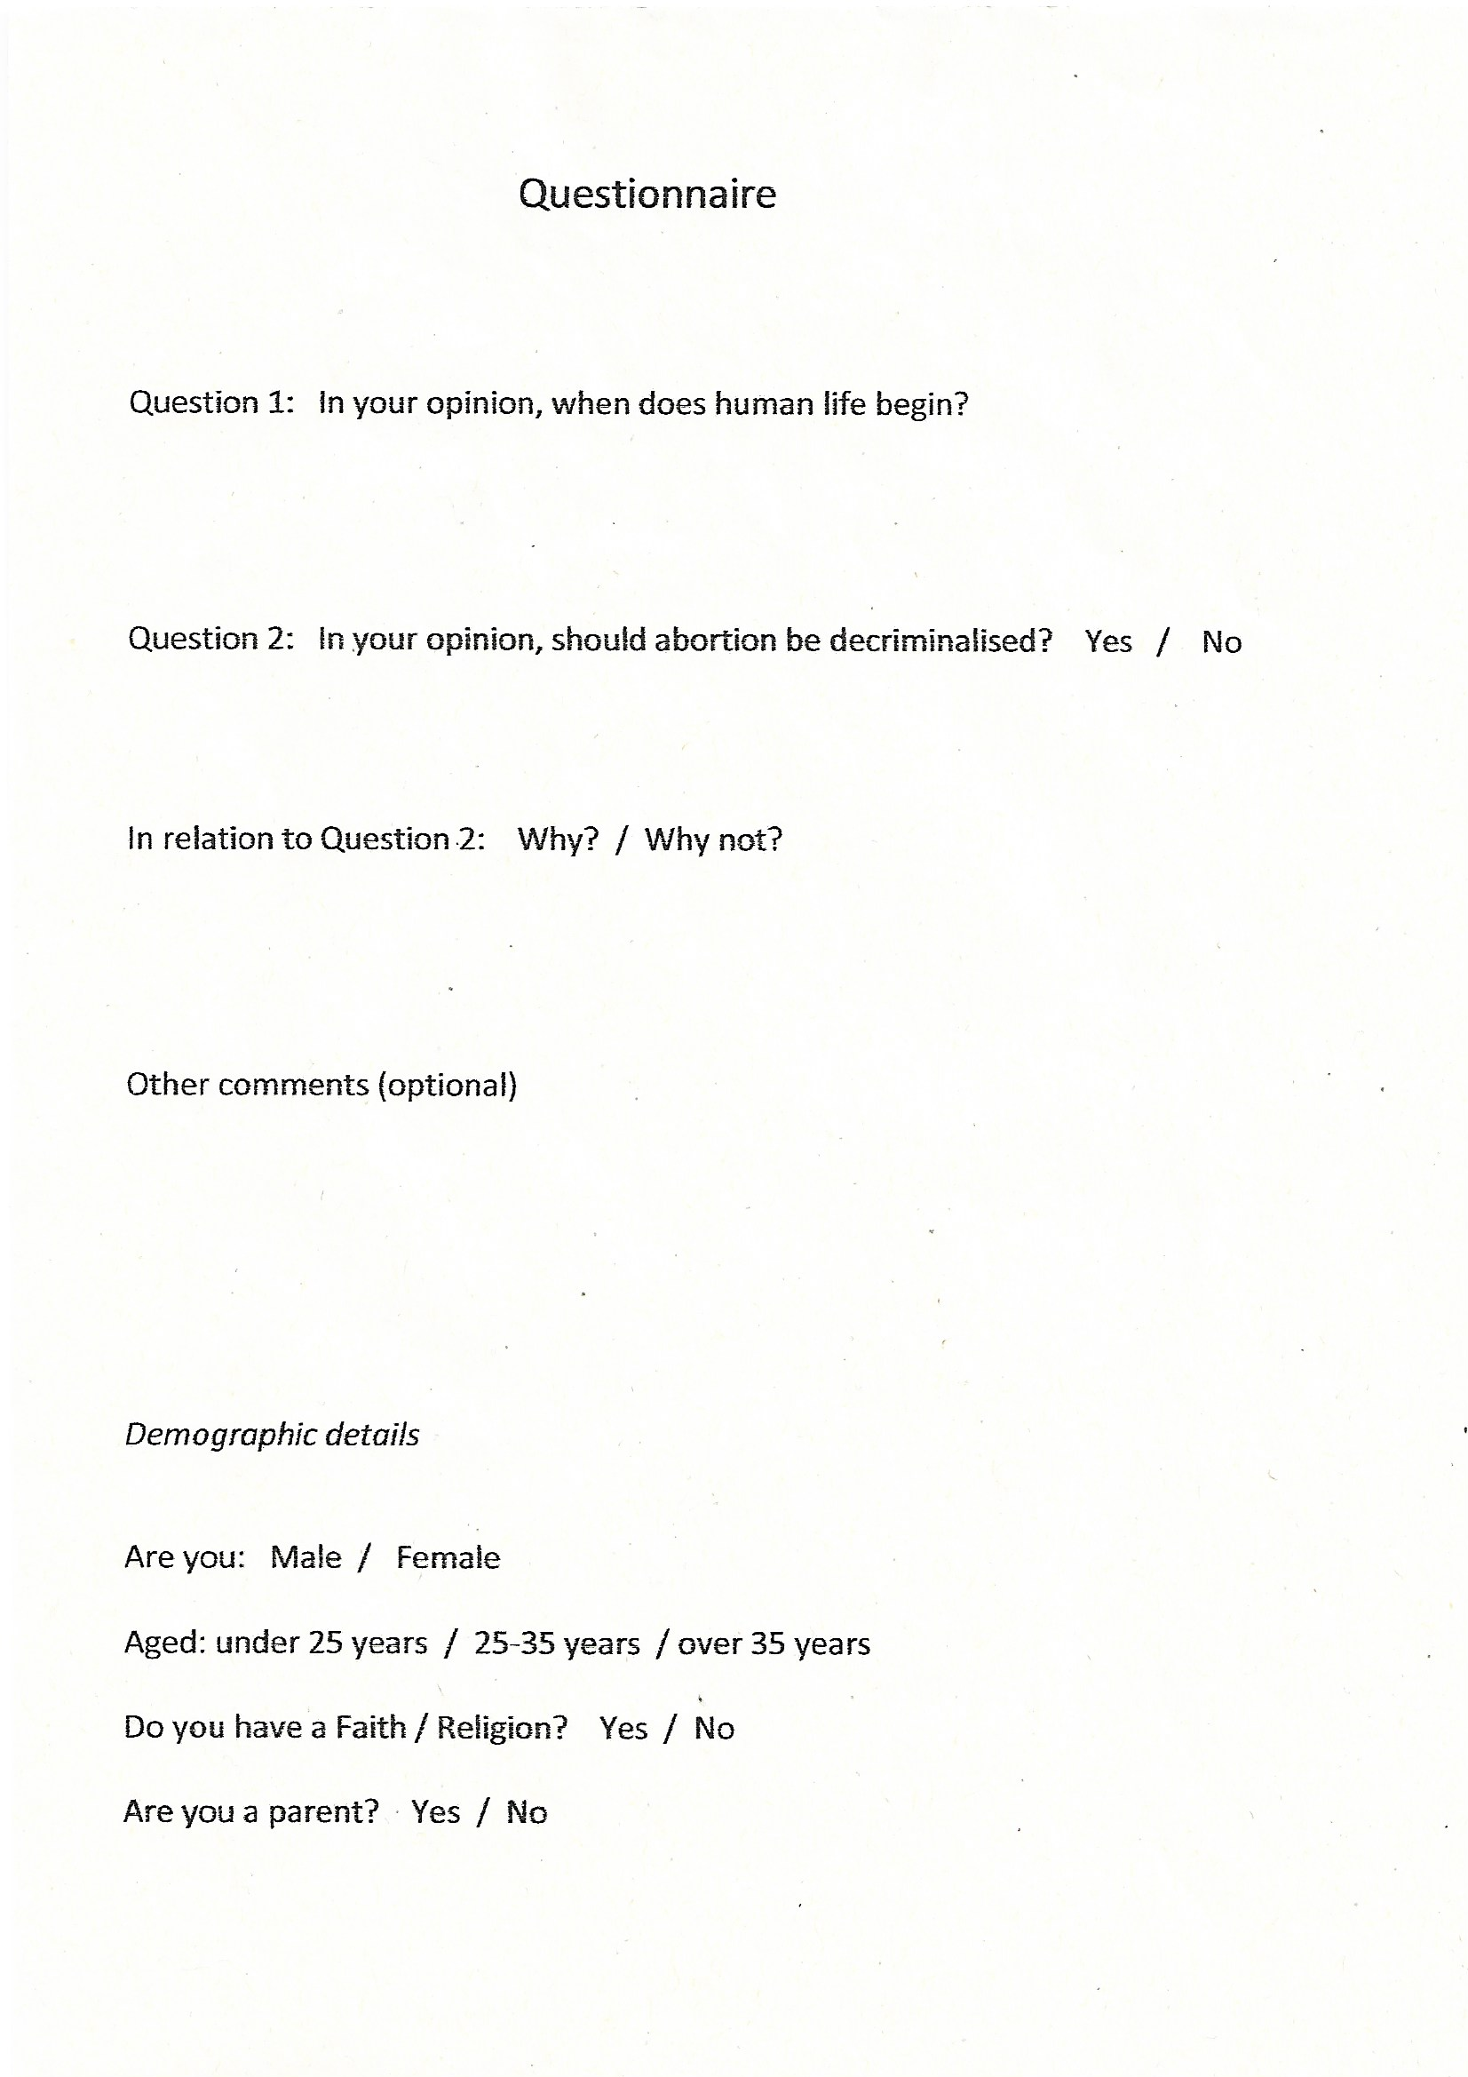
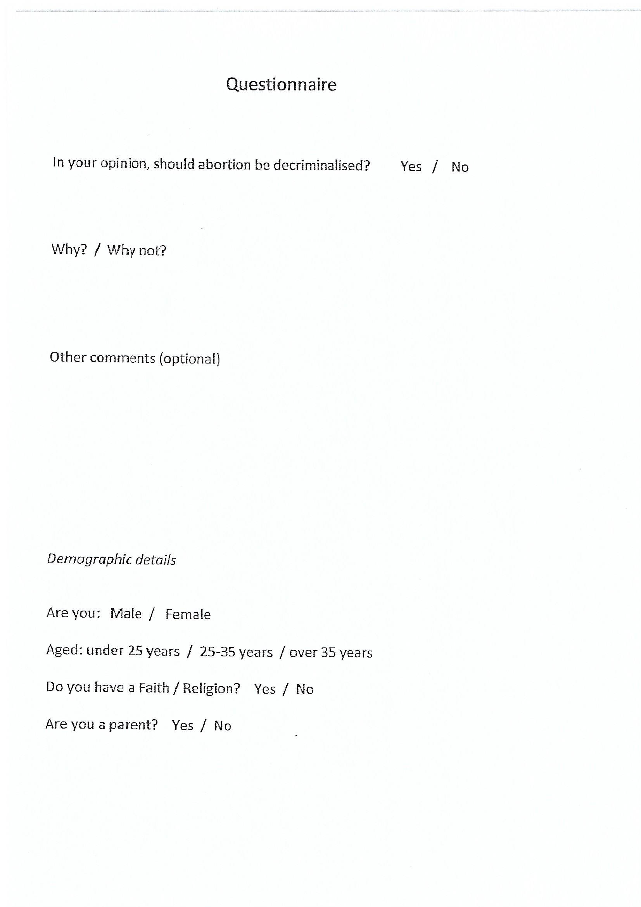
The A4 Questionnaire forms used in the survey

Slide 41
“In your opinion, should abortion be decriminalised in the UK?”

Slide 42
Figure 1 “In your opinion, should abortion be decriminalised?”

Slide 43
Figure 2 Reasons stated for supporting “decriminalisation” of abortion (responses from 94 individuals – several stated more than one reason)

Slide 44
Figure 4 “When does human life begin?” – responses 2019 survey vs 2016 survey (data expressed as percentage)

Slide 45
Catholic Medical Association (UK) Mission Statement
“We teach, we guide, we protect. We spread the Gospel. We conform ourselves to the Image of Him Who carried His Cross and Who died upon it…”

Slide 46
“…For I was hungry and you gave me food; I was thirsty and you gave me drink; I was a stranger and you made me welcome; naked and you clothed me, sick and you visited me, in prison and you came to see me…” I tell you solemnly, in so far as you did this to one of the least of these brothers of mine you did it to me…”
Matthew 25:35-40

Slide 47
RCP Poll 2019 – Do you support a change in the law to permit assisted dying?
No – 49.1% (57.5% in 2014)
Yes – 40.5% (32.3% in 2014)
Undecided – 10.4% [in 2014 – Yes but not by doctors 10.2%]

Slide 48
Press releases 21/3/19
“Because no clear majority voted for a supportive or opposed stance, the RCP will now adopt a neutral stance on assisted dying”
“A Survey of the fellows and members of the RCP has shown that a majority of respondents still do not support a change in the law on assisted dying. This broadly reflects the overarching result of the 2006 survey, although the number taking this position has fallen”

