Slide 1
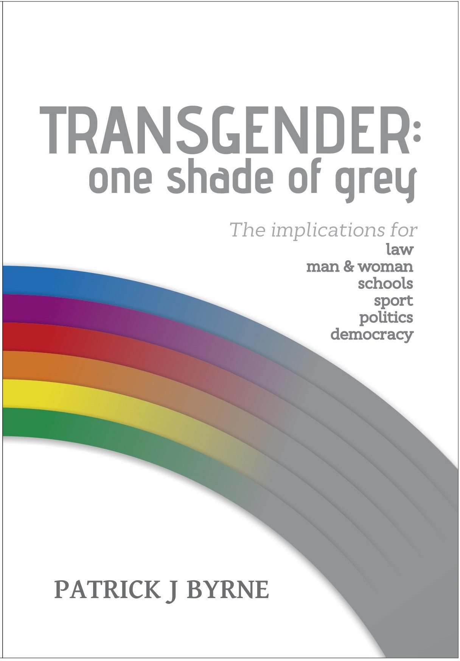
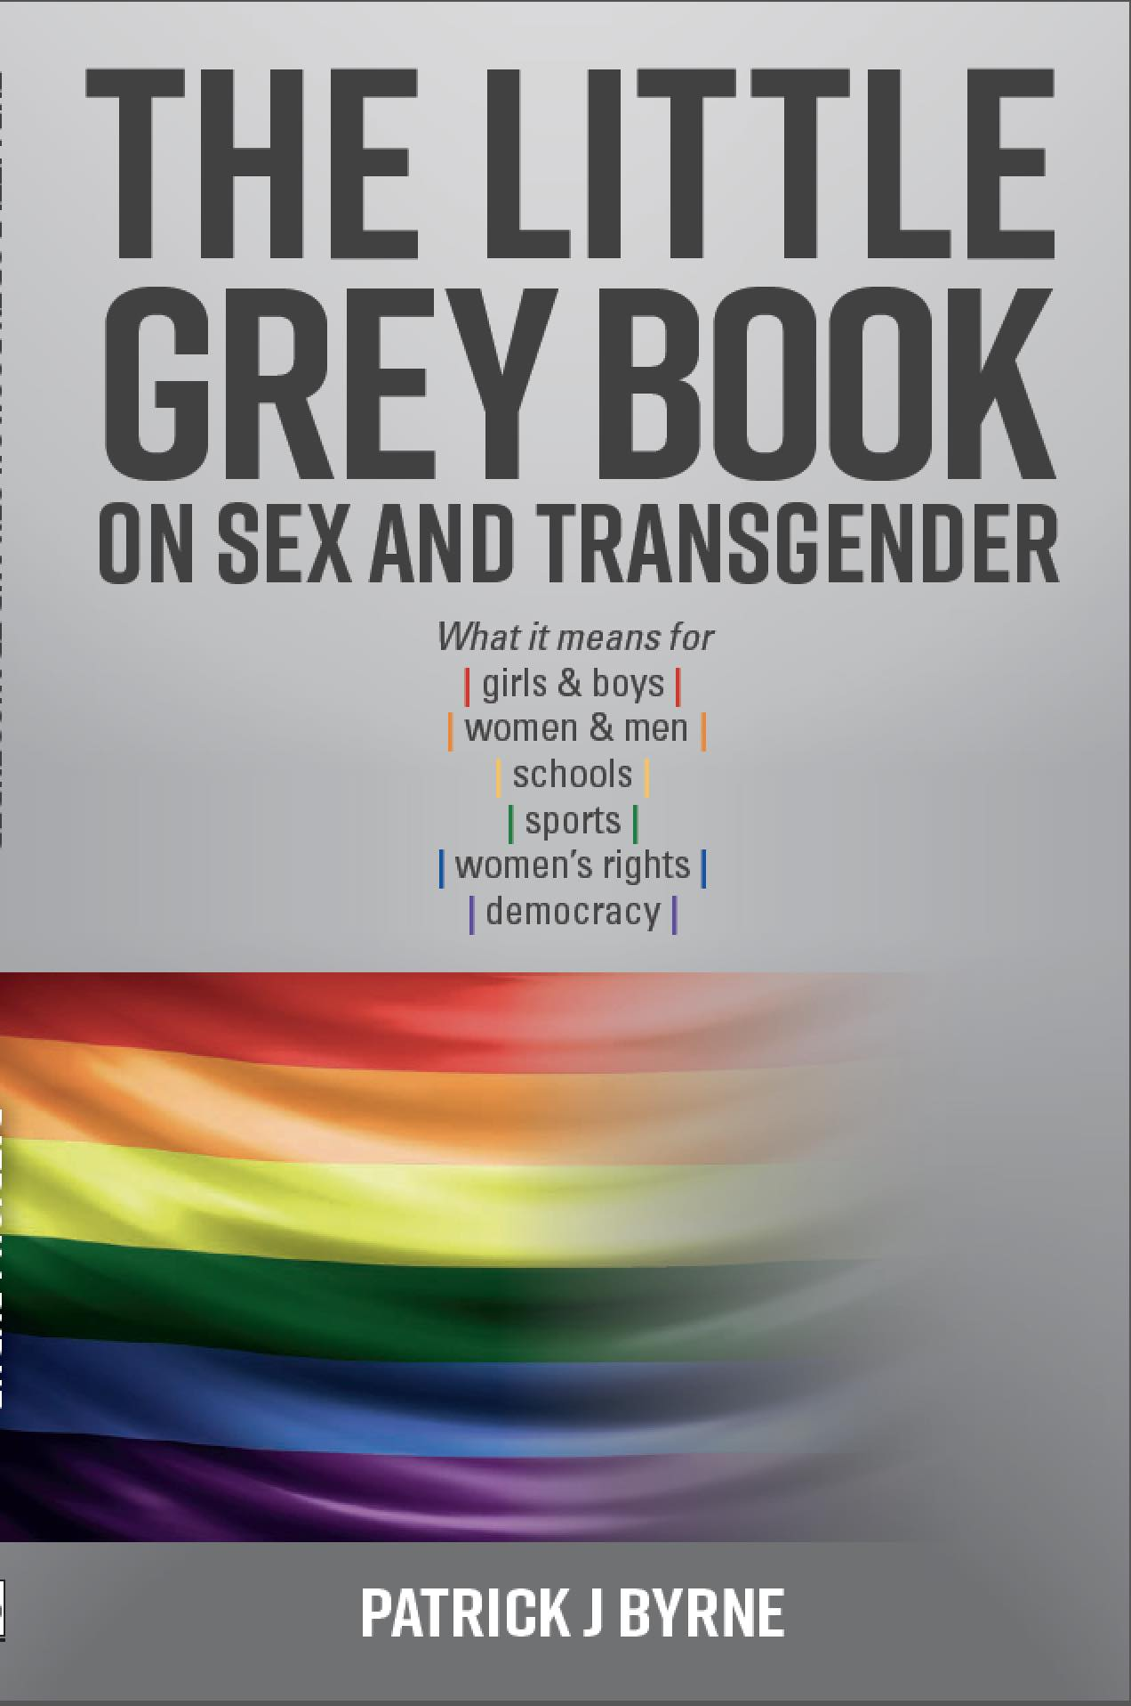
MaterCare Conference, 2019
The Threats from Transgenderism
Patrick J Byrne
President National Civic Council

Slide 2
Michel Foucault
Grandfather of queer/transgender theory.
There is no common human nature:
‘Nothing in man – not even his body – is sufficiently stable to serve as the basis for self-recognition or for understanding other men’.
National Civic Council

Slide 3
Transgender world view
All definitions of gender identity
– in the social sciences, psychological literature, declarations like the Yogyakarta Principles and in gender identity laws –
say it is wholly a social construct, where the mind can dominate over the body, so a person chooses what their nature is to be.
National Civic Council

Slide 4
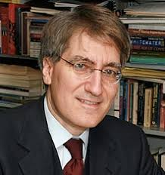
Robert P George says this is ‘body-self dualism’.
Transgenderism treats a person’s biological ‘hardware’ as irrelevant/incidental to sexual/gender identity.
National Civic Council

Slide 5
Robert P George says this is ‘body-self dualism’.
It prioritises a person’s social ‘software’ based on ‘outward social markers, including their name, outward appearance, mannerism and dress’.
All official government documents like passports, taxation and Medicare forms to allow a person to legally self-identify as
Male, or Female, or X(Indeterminate, Unspecified, Intersex).
Australian Government Guidelines on the Recognition of Sex and Gender
National Civic Council

Slide 6
Passports

Slide 7
Male, Female, X(Indeterminate, Unspecified, Intersex)
Setting up AFA Action Groups to campaign against LGBT sex education and same-sex marriage
a boy identifies as a girl, a girl identify as a boy
identify at a point on a spectrum between 100% male to 100% female
as non-binary – pangender, gender queer, androgynous, poligender, etc
genderless – no sex or gender identity
National Civic Council

Slide 8
If there is no human nature
National Civic Council

Slide 9
Michel Foucault
No common human nature,
no universal human rights.
National Civic Council

Slide 10
Biological world view: ‘dynamic unity’
Self-evident the mind and body operating as an integrated whole, just as Aristotle says, the wax of a candle and its shape are one.
From a common, human nature, binary biological sex is
self-evident and defined by natural, male and female reproductive functions only.
Lawrence Mayer, Paul McHugh, Sexuality and Gender: Findings from the Biological, Psychological, and Social Sciences, 2016.
National Civic Council

Slide 11
Contradiction
It’s a contradiction for transgender ideology to claim that gender identity is wholly a social construct, while also claiming that intersex people are biological evidence that a person can be other than male or female.
National Civic Council

Slide 12
The Intersex Society of North America disagrees
ISNA strongly states that Intersex is not evidence of a third human sex or gender.
National Civic Council

Slide 13
Rebecca Reilly-Cooper
Intersex is no more evidence of transgenderism than a person born without legs is evidence that humans are not bipedal (stand upright on two legs).
National Civic Council

Slide 14
From social theory to ideology …
The core of transgender theory is
gender identity is fluid
child agency
a trilogy authoritarian laws -- birth certificate, anti-discrimination and marriage laws
National Civic Council

Slide 15
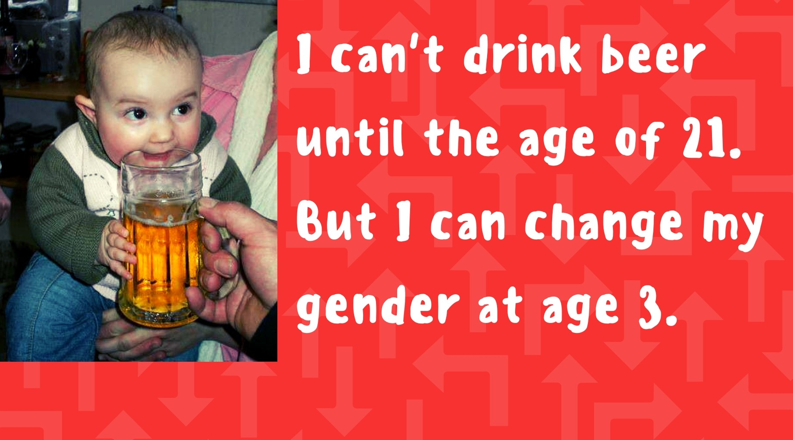
National Civic Council

Slide 16
Targets children
Disturbingly, queer/transgender theory is defined as all that is opposed to normal.
Normal means ‘that which functions in accordance with its design’ . Yale Journal of Biological Medicine, 1945
National Civic Council

Slide 17
Targets children
Stanford Dictionary of Philosophy asks, does queer include fetish, S&M and paedophilia?
Queer theory cannot answer the question, and many leading queer theorists advocate allowing adult-child sex, including Foucault and Gale Rubin, who wrote the foundation document of queer theory.
National Civic Council

Slide 18
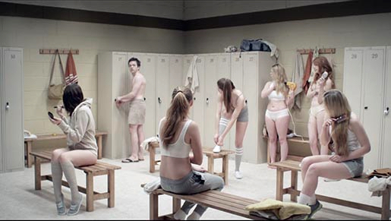
Erases women …
Women’s inherent sex based-rights (e.g. to have their own safe spaces, sports) are put in irresolvable conflict with legally created transgender rights (e.g. the created right of men who identify as women to access female safe spaces, sports).
National Civic Council

Slide 19
1. Birth certificates
…. a person’s first legal document that establishes a cascade of rights that unfold over a lifetime.
National Civic Council

Slide 20
1. Birth certificates
From a person’s recognised sex flow an array of sex based rights, privileges, protections and access to services …
National Civic Council

Slide 22
2. Discrimination laws
Self-defined gender identity is made a protected attribute, prioritising transgender rights over sex-based rights.
National Civic Council

Slide 23
2. Discrimination laws
US Equality Act Bill says:
Gender identity means:
the gender-related identity, appearance, mannerisms, or other gender-related characteristics of an individual, regardless of the individual’s designated sex at birth.
National Civic Council

Slide 24
2. Discrimination laws
Gender identity means:
the gender-related identity, ….
This is a circular argument.
National Civic Council

Slide 25
2. Discrimination laws
Gender identity means:
the gender-related identity, appearance, mannerisms, or other gender-related characteristics …
These are “sex related” characteristics: boys wear trousers, girls wear dresses.
National Civic Council

Slide 26
2. Discrimination laws
All gender identity definitions depend on biological sex.
You can’t be on a spectrum between 100% male and 100% female unless there are first biological males and females, which begs the question: are we all on this spectrum somewhere, or are we all just male and female?
Transgenderism is so shallow it cannot answer its own conundrum. Rebecca Reilly-Cooper
National Civic Council

Slide 27
2. Discrimination laws
… put obligations
on schools
National Civic Council

Slide 28
3. Transgender marriage law
The marriage of two people by their gender identity.
National Civic Council

Slide 29
National Civic Council

Slide 30
Gender identity laws
… redefine human identity redefines human relationships, dissolving the meaning of man+woman marriage and biological family.
National Civic Council

Slide 31
The authoritarian state
Birth certificate law
• Target children.
• Violate/dissolve the
sex-based rights of women.
Legal service obligations for transgenders … on threat of discrimination charges and penalties, with professionals losing their accreditation and employment
Discrimination law
Marriage law

Slide 32
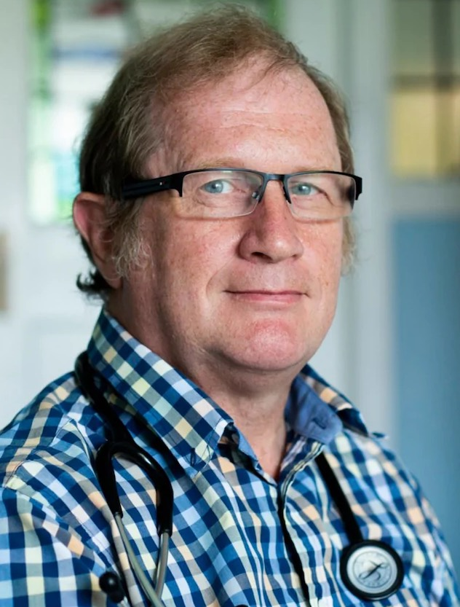
Losing your job
Dr David Mackereth, 26 years as an NHS doctor. Contract terminated as a medical assessor for the UK Department of Work and Pensions in disability sector.
Referred to patients by their sex, not their preferred gender identity pronoun.
Violated the UK Equality Act 2010.
National Civic Council

Slide 33
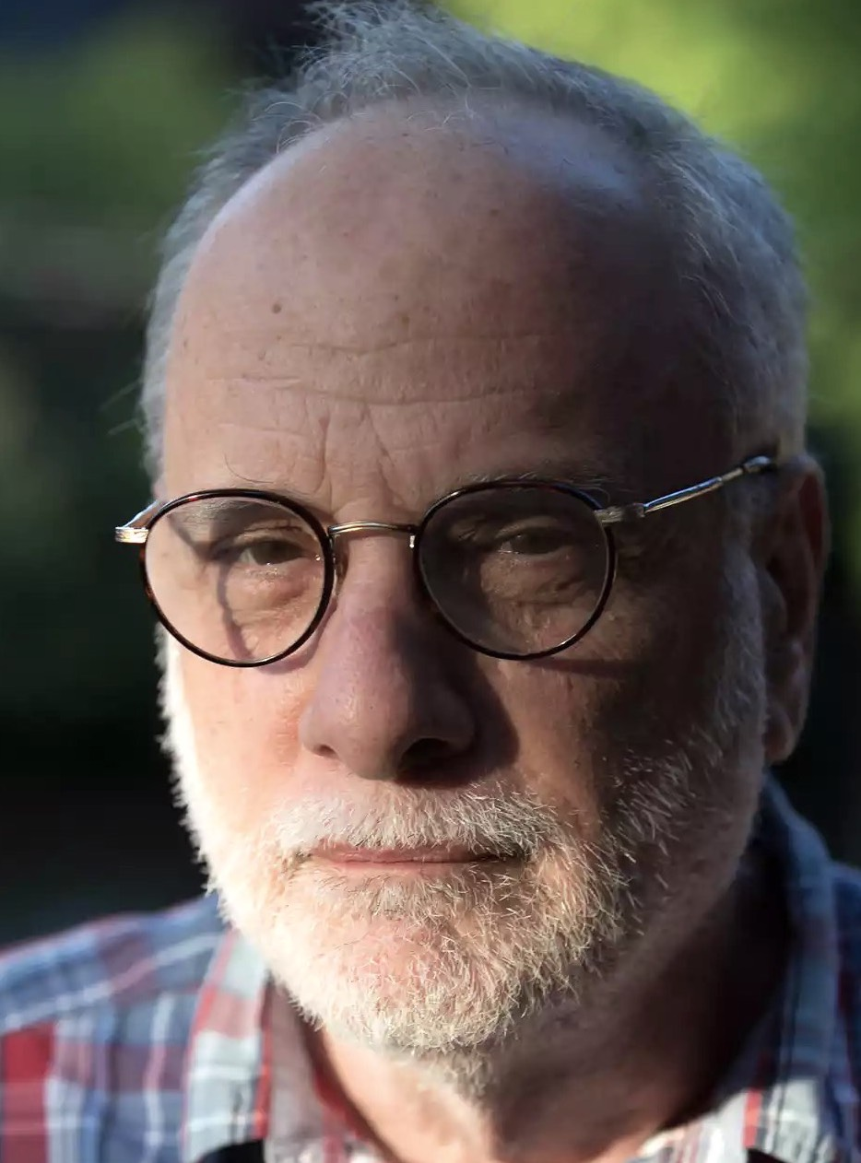
Losing your job
Prof Kenneth Zucker: psychologist, sexologist
Headed the American Psychiatric Ass’n Cttee for DSM-5 position on diagnosis and treatment of gender dysphoria.
2015 stood down as head Toronto’s Center for Addiction and Mental Health. Unit closed.
Supported “watch & wait” approach to children with gender dysphoria as 80% – 97.5% identify with natal sex as adults.
National Civic Council

Slide 34
Doctors hit from two directions
California 2019: appeals court ruled that discrimination charges against a Catholic hospital can proceed over the cancelation of a hysterectomy on a transgender female-to-male.
National Civic Council

Slide 35
Doctors hit from two directions
California 2019: appeals court ruled that discrimination charges against a Catholic hospital can proceed over the cancelation of a hysterectomy on a transgender female-to-male.
Australia 2009: three transsexuals sued for damages the Monash Gender Clinic, which settled out of court and temporarily closed, for misdiagnosing gender dysphoria instead of other psychological disorders.
National Civic Council

Slide 36
The authoritarian state
Who determines what are human rights?
Answer: the politically strongest and best organised, those out to crush all that is normal in biology, family and religion.
National Civic Council

Slide 37
The authoritarian state
Imposing a religion or ideology on everyone is the mark of an intolerant, authoritarian state.
National Civic Council

Slide 38
The authoritarian state
Imposing a religion or ideology on everyone is the mark of an intolerant, authoritarian state.
Gender identity laws threaten the legal and cultural war of all against all.
National Civic Council

Slide 39
Transgenderism versus biological science
Sex is defined by immutable reproductive function.
National Civic Council

Slide 40
Transgenderism versus biological science
Sex is defined by immutable reproductive function.
Weismann Institute: 6,500, one third, of all 20,000 human protein coding genes express differently in men and women.
National Civic Council

Slide 41
Transgenderism versus biological science
Sex is defined by natural reproductive function.
Weismann Institute: 6,500, one third, of all 20,000 human protein coding genes express differently in men and women.
US National Academy of Medicine 2001: all medical research needs to be conducted separately on men and women because their biological differences so profound that it has led to a whole new area of medicine called ‘sex based biology’.
National Civic Council

Slide 42
Solution
The solution is very simple, but politically difficult.
If sex is defined by ‘natural reproductive function’ in laws to restore the sex-based rights of women and men, all the legal conflicts between the transgender and biological world views evaporate.
National Civic Council

Slide 43
END

