Slide 1
A.M.D.G MATERCARE INTERNATIONAL (MCI) CONFERENCE 2019 CATHOLIC HEALTHCARE: WILL IT WITHER OR WHITHER CAN IT GO? ADVANCES IN RESTORATIVE REPRODUCTIVE MEDICINE : AFRICAN EXPERIENCE
Lady Dr. Henrietta M. Williams M.D., K.S.J., C.F.C.M.C., F.C.P., B.A. Divinity.
www.naprofccaf.org
henriettawilliams@hotmail.com
08062378524: 08023200803

Slide 2
How IVF Developed in Nigeria http://www.ivfbabiesnigeria.blogspot.com
Wednesday, September 23, 2015
CLAIMS OF FIRST IVF BABY (IN NIGERIA): Professor Oladapo Ashiru/Professor Osato Giwa-Osagie.
On 17th March 1989, human ingenuity came into play at the Lagos University Teaching Hospital (LUTH) Idiaraba, Lagos, when a team of experts from the Hospital, and the College of Medicine University of Lagos, became the first Researchers ever, to produce the test tube baby in Black Africa, comprising East, West, and Central Africa. … conceived through the delicate In-Vitro Fertilisation and Embryo Transfer (IVF-ET) method was born……..Mrs. Oni returned to Nigeria sometimes in October and was seen again in the Ante-Natal Clinic in October. November by Dr. (Mrs) O. K. Ogedengbe, a Consultant and Dr. (Mrs.) H. Williams, Resident in Obstetrics and Gynaecology.

Slide 3


MISSION
Ever Ancient
“I set before you
life or death,
blessing or curse.
Choose life, so that you and
your descendants may live
in the love of Yahweh
your God…” Deuteronomy 30:19,20
Notes:
Deuteronomy 30: 19,20
God sets before us two ways of living..God’s way or the world’s way.
There are only 2 kingdoms on earth..God’s and Satan’s
The kingdom of life and light and the kingdom of death and darkness.
So we are exhorted to choose life and live in God’s kingdom

Slide 4

MISSION

Slide 5
OUR MISSION
Matercare International`s mission is to serve the Culture of Life where it is most at risk- in those crisis areas and ‘hotspots’ where mothers and their children, born and unborn, are neglected or abandoned outright.

Slide 6
THE HOPE OF A SAFER MOTHERHOOD FOR AFRICA: 4 Pillars of Safe Motherhood (Recommendations by WHO 1987)
1) Universally available family planning and adequate primary health care
2) Good antenatal care, including nutrition, with early detection and referral of those at high risk;
3) Assistance of a trained person at all births
4) Access to the essential elements of obstetric care for women at higher risk.

Slide 7
MATERNAL MORTALITY LIFETIME RISK
Developing Countries 1:7,000-10,000
Developed Countries 1:15-50
Extraordinary Differences between the industrialised and the developing countries
Halfan Mahler Feb 1987

Slide 8
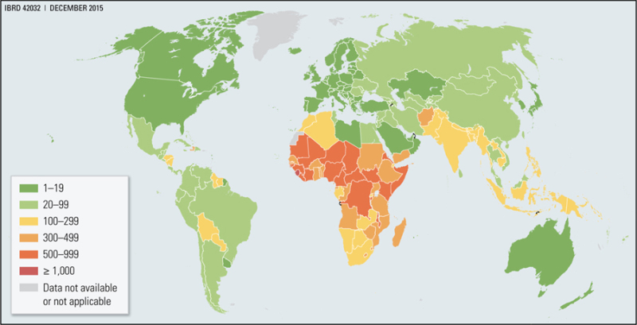
Maternal Mortality Ratio per 100,000 Live Births, 2015 WHO 2015a. From: Chapter 7, Interventions to Reduce Maternal and Newborn Morbidity and Mortality © 2016 International Bank for Reconstruction and Development / The World Bank.

Slide 9
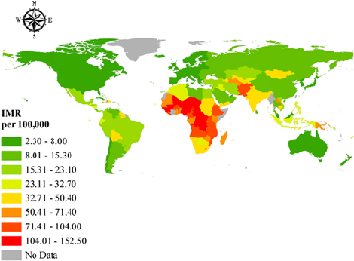
Geographical Representation of Infant Mortality Rate

Slide 10
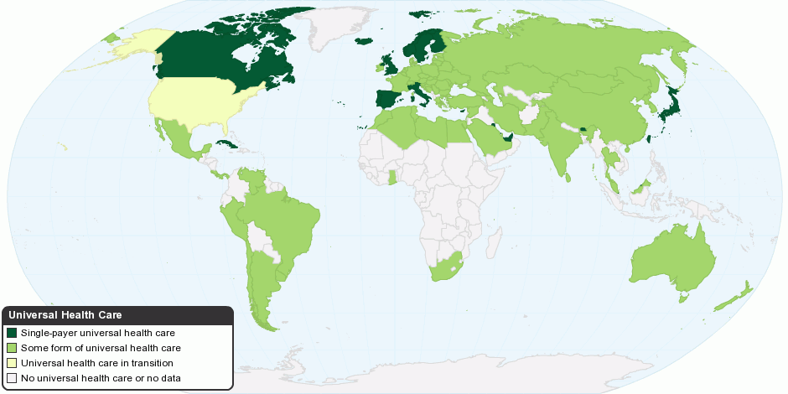
World map of countries with universal health care; Universal healthcare is a health care system that provides health care and financial protection to all residents of a particular country or region. Wikipedia

Slide 12
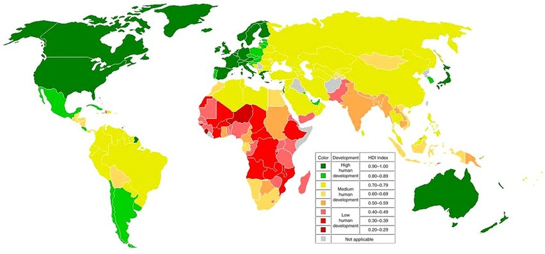
The Human Development Index (HDI) is a statistic composite index of life expectancy, education, and per capita income indicators, Examples include—Being: well fed, sheltered, healthy; Doings: work, education, voting, participating in community life.

Slide 13

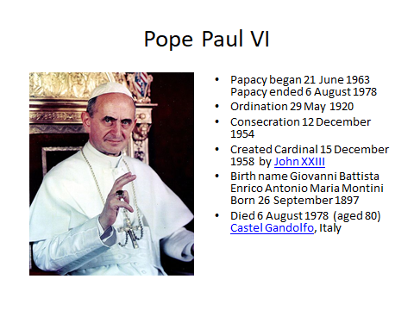
SAINT PAUL VI

Slide 14
Pope Francis: What is Integral Human Development?
Blessed Paul VI’s encyclical Populorum Progressio. 1967, meaning of “full development” (cf. n. 21), : “the development of each man and of the whole man” (n. 14 ).
integrating the different peoples of the earth. The duty of solidarity requires us to seek fair ways of sharing, so that there is no longer that dramatic inequality between those who have too much and those who have nothing,
offering viable models of social integration. principle of subsidiarity guarantees the need for the contribution of everyone, both as individuals and as groups, if we want to create a human society.
integration in development of all those elements of which it is truly constituted. The different systems: the economy, finance, labour, culture, family life, and religion are, each in its own way, essential components of this growth.
integrating individual and community dimensions. the presence of authentic relationships, and the community is generative when its members are, together and individually; the family, which is the first cell of society and where we learn to live together.
integrating the body and soul. Paul VI wrote that development cannot be reduced merely to economic growth ; respect the place where God is present to us and speaks to our hearts.

Slide 15
THREATS New Global Ethics of Secular Humanism and Cultural Revolution
In 1968, Pope Paul VI Humanae vita banned CONTRACEPTION as morally evil
[Robert McNamara served as head of the World Bank from April 1968 to June 1981. In his 13 years, negotiating a growth in funds to channel credits for development, in the form of health, food, and education projects. As World Bank President, he declared at the 1968 Annual Meeting of the International Monetary Fund and the World Bank Group that only countries permitting birth control practices would get preferential access to resources.
The United Nations Sexual and Reproductive Health and Rights Agenda for Africa driven by powerful minorities at the rudder of governance since 1989. (”SADDUCES, those who say that people will not rise from death” Matt 22;23, Mk 12;18) represented by UNDP/UNFPA/WHO/World Bank/IMF , and their agencies IPPF, UNAIDS, Marie Stopes, Planned Parenthood, etc.

Slide 16
WHO BUDGET FUNDING FOR SEXUAL AND REPRODUCTIVE HEALTH 2010-2015
> 45% Research/Program development and management
13.4% contraceptives
10.5% to sexually transmitted diseases and HIV/AIDS
11.8% preventing unsafe abortions and post abortion care by providing `safe abortions`
7.9% Maternal and Child Health
6.3% Gender and Reproductive Rights
1% Primary Health Care.

Slide 17
2 cultures have developed Globally Pro-Choice Pro-Life
Culture of Death, (“Sadduces”)
HUMAN DEVELOPMENT INDEX
Sexual and Reproductive Health and Rights
Contraceptive Mentality and Population Control
Abortion and Abortion Rights
In vitro Fertilisation (IVF)
Euthanasia and physician assisted suicide
LGBT and Homosexual Rights
Women`s Rights
Culture of Life from the Christian value of humanity: IMAGE OF GOD
INTEGRAL HUMAN DEVELOPMENT
SPIRITUAL AND MORAL VALUES
Sexuality Education and Natural Family Planning by Natural Law :
Fertility Awareness. (Creighton Model System)
Right to Life and Crisis Pregnancy Management
Natural Procreative Technology
NaProTechnology
Palliative Care
Rights of the Family
Rights of the Child to life.

Slide 18
WHO Bulletin 2011:89:137-143
The low subjective demand or need for contraception in Africa has not changed over the past decade.
Induced abortions could partially offset the lack of effective contraception. (The Argument to legalise abortion)
Western Africa already has the highest abortion-related mortality of any region in the world, with an estimated 140 abortion-related deaths per 100 000 live births per
Contraception should be vigorously promoted in western Africa on both health and economic grounds.
John G Cleland ª, Robert P Ndugwa ª & Eliya M Zulu ^{b}

Slide 19
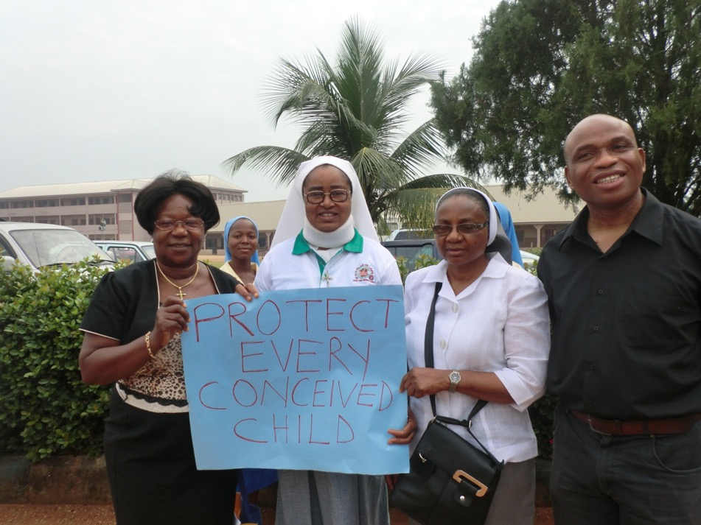
CONSCIENTIOUS OBJECTION: Government Harassment of Catholic Doctor for Pro Life Protest in Imo State

Slide 20
Factors associated with the knowledge, practice and perceptions of contraception in rural southern Nigeria. (Christian)
Despite intense programmatic efforts by the Nigerian government and various non-governmental agencies to reverse the trend, there has been little evidence to suggest a systematic improvement in these indicators.
Ghana Med J. 2009 Sep;43(3):115-21.
(Lack of trust of public health services. Free Contraceptives substituted for drugs !!!)

Slide 21
FERTILITY IN GOD`S PLAN FOR MARRIAGE
Africa has a VERY STRONG FERTILITY CULTURE.
Childlessness is a frequent cause of marital breakdown.
Infertility as well as over fecundity affect marital harmony in Africa
Despite enormous benefits, unmet need for family planning remains high in sub-saharan Africa.
Not many studies have explored its knowledge , accessibility, acceptability, and use of Natural Family Planning in Africa.
AFRICAN FAMILY PLANNING MUST ADDRESS BOTH INFERTILITY AND OVERFECUNDITY.

Slide 22

MATERCARE INTERNATIONAL (MCI)

Slide 23
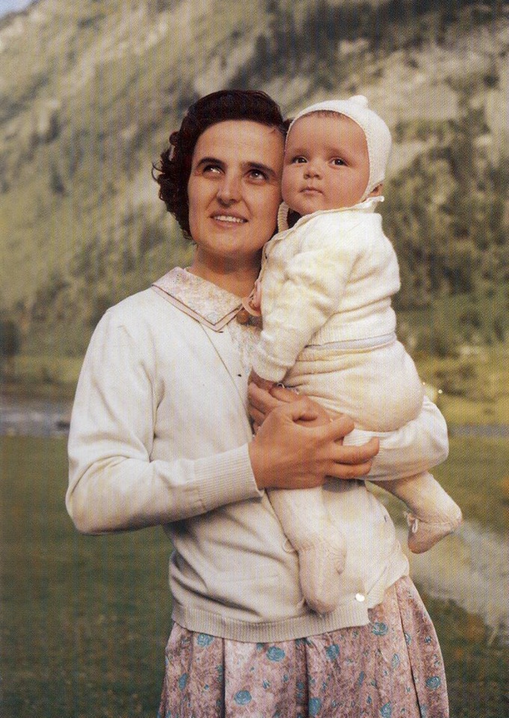
ST GIANNA MOLLA Patron Saint MATERCARE
Mother
Paediatrician
Maternal Death
Canonised 2003
Wife

Slide 24

World Federation of Catholic Gynaecologists with JP11

Slide 25
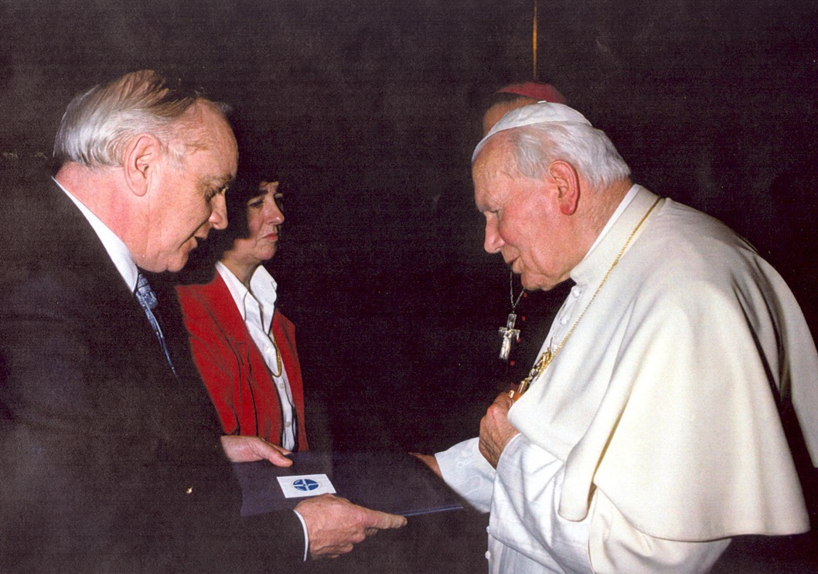
Saint John Paul 11 and Matercare President Prof Robert Walley

Slide 26
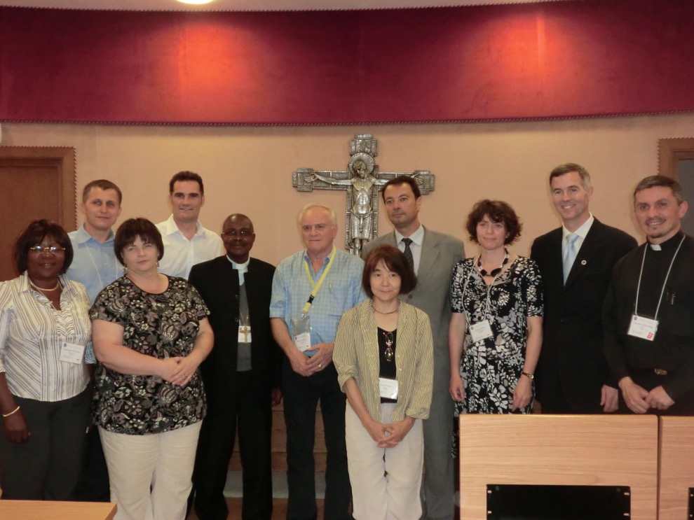
Matercare meeting in Rome 2011

Slide 27
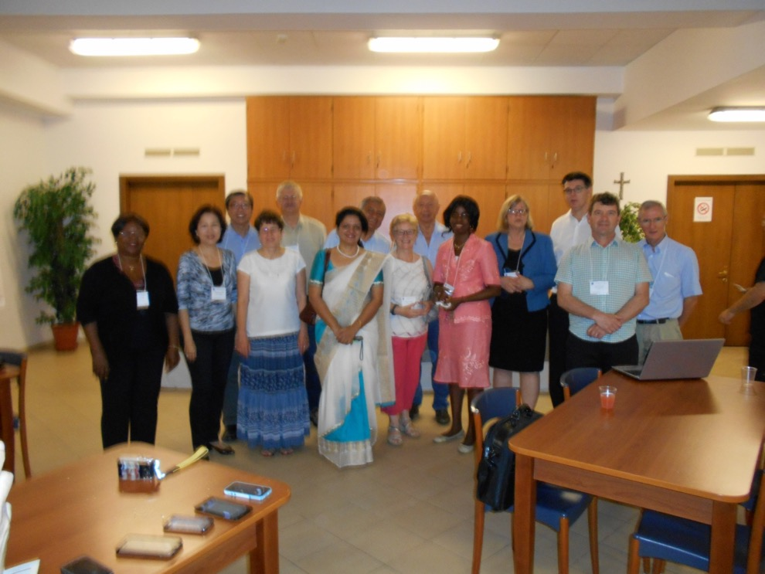
ROME August 2015, Catholic Doctors from 30 countries and all the continents

Slide 28
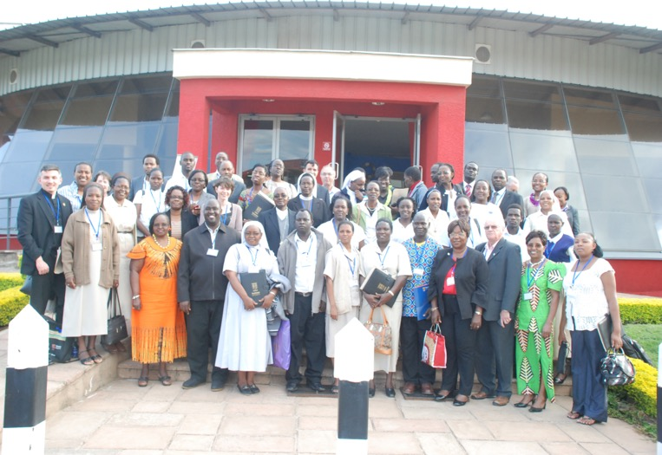
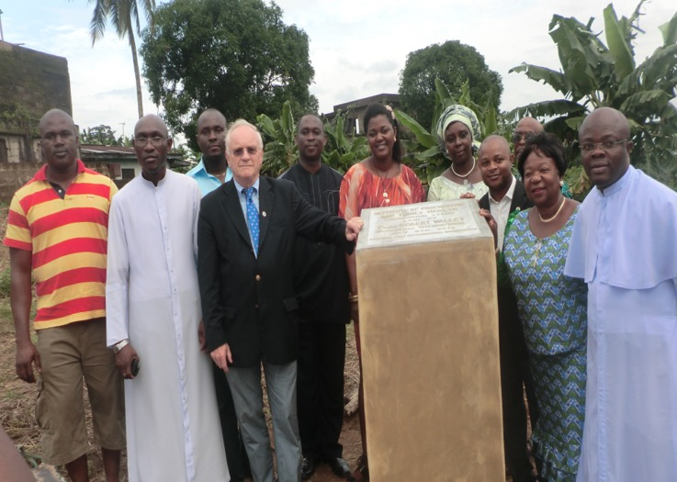
FAMILY AND PROCREATIVE HEALTH Training catholic doctors and midwives. Kenya, Nigeria.

Slide 29
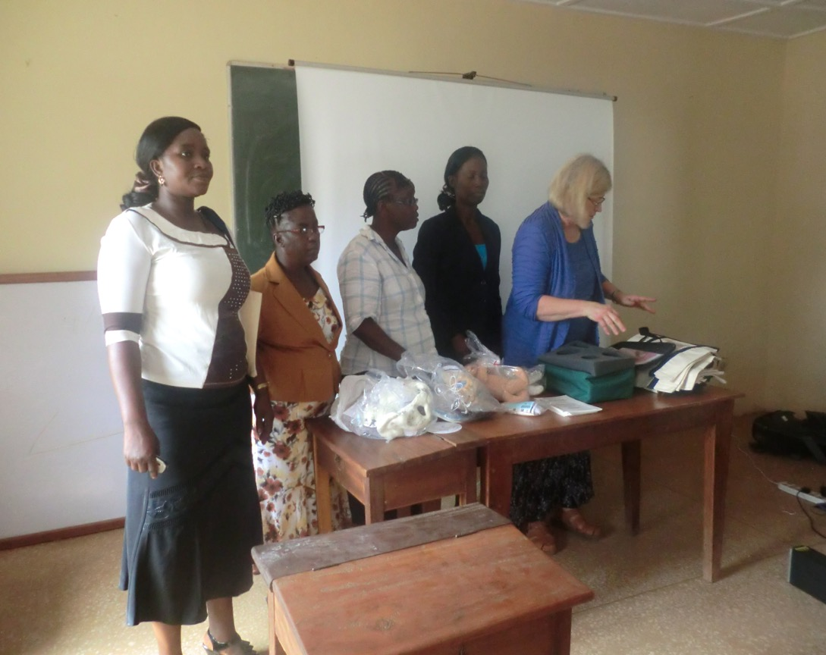
Kogi State: Midwifery Students taught essential obstetrics (shock garment)

Slide 30
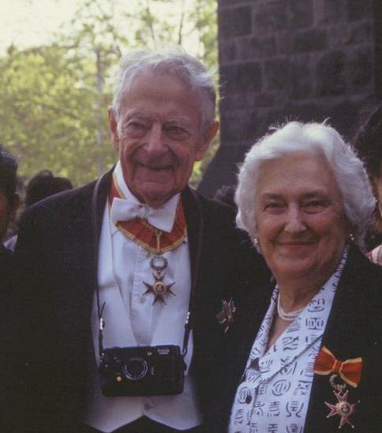
Pioneers of Natural Family Planning
Professor of Neurology John Billings and wife, paediatrician Dr Ann Billings. Died 2007

Slide 32
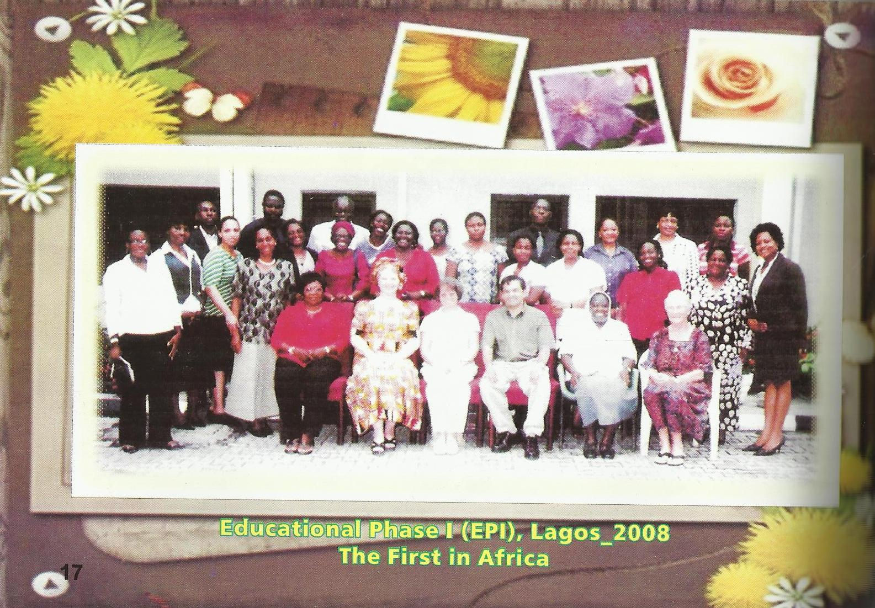

Slide 33
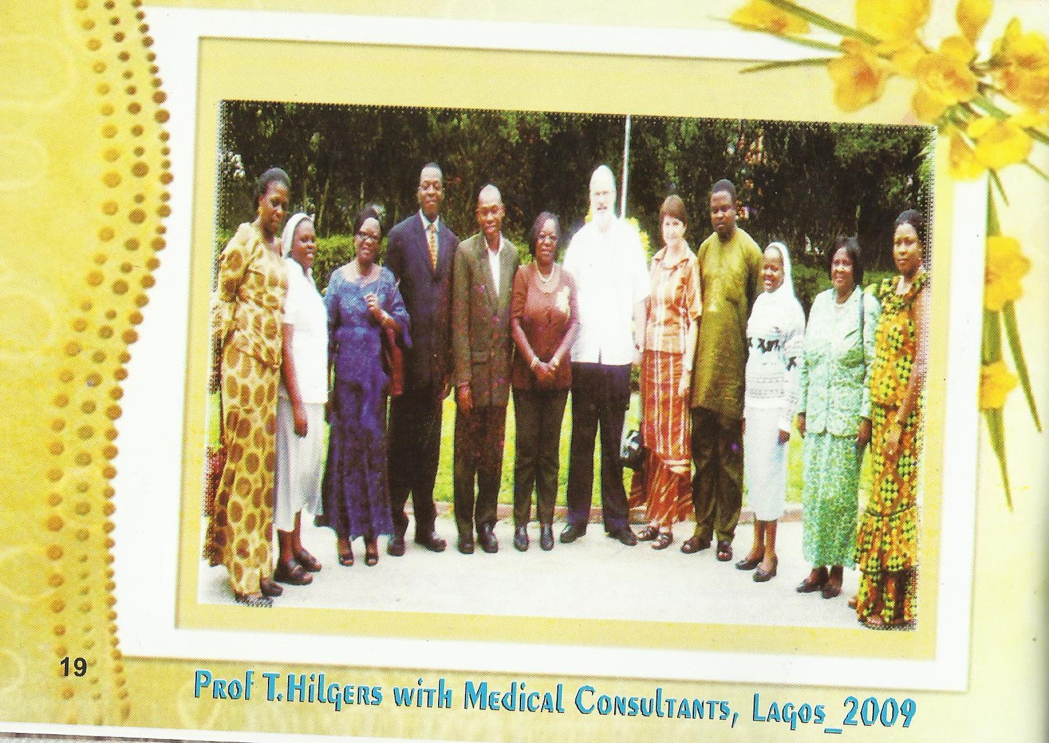

Slide 34
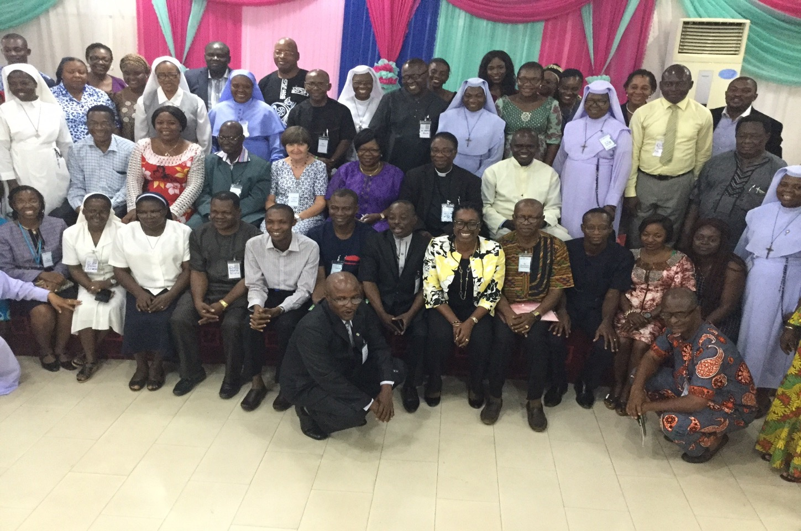
NIGERIAN FERTILITY CARE TRAINED PRACTITIONERS AND MEDICAL CONSULTANTS: ABUJA 2017

Slide 35


Slide 36

First and only Educator in Africa won “Outstanding Educator of the Year Award” 2017

Slide 37
Fertility Care Centres of Africa 2019 FCCAf “FROM PUBERTY THROUGH MENOPAUSE”
Members 53 Fertility Care Practitioners`S = 47
Medical Consultants`s = 23 (5 Obs/Gyn, 18 Family Physicians)
Educator 1
7 Education Programs.
VISION: To incorporate and integrate the new women`s health science of the Creighton Model Fertility Care System and NaProTechnology into health services in Nigeria and in all other African countries.
MISSION: To enhance women`s health and build strong families by promoting responsible parenthood, providing effective, ethical, and scientific solutions to couples procreative challenges, and teaching women how to monitor their gynaecologic health throughout life.
TARGET POPULATION OF NIGERIA 150,000,000.00

Slide 38
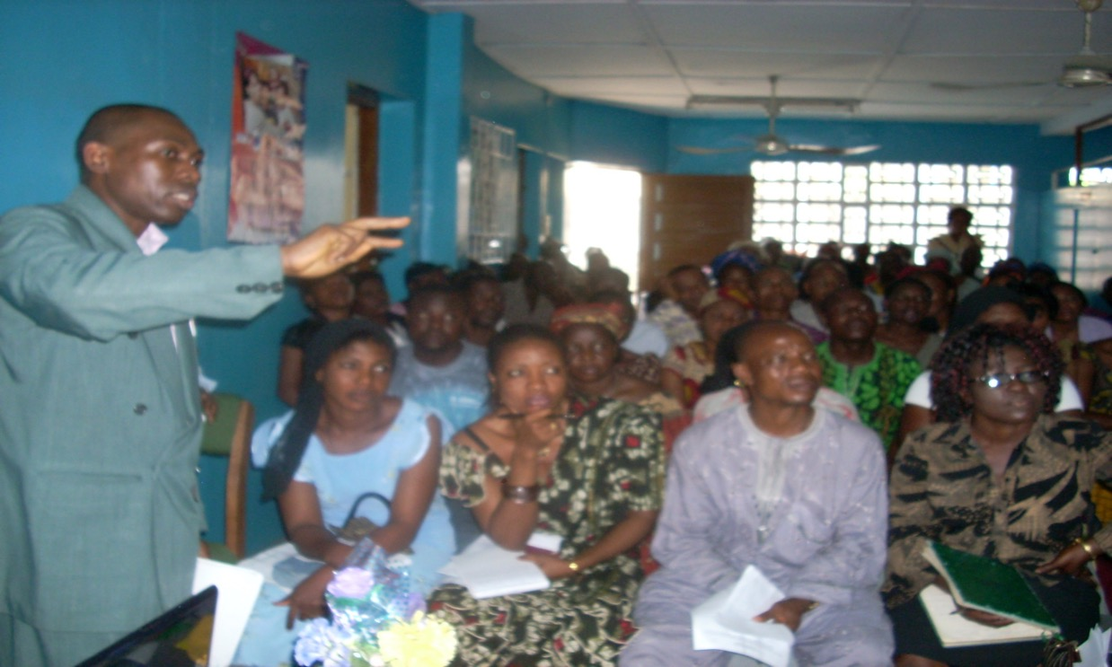
INTRODUCTORY SESSION At SONEX CLINIC

Slide 39
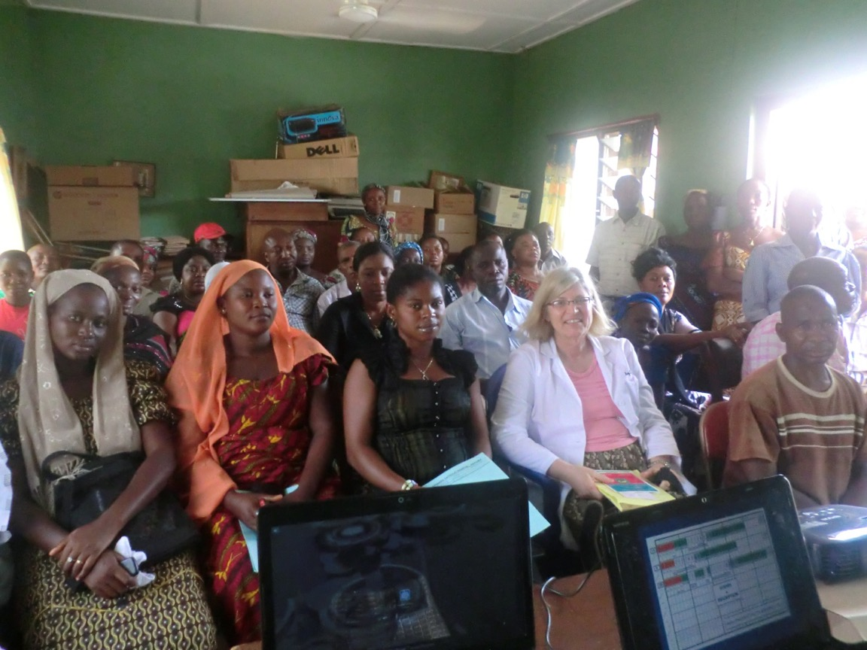
Presenting CRMS and Naprotechnology for Fertility Awareness and Infertility to Rural Community in Kogi State

Slide 40


Responsible Parenthood for postponing or achieving pregnancy

Slide 41
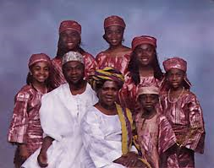
Responsible Parenthood: Sex Ratio?
the full awareness of their obligations in the matter of responsible parenthood
biological processes, responsible parenthood means an awareness of, and respect for, their proper functions.
man's innate drives and emotions, responsible parenthood means that man's reason and will must exert control over them.
Physical, economic, psychological and social conditions, responsible parenthood is exercised by those who prudently and generously decide to have more children, and by those who, for serious reasons and with due respect to moral precepts, decide not to have additional children for either a certain or an indefinite period of time.
INTEGRAL HUMAN DEVELOPMENT

Slide 42
Nigerian Demographic Health Survey 2008
72% of women and 90% of men are aware of Contraception
Awareness is related to utilisation
Only 36% know Natural Family Planning, usually the Rhythm Method.
Natural Family Planning is not well understood.

Slide 43
Uptake of Natural Family Planning by clients of Catholic Hospitals in Masaka Diocese (UGANDA)
Roman Catholic Health Services do not have Staff trained in NFP
No budgets, supplies ,registers ,teaching aids, and records of NFP were kept
No space for NFP clinics
No arrangement for CPE for NFP Providers
Basic Knowledge about NFP was from friends
76% of clients in Catholic Health Institutions had more information on Contraceptives, and knew how to access them.
Nakiboneka, Maniple. 2008. Health Policy and Development. 6(3) 126-141. UMU Press

Slide 44
Awareness and Utilisation of NFP Reasons For Non Use of NFP
Provider Bias: Doctors and Nurses have no knowledge of NFP. Perception of NFP is that it is ineffective, difficult, requires abstinence, time consuming.
Lack of information about NFP
Lack of Profitable product to sell or advertise by pharmacists the main health provider
Poverty: no space for separation during fertile period
Lack of spouse cooperation/ alcohol abuse
Religious beliefs about onset of life and purpose of sexual union (Catholics).
Lack of support from both govt and non-govt sources. Only some Catholic Institutions.

Slide 45
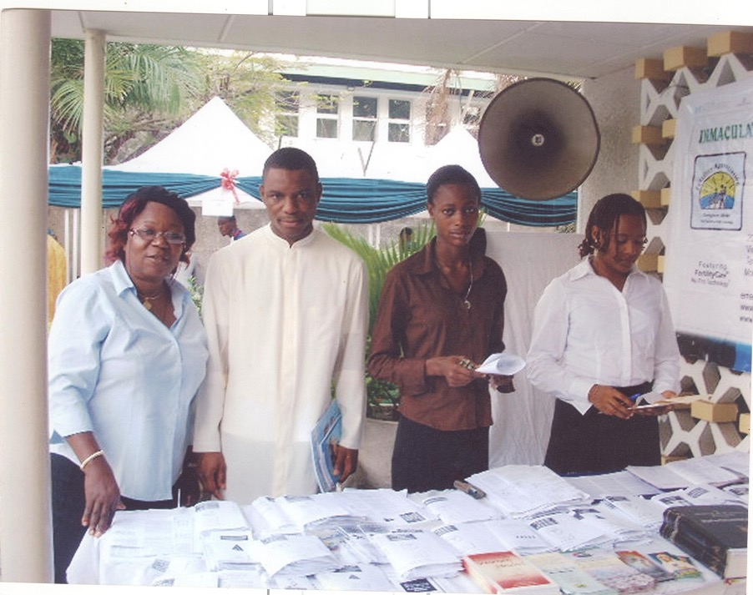
Parish Outreaches (Urban High Income Area)

Slide 46
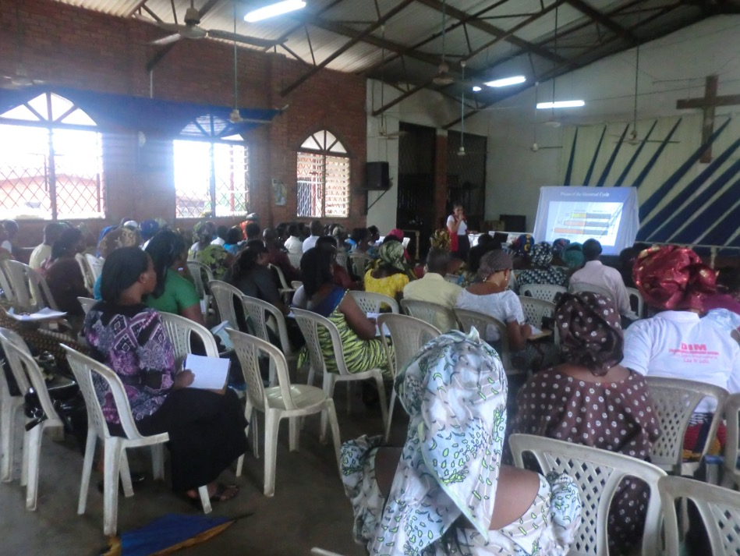
Introductory Session to Catholic Womens Organisation in a Parish in Ikorodu

Slide 47
Slide 64

Slide 48
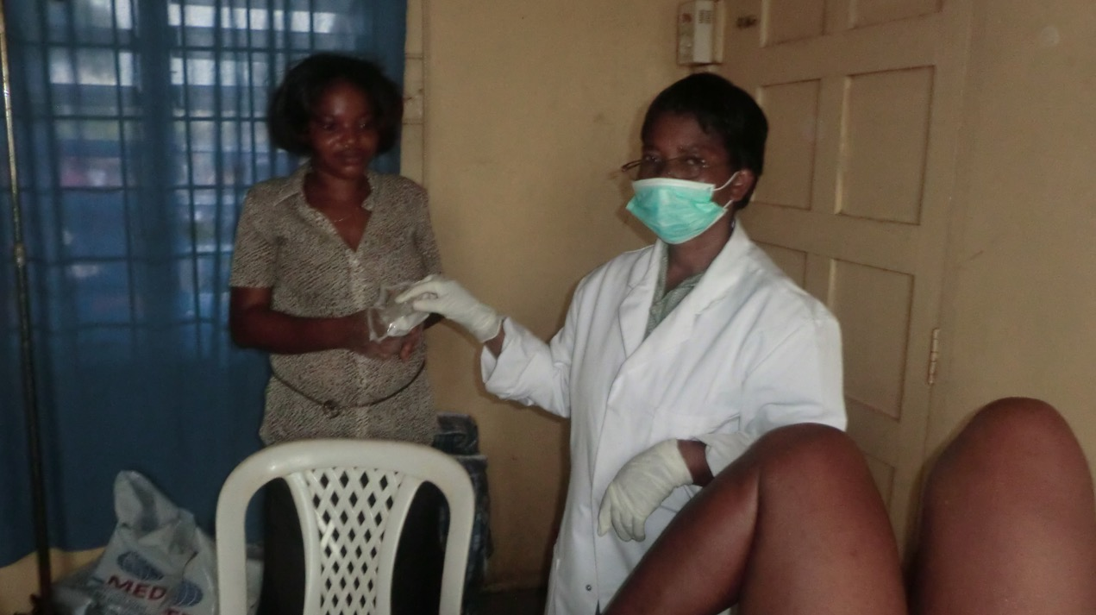
Followed by mass cervical cancer screening by VIA (visual Inspection with acetic acid)

Slide 49
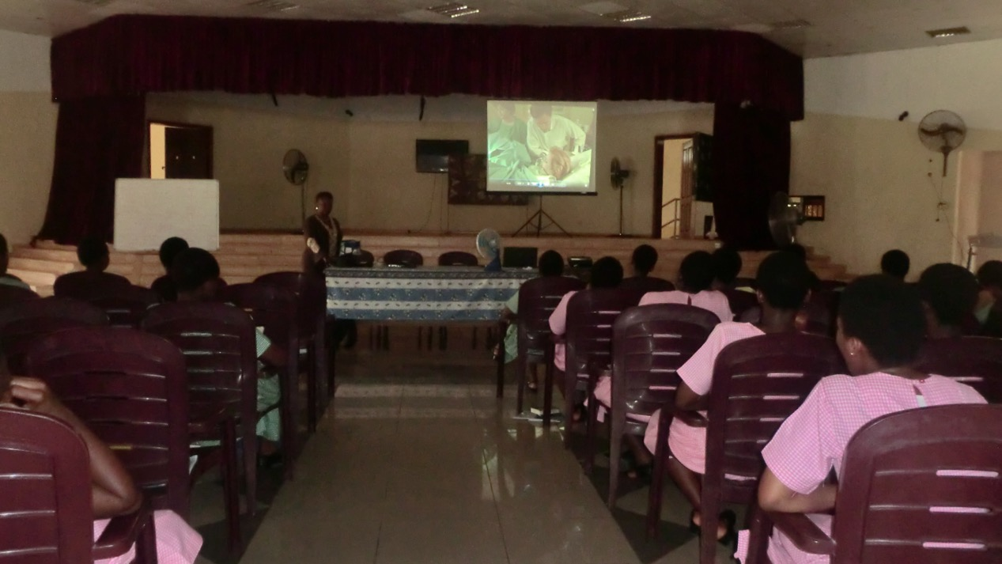
Adolescent Sexuality Education of Senior High School Girls at Louisville in Ijebu Mushin

Slide 50
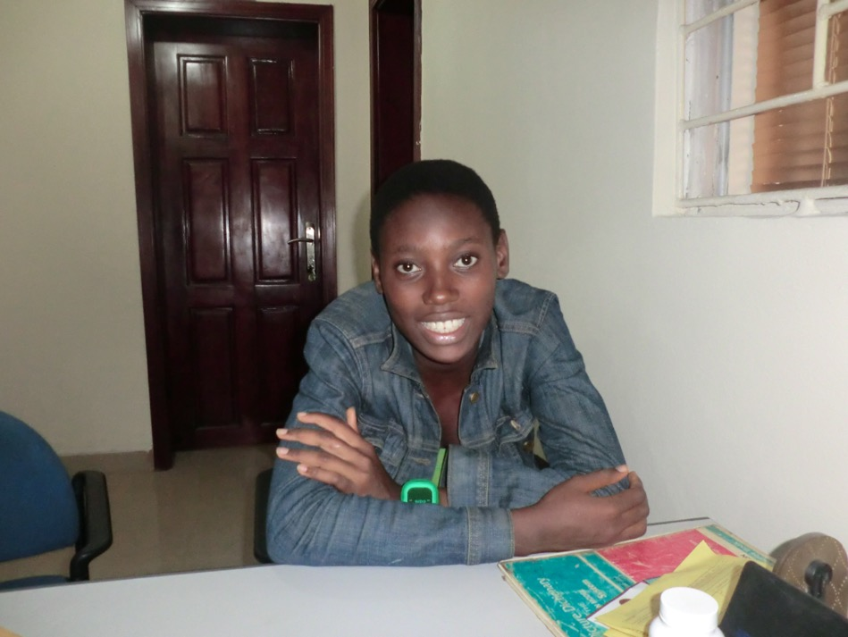
Counselling in crisis pregnancy management of 17 yr old teenager

Slide 51
FERTILITY CARE SERVICES (Crude Pilot Studies) For CRMS/NPT Pregnancy Rates in Infertility Cases without Surgery
Analysis of Randomised sample population of 54 out of a total of 191 clients with at least 1 follow up.
Pregnancies 26 48%
Live births 24 44%
Miscarriages 2 4%
Adopted male child 1 2%
Went on to do IVF, 2 failed cycles 1 2%

Slide 52
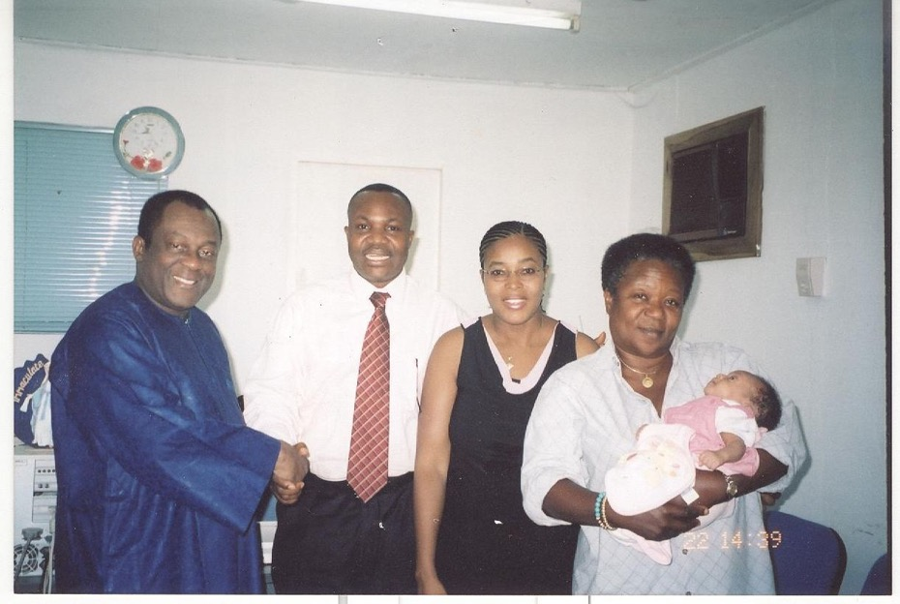

`MIRACLE BABY` Reported in the Nigerian press. Severe Oligospermia

Slide 53

Pregnancy after 2 failed IVF`s

Slide 54
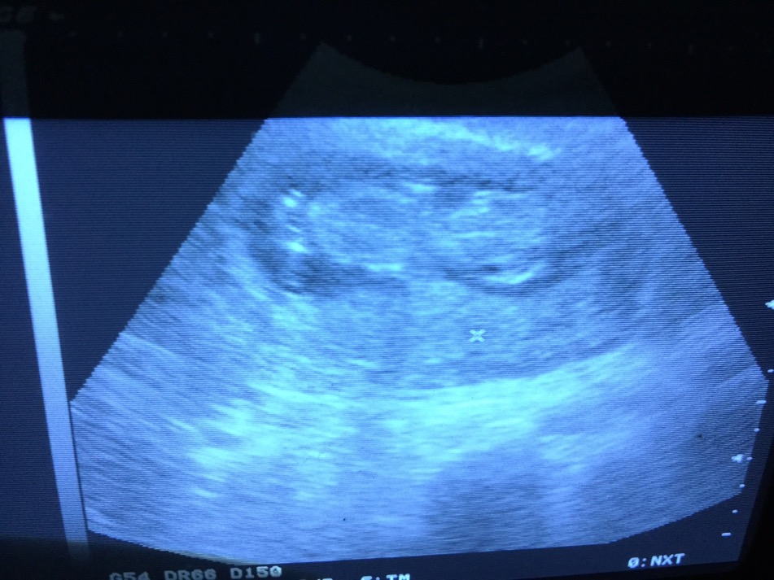
After 2 Failed IVF`s Successful CRMS/NPT Pregnancy in a medical doctor at FERTILITY CARE SERVIES: LAGOS

Slide 55
CREIGHTON MODEL SYSTEM: SATISFACTION FOR THE PRELIMINARY SESSION IN SOUTH EASTERN NIGERIA
by
Dr Ezenkwele, Eziamaka P
At the 10th Annual General Meeting and 2013 Restorative Reproductive Medicine Conference
New Orleans, Louisiana, USA
7th August 2013

Slide 56
FIGURE 7: CLIENTS’ COMMENTS ON PRESENTATION

Slide 57
Awareness and Utilisation of Natural Family Planning among workers in Ibadan NE local govt ( Pilot Study)
400 workers ; questionnaire
99.7% aware of at least 1 method of contraception
67% aware of NFP, rhythm 45.4%, Billings 35.4%, temperature 20.4%, symptothermal 15.2%,
88% wanted more information
64.8% used some family planning
25.4 had used NFP, but only 6.6% current use
47% believed in effectiveness of NFP
Awareness of and effectiveness of NFP was significantly associated with its use.
Asuzu M C 2013;University College Teaching Hospital Ibadan, Community Health Department.

Slide 58
Awareness and Utilisation of Natural Family Planning among workers in Ibadan NE local govt ( Pilot Study)
400 workers ; questionnaire
99.7% aware of at least 1 method of contraception
67% aware of NFP, rhythm 45.4%, Billings 35.4%, temperature 20.4%, symptothermal 15.2%,
88% wanted more information
64.8% used some family planning
25.4 had used NFP, but only 6.6% current use
47% believed in effectiveness of NFP
Awareness of and effectiveness of NFP was significantly associated with its use.
Asuzu M C 2013;University College Teaching Hospital Ibadan, Community Health Department.

Slide 59
OBSTETRICIANS’ KNOWLEDGE, ATTITUDE AND PRACTICE OF NAPROTECHNOLOGY IN NIGERIA
¹Ezenkwele EP, ²Ugwu OM, ¹Emegoakor FCJ, ¹Menuba IE
^{1, 3}Ezenkwele EP, ²Ugwu OM, ¹Emegoakor FCJ, ¹Menuba IE
1University of Nigeria, Enugu Campus/ UNTH, Enugu, Nigeria
2Coal Camp Medical Centre, Enugu , Nigeria
3Harvard T Chan School of Public Health
Presented at 52nd Annual Scientific Conference of SOGON at Calabar, Cross River
November 23rd, 2018

Slide 60
METHODOLOGY
A cross-sectional study
Involving one hundred and eighty-three obstetricians (183)
Self-administered questionnaires were used
Information on their socio-demographics
Their knowledge, attitude and practice of NPT

Slide 61
KNOWLEDGE

Slide 62
ATTITUDE

Slide 63
A New Vital Sign: Outcomes from Treatment of Infertility in Six Fertility Clinics in Nigeria
by
¹Obiorah CO, ²Ezenkwele EP, ³Williams H, ⁴Achebe FU, ¹Asuzu MC
¹Department of Community Medicine, University of Ibadan
²Department of Obstetrics and Gynaecology, University of Nigeria, Enugu Campus/ UNTH, Enugu
³Fertility Care Services of Victoria Island, Lagos,
⁴St Margaret’s Hospital and Maternity, Felele, Lokoja, Kogi State
Presented at 52nd Annual Scientific Conference of SOGON at Calabar, Cross River
November 22nd, 2018

Slide 64
NAPROTECHNOLOGY TREATMENT USED
TYPE OF TREATMENT | ALL WOMEN N=246 (%) | WOMEN THAT CONCEIVED N=88 (%)
CrMS instruction alone | 15 (6.1) | 9 (10.2)
CrMs + medical | 197 (80.1) | 69(78.4)
CrMs + medical + surgical | 34 (13.8) | 9 (10.2)

Slide 65
RESULTS
Eighty-eight (88) or 35.8% of the 246 women conceived and 65 (26.4%) had live births
Eighty-three (83) or 33.7% of the women had conceived by 24 months of treatment
with a life table adjusted cumulative proportion of 60 per 100 couples
60 (24.4%) of the women had live births by 24 months of treatment
with a life table adjusted proportion of 45 per 100 couples
The women who conceived were between 20-48 years
Their husbands were between 30 and 50 years old
Mean of 5 years trying to conceive

Slide 66
USING THE CRMS TO EVALUATE THE EFFECT OF ACT Artemeter+Lumefantrine (ANTI MALARIA DRUGS) ON FERTILITY
DR. ACHEBE FRANCIS UDOKA
MD, CFCMC, FCP, DFM
ST. MARGARET’S NAPROFERTILITYCARE CENTER, LOKOJA

Slide 67
SUMMARY OF THE ANALYSIS OF THE EFFECTS OF ACT ON REPRODUCTIVE CYCLE OF FERTILE WOMEN WHEN USED IN THE FOLLICULAR PHASE OF THE CYCLE.
1. Causes ovulation defect LUF (luteinized unruptured follicle). Absolute infertility in the very cycle of use.
2. Causes ovulation defect in the very next cycle after use namely, PRS (partial rupture syndrome), and in some cases LUF.
3. Probably may take two or more cycles to recover from induced ovulation defects.
4. Causes very significant reduction in cervical mucus production in the very cycle of use about 40% reduction (p- value < 0.05). Detrimental to sperm survival.
5. Takes about one to two cycles to recover from induced cervical mucus reduction.
6. Causes very significant( P value < 0.05) reduction of luteal phase progesterone production; suggesting an adverse effect on the corpus luteum function. Luteal phase defect.
7. Causes very significant reduction of implantation window by increasing remnant follicle effect, producing very high amount of estrogen in the luteal phase ( p value < 0.05).
8. The adverse fertility effect of ACT on the older woman was significant and recovery was also more delayed.

Slide 68
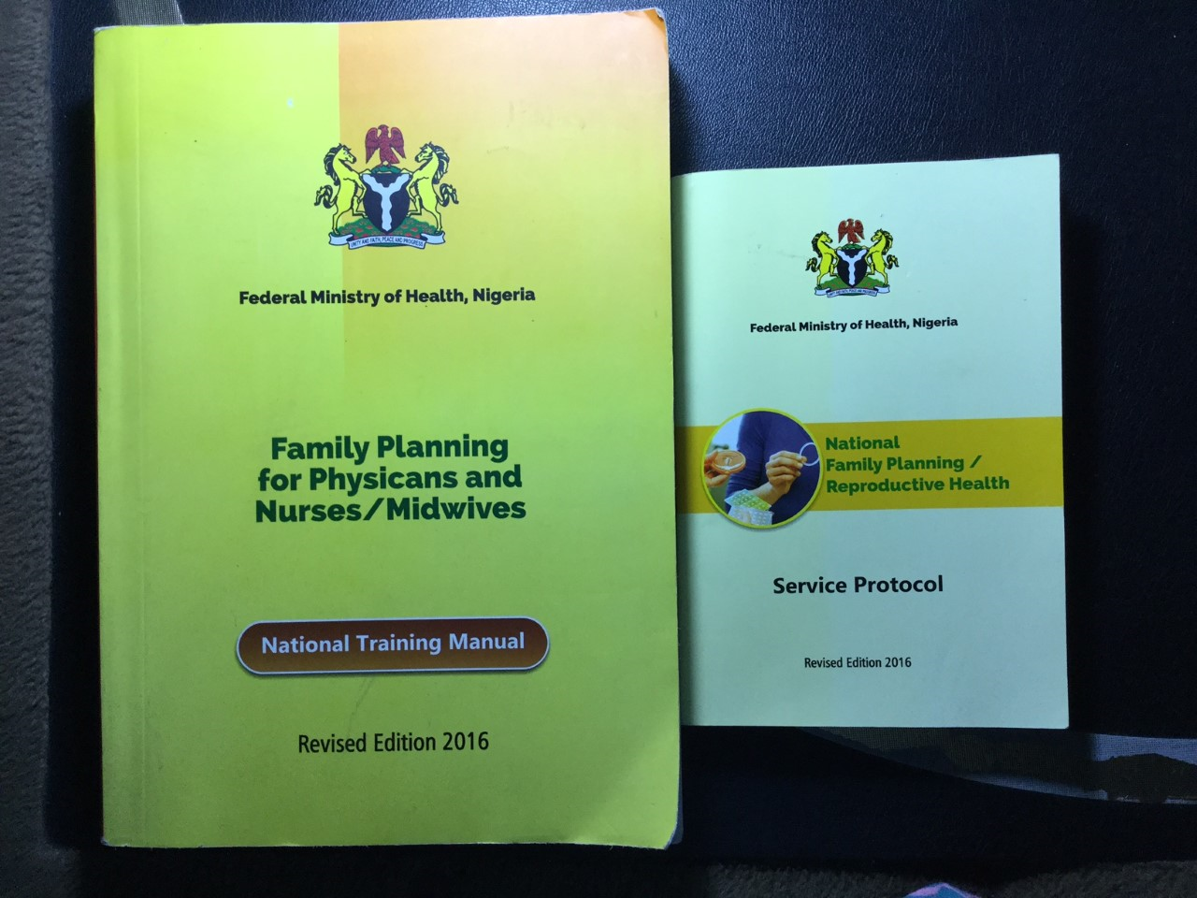
Federal Min of Health Family Planning National Training Manuals

Slide 69
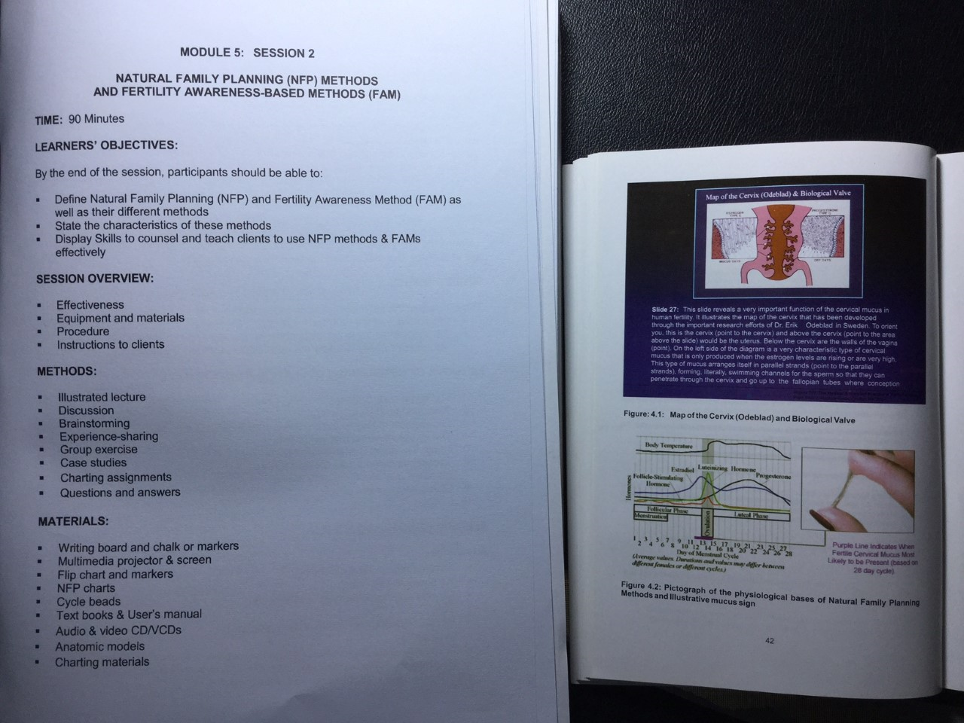
Curriculum for NFP and FAM methods

Slide 70
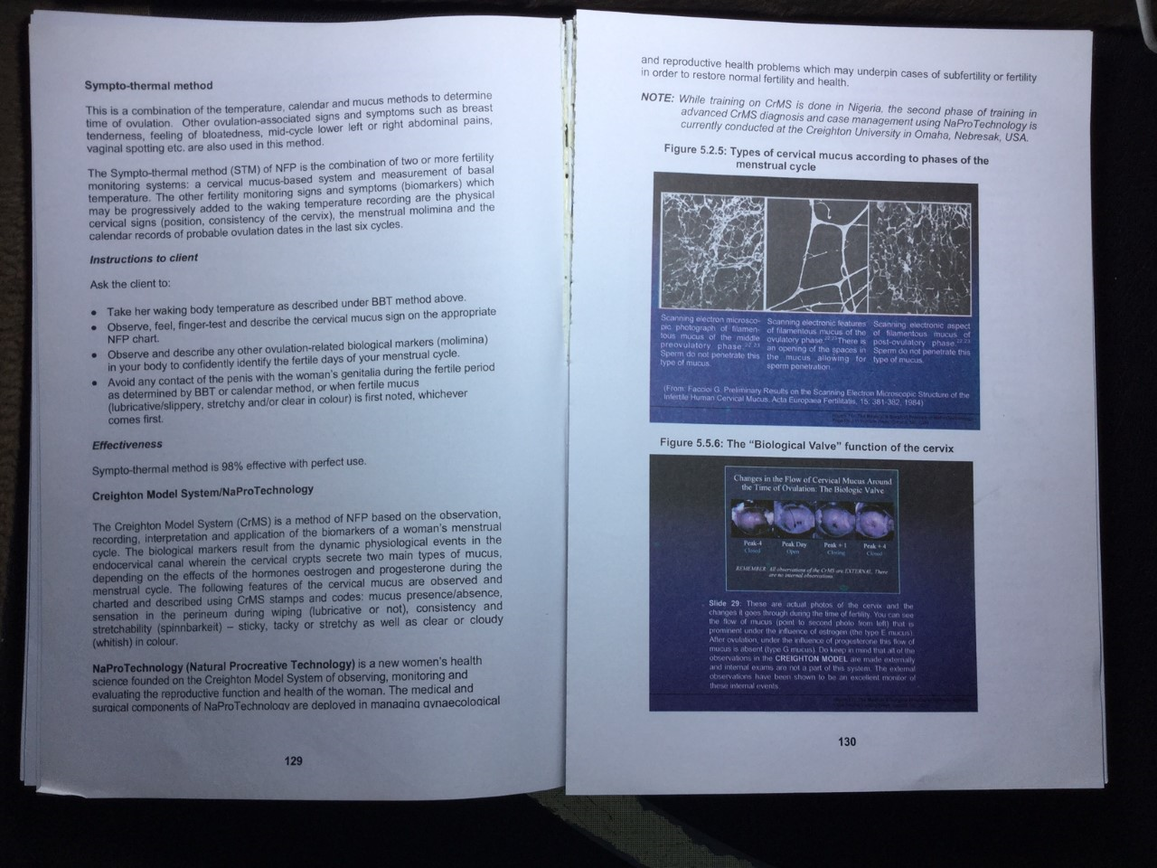
CRMS AND BIOLOGICAL VALVE

Slide 71

CRMS AND INSTRUCTIONS

Slide 72
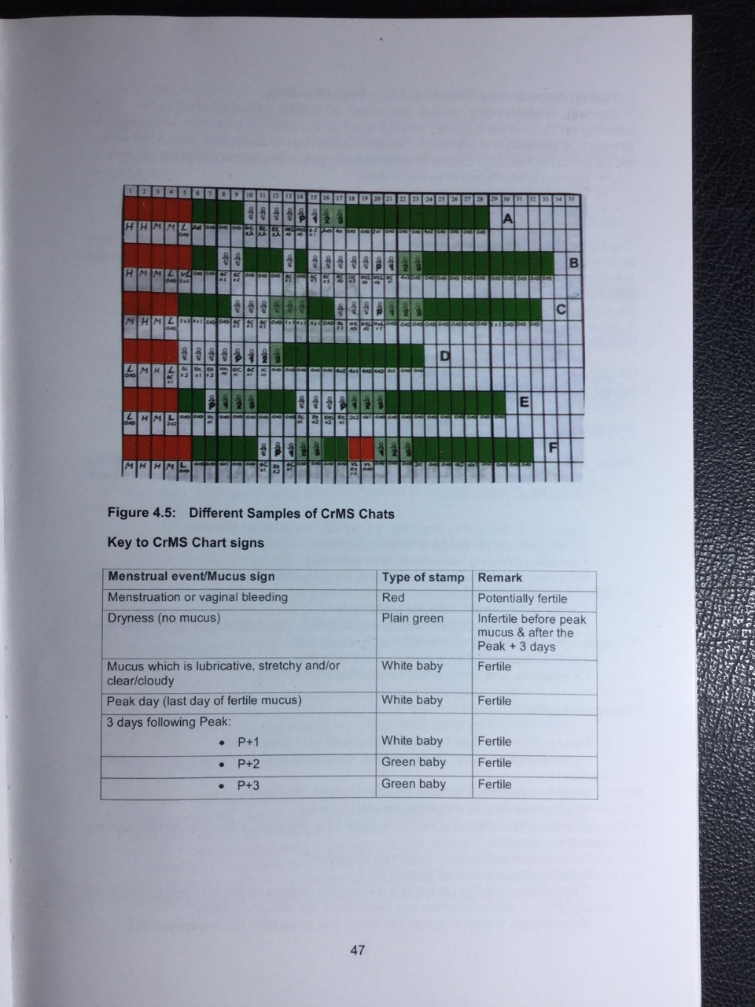
SERVICE PROTOCOL MANUAL

Slide 73
CONCLUSION/RECOMMENDATIONS
Obstetricians (PROVIDERS) in Nigeria had poor knowledge and practice of Natural Procreative Technology as well as a negative attitude towards it
There is need to create awareness of NPT especially among the obstetricians in Nigeria via information, education and communication in their annual scientific conferences and training centers
Which may translate to a choice of undergoing the required training to become a Naprotechnologist
As a consequence, many patients may benefit from their services

Slide 74
What Next? THE FUTURE “FAMILY AND PROCREATIVE HEALTH”
OUR DREAMS/VISION (age dependent)
Training and Retraining of Health Care providers nationally to access women at grass roots.
Providing Health/ Maternity centres/clinics in Parishes for FAMILY AND PROCREATIVE HEALTH CARE
Building/re- equipping secondary health facilities
Building Institutes/universities to facilitate and coordinate training, research, and service provision nationally
Partnering with state/federal government where possible
Provision of World Standard Best Quality and affordable women and family health services to attract Medical Tourism within Africa.

