Slide 1
Poland – the last hope for life defending the handicaPped
Bogdan Chazan MD, PhD
MaterCare International (MCI)
14th International Conference
Rome, September 18 – September 22, 2019

Slide 3
21 – 22 June 2019, Rzeszow, Poland
Podkarpackie’s Philharmonic Hall

Slide 4
15.35 – 15.55 The Onward March of the Global Anti Life Agenda: Ireland Has Succumbed, Poland Must Stand Firm.
Patrick BUCKLEY, Human Life International, Ireland

Slide 5
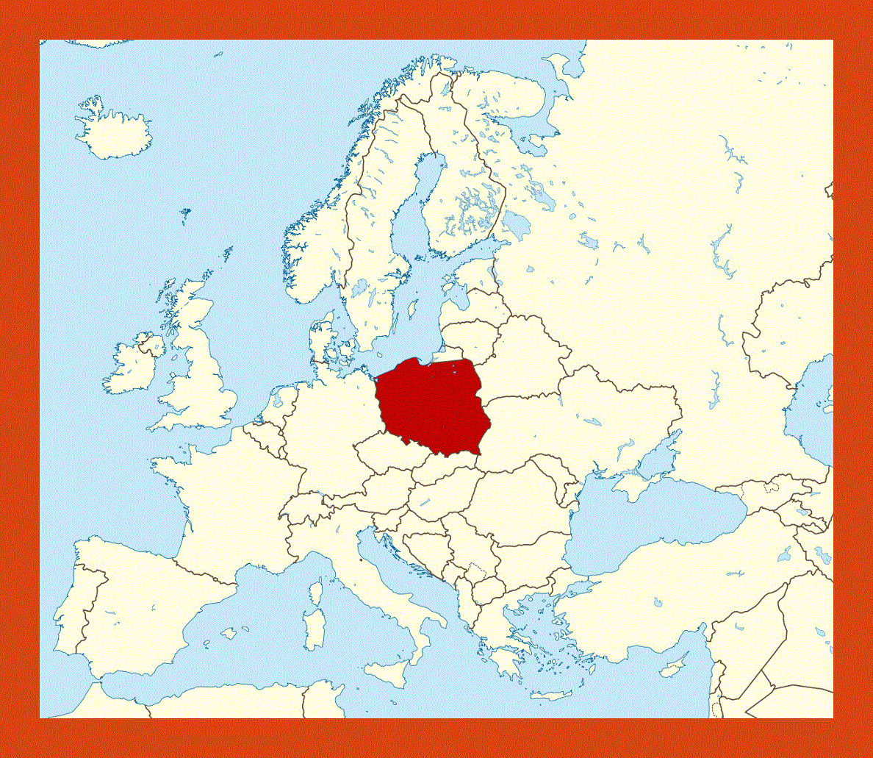

Slide 6
Abortion in Poland is permitteD on Three grounds
Pregnancy creates the threat to the life or health of the mother.
Prenatal exeminations or other procedures indicate the diagnosis or high probalility of a severe and irreversible fetel defect or incurable illness that threatens the fetus’ life.
There are reasons to suspect that the pregnancy results from an unlawful act.

Slide 7
The numer of legal abortions in poland
More than 1000 abortions each year
Majority because of eugenic resons (95 %)
Abortions of a child conceived as a result of criminal act (mainly sex with the persons under 15 years of life), 1 – 3 anually,

Slide 8
How to lower the number of Abortions ? How to save the children ?
Changing the law
The regions free of abortions
Education of whole society
Preparation of young generations for the family life (sex education) in schools

Slide 9
1. Changing the law – The last attempts
2016. Foundation „PRO – Right to Life” project „Stop abortion”
2017. The Life and Family Foundation project „Hold up abortion”
2018. The „Pro life” act
2018. Request of the parliament deputies to the Constitutional Tribunal
After approaching election (12th of October)?

Slide 10
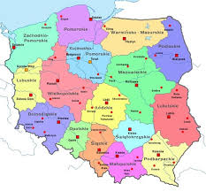
2. The Region Free of Abortion

Slide 11
3. Education of the whole society
Posters on cars and on walls of pro abortion hospitals showing the truth of abortion.
Positive transmission of the beauty of life
Not fight but care strategy
Creation of well – disposed social atmosphere
Marches for Life and Family
Houses for lonely mothers
Day of the Sanctity of Life
c. Building of the civilisation of life should be multidimensional

Slide 12
4. Preparation of young generations for life within family (sex education) in schools
Educational path in schools
2019. The unsuccesful attempt (massive protests of parents) to introduce to schools in big cities the WHO programme of the Comprehensive sexuality education (CSE) which „plays a central role in the preparation of young people for a safe, productive, fulfilling life in a world where HIV and AIDS, sexually transmitted infections (STIs), unintended pregnancies, gender-based violence (GBV) and gender inequality still pose serious risks to their well-being ...
The comparison to current the situation in England and Wales

Slide 13
The freedom of the Conscience the Concience clause
Freedom of conscience is a fundamental right.
No legal act is needed to quote on the freedom of conscience. It is an expression of man’s personal freedom.
Conscience clause restricts this freedom but is not its basis.
Imposing the physician referring to the clause the obligation to indicate another professional who will not use it is immoral.
The Polish Consitutional Tribunal jedgement this obligation as inconsistent with the Constitution. The act is being prepared.

Slide 14
The freedom of the conscience may refer in Reproductive medicine to:
Abortion
Contraception
Sterilization
In vitro fertilization
Surrogate motherhood
Embryo production and preimplantation selection
Euthanasia
Assised suicide
Sale of anti – implantation or early – abortion drugs

Slide 15
The conscience of the institution
The 2010 Council of Europe resolution.
The tradition or the patron of the hospital
The conscience of manager (often doctor)
The numerous conscience objections of the personnel

Slide 16
The Difficult situation of professionals

Slide 17
The conscience of the patient

Slide 18
Is it possible to provide obstetric and gynecological care in accordance with Evangelium Vitae under these conditions ? On the world ? In Poland ?

Slide 19
Dr John Lee’s call
The last sentence from the project of final resolution of the 25th Congress of the World Federation of Catholic Medical Associations held last year in Zagreb, Croatia, written by the former head of the Federation dr John Lee from Singapur:
„We Catholic physicians and health care professionals, responding to the Holy Fathers throughout the past 50 years, especially our current Holy Father Pope Francis, should expand and multiply our charitable, pro bono work in helping the sick, the poor and the vulnerable throught world, even it requires stepping out of our comfort zones and making financial and personal sacrifices.

Slide 20
A Heartfelt appeal…

Slide 21
Poland again…

Slide 22
Thanks for your Attention

