Slide 1
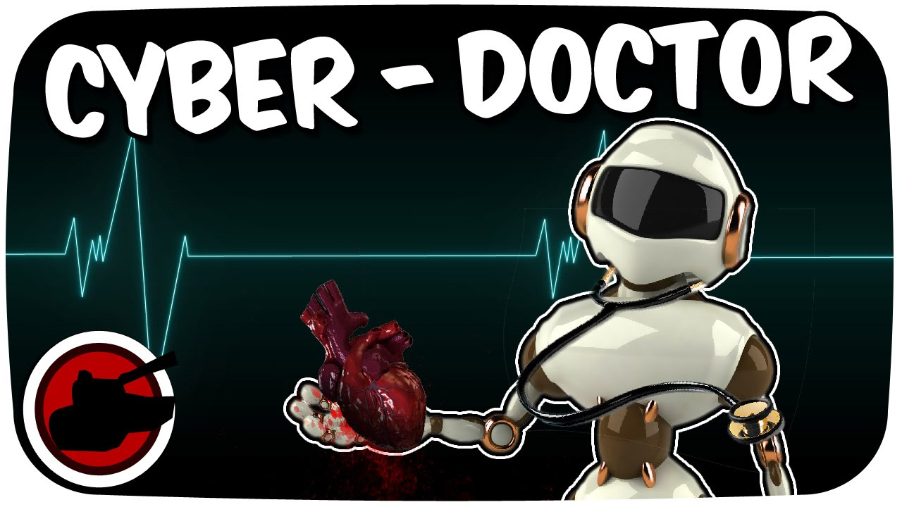
From
Good Samaritan
To
Cyber Doctor
To Posthumanism
No more suffering
No Death
Is Medicine as a Vocation Still Possible?
Is Medicine as a Christian Vocation Still Possible?
Dr. M. Pilar Núñez-Cubero, MD, PhD, OBGYN
Prof. of Bioethics

Slide 2
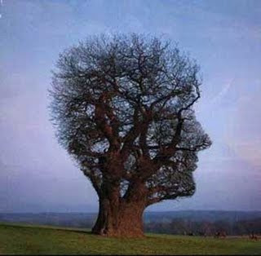
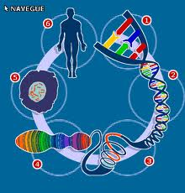
The current situation
Medicine, Science & Society in the Third Millennium

Slide 3
Years ago, one’s vocation, was a calling, linked our Christian faith,
“the call of God”
Martin Luther and John Calvin emphasized the importance of all work as being something one was called to by God
It was understood that a person’s work -as in our case, medicine – was a true calling.

Slide 4
The characteristics of “a calling” meant that a career in medicine had less to do with personal fulfillment, and more with responding to a need and contributing to the common good. The emphasis was on “us” or “society” versus “me.”
In the current generation,
I believe this view is not widely held.

Slide 5
Amongst my colleagues, conversation surrounding a career in medicine is self-centered:
How much money will I make?
How prestigious will I become?
What sort of lifestyle will I have?
Will I be fulfilled?
the overwhelming subject
is “ME.”

Slide 6
Previously, medicine was a vehicle for helping people
This was linked to a wider sociological setting that emphasized:
Collective well-being over self-actualization and individual autonomy
Nowadays…
“we have put our own good, as individuals… ahead of the common good.”
Robert Bellah (Habits of the Heart)

Slide 7
This problem is especially poignant in medicine.
We are not caring for people’s finances or products.
We are caring for individuals when they are most vulnerable.
Medicine
Is a place where money and prestige are to be had.
It is an attractive place to seek self-gain,
but it is an especially dangerous profession in which to do so has repercussions of inappropriate care,
and can devastate the vulnerable people served.

Slide 8
If we think like this, we will be uncaring doctors
We see patients as secondary,
or even as obstacles, to our primary goals
We do not see them as people in need of help,
nor do we see ourselves as public servants.
Unless some prestigious publication is attached
to our care-giving, patients are not worth our time
We usher them out because their questions don’t benefit us…,
If patients present as cases which can’t further our academic career...,
they can become a nuisance
When we enter medicine solely for personal fulfillment,
we view our patients as mere objects rather than as persons in need

Slide 9
But if we want a generation of physicians that truly care
Bellah wisely said, we must return
Let us reflect today the why of medicine and hope that
we must shift the culture of “medicine and me” to that of “medicine and my role in helping patients”
“to the idea of work as a contribution to the good of all
and not merely as a means to one’s own advancement.”
in our hearts, we find a genuine desire
to be there for our patients.

Slide 10
Vocation and Profession

Slide 11
PROFESSION
A profession is a type of job that requires advanced education or training. Acting like a professional really means doing what it takes to make others think of you as reliable, respectful, and competent. Depending on where you work and the type of job you have, this can take on many different forms.
This usually involves a type of contractual relationship

Slide 12
VOCATION
To work in medicine, you should have a vocation for it.
Vocation is an occupation which someone strongly feels the need to do, despite a lack of monetary gain or other benefits.
Therefore everyone's vocation should be what they feel compelled to do, because it gives a deeper meaning to their life. The type of work that you feel you are suited to, and to which you devote much of your time and energy
Be “thoroughly scientific and ethically correct”

Slide 13
Vocation
Vocation is the ideal destination,
the one mission that every person has to be or to perform in his/her own life, something inside of him/her, fighting to be done and crashing through the obstacles and difficulties around oneself- soul, body, societal and environmental- to attain and
to carry out his own mission (Ortega y Gasset).

Slide 14
The first sign of one’s vocation is LOVE. This drives the personal task of removing and fighting against the difficulties which prevent the fulfillment of that vocation.

Slide 15
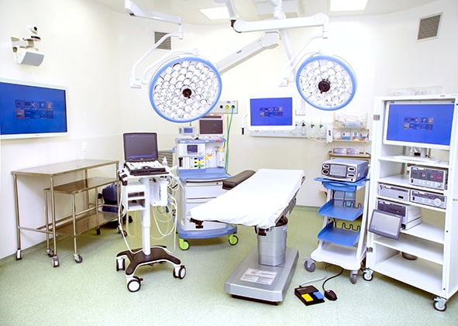
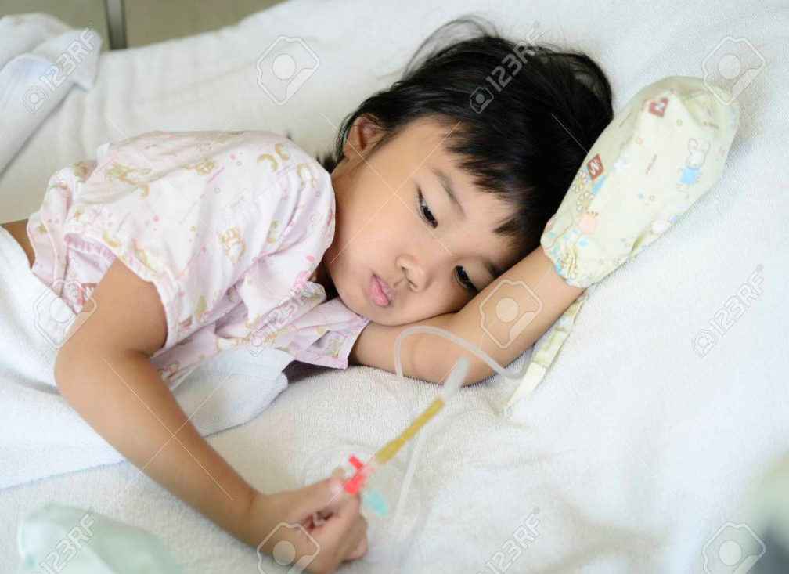
Medical Vocation

Slide 16
VOCATION TO MEDICAL PRACTICE
All levels of interpretation (literal, moral, allegorical, and analogical) must be used to clarify the DOCTOR–PATIENT ENCOUNTER.
During the first encounter, the doctor must evaluate the patient’s situation in 5 domains (verisimilitude, narrative indeterminacy, narrative fidelity, benefit to the patient, and empathic resonance), and explore the values of the patient
Spiritual
Mental
Emotional
The human person is a blend of these elements.

Slide 17
MEDICAL VOCATION
After the first encounter
Take the path of reason to understand the true physical, mental, social, spiritual and emotional reality of the patient (Zubiri)
Use these 5 reference points
Outline the differential diagnoses
· Check the veracity of these possibilities (evidence)

Slide 18
After that, comes the moral pathway to check for any conflict in values. This allows for a dialogue on decision-making which respects personal autonomy.
“without forgetting that an emotional situation can drive the patient to a blinding level of anxiety,” and to take time to deliberate and reach the right decision.

Slide 19
Medical
Doctors
Medical professionals cannot forget … their moral principles.
Bioethics
bioethical principles and virtues, especially prudence, not as caution, but as Phronesis or practical wisdom (Pellegrino).
Duty
to fulfil their DUTY.

Slide 20
Decision making - Deliberation
1. Analyse the facts
2. Reflect on the values at stake
3. Deduce the necessary duties
Facts
Values
Duties

Slide 21
Moral awareness must orientate and guide our way on the moral path.
This type of awareness guides us in the most difficult decisions
It is in the execution of our DUTY, that we have to make ethical decisions
Knowing that Medicine is a science of probability, not a science of certainty
And being mindful that all moral awareness is manipulable

Slide 22
Legislation and medical deontological codes:
must accommodate the conscientious objection of health care professionals for ethical, moral and religious reasons, thereby guaranteeing their freedom and independence.
Remember that a conscience can be pathological if it is lax or overly rigid, and that Conscientious Objection is PERSONAL, NOT INSTITUTIONAL

Slide 23
TODAYS MEDICAL VOCATION
Love your medical work
Love your patients
Be competent
Have dedication
When duty and our desires coincide, we get peace and joy
“we enjoy medical work”

Slide 24
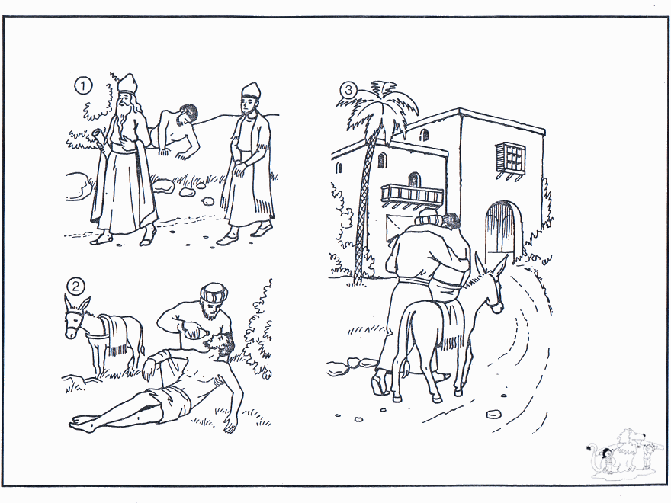
Christian Medical Vocation

Slide 25
The Good Samaritan
Conscience
Compassion
Proximity
Care
Collaboration
Accompaniment

Slide 26
Vocation of the Christian Lay Physician and other Catholic Healthworkers
They “see their daily activities as an occasion to join themselves to God, fulfill His will, serve other people, and lead them to communion with God in Christ.” Christifideles Laici, 52
They give a coherent testimony with their lives
“A baptized Christian who takes to heart his being a Christian, effectively lives and achieves his specific profession in the world where he is placed.” ^{(Ratzinger)}

Slide 27
promoting the dignity of the person;
protecting the inviolable right to life;
acknowledging religious freedom and the family as the basic environment for social engagement;
charity, as inspiration and support for solidarity;
the duty of all to engage in politics;
the individual’s centrality in social and economic spheres;
evangelizing culture on the general and individual level
Christifideles Laici lists the following as areas of action:

Slide 28
Pope Francis’ address to healthcare workers
“treat the sick as people, not as numbers” (June 2019)
Aim to defend, respect and promote life.
The health care system has changed radically, because of advances in technology and an increase in ethical problems.
“Any medical practice or intervention … must first be evaluated … to see if it … respects life and human dignity.”
He thanked them for their “irreplaceable service” to …the sick, elderly, and marginalized.

Slide 29
Each person is a unique and unrepeatable image of the humanity of Christ, who demonstrated that each individual “is not a number, but a person, unique and unrepeatable.”
Corporate efficiency and cost saving in health care have often trumped the need of patients to be accompanied through their illness.

Slide 30
Christian Healthcare professionals were encouraged to pay particular attention to spirituality,
“so that this fundamental dimension of the person, often neglected in our time, but so important, is rediscovered and appreciated, especially for those who live with illness, or are close to those who suffer.”

Slide 31
Modern medicine
and society
pose challenges to the
Christian Medical Vocation

Slide 32
Challenges to a medical vocation include:
Challenges to the value and dignity of human life from it’s beginning to it’s natural end ie abortion and euthanasia
Preimplantation Genetic Diagnosis, Non-invasive Prenatal Testing. eg Savulescu opines that parents have a “moral” obligation to test and “select.”
Creating embryos for reproductive or therapeutic research eg human cloning, embroyonic stem cells. One life cannot be eliminated for the purpose of saving another.
Assisted Reproductive Technologies, including surrogacy
Transhumanism (can and should man be changed?)

Slide 33
Challenges to a medical vocation include:
Robotics- can robots treat patients?
Optimising the welfare of society- the greatest wellbeing for whom? For all?
Elevating patient autonomy so as to enable treatment that is not medically indicated?
Ethics, law and "legislation”
Gender situations
Bureaucracy, politicization and commercialization

Slide 34
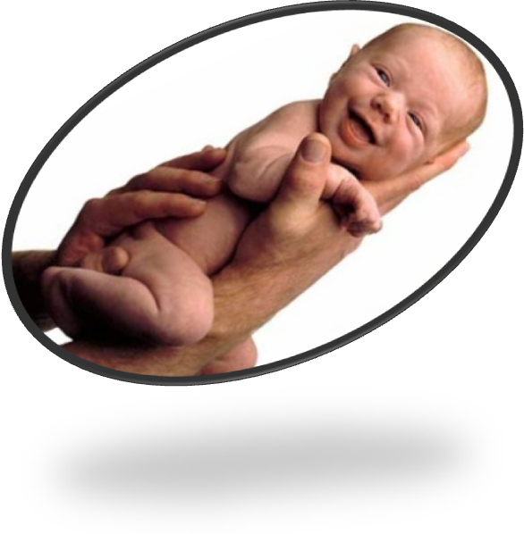
Disrespect for
Life and Dignity
(abortion, euthanasia)
Embryos created for research, stem cells
Kill someone to cure another?
PGD and NIPT,
(Savulescu)
Assist. Reprod. Technologies
Surrogacy
Genetics
Life is Devalued

Slide 35
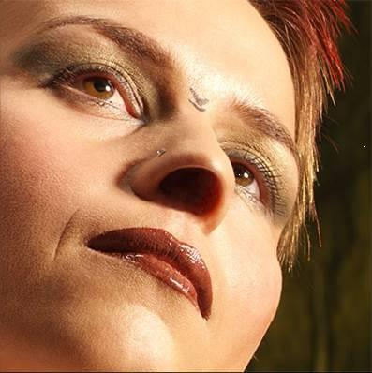
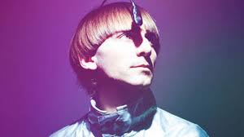
Transhumanism:
Why and for whom?
Treatment
Change the Human
Enhancement

Slide 36
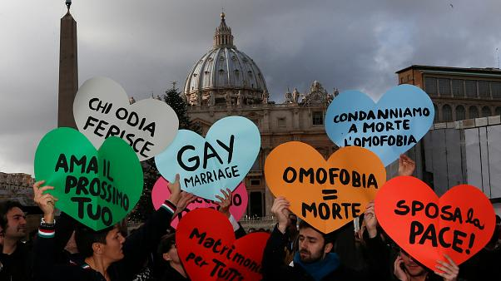
Gender situations and theories

Slide 37
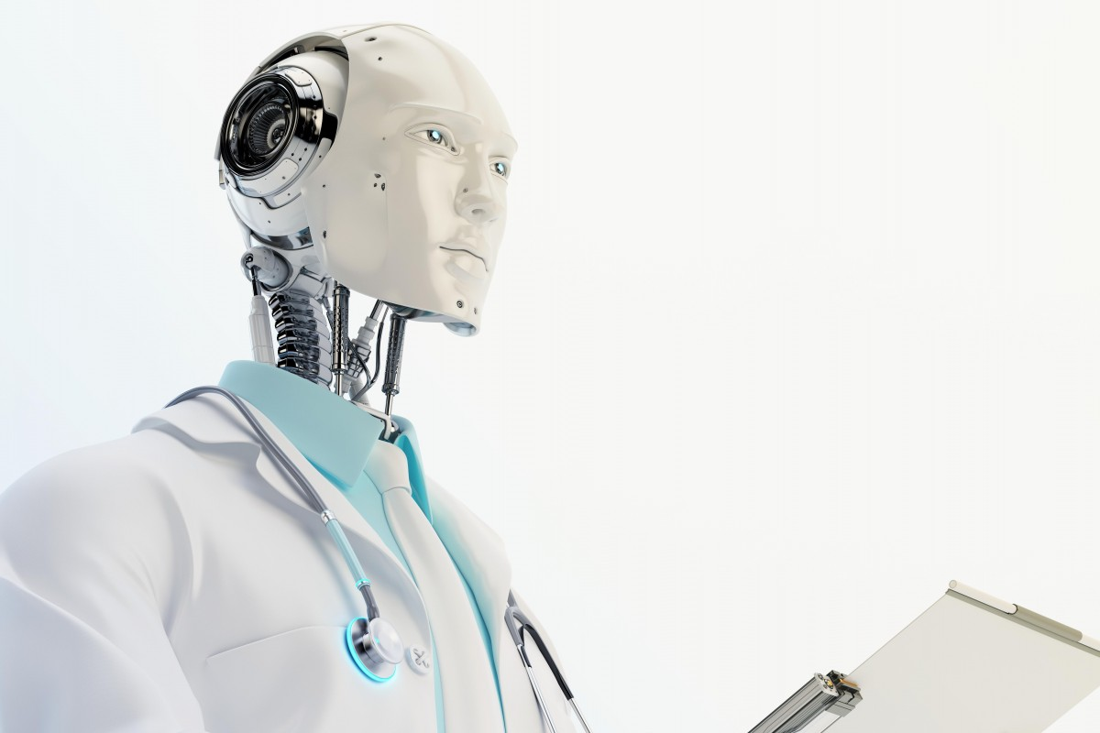
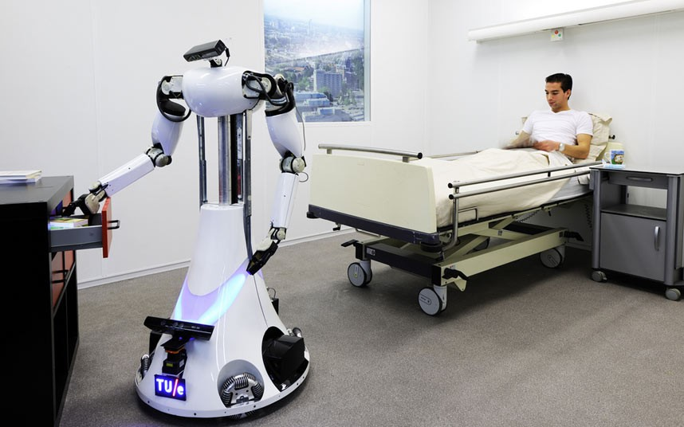
Can Robots take care of patients?

Slide 38
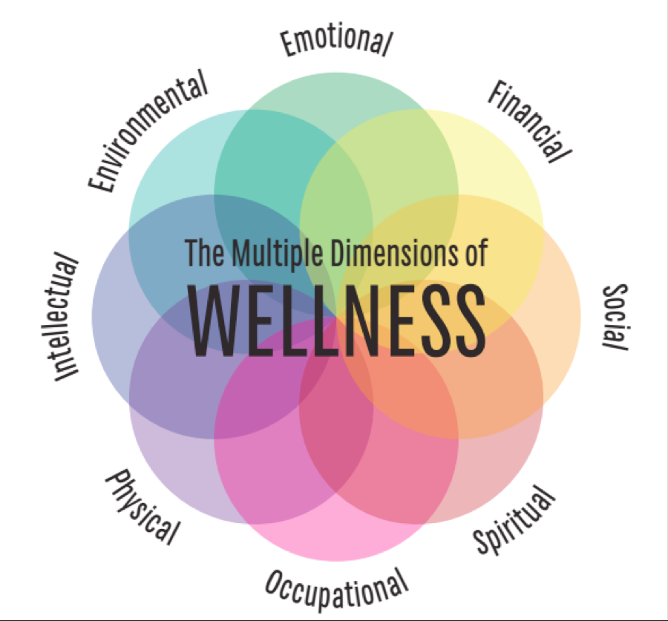
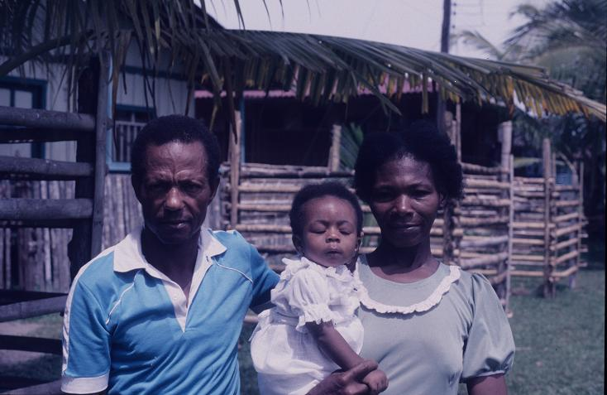
Optimising wellbeing in society.
For whom? For everyone?

Slide 39
Patient autonomy
Can a patient demand treatment which is not medically indicated?
From
paternalistic medicine
To an autonomous model

Slide 40
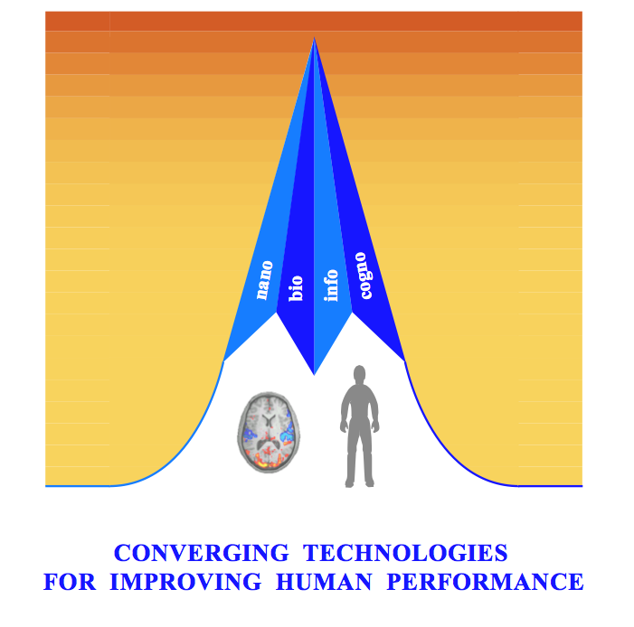
Bureaucracy
NEW WORLD ORDER:
Techno-liberal globalization
Technical-community globalization
Genetics: gene therapy
Hybridization of man and machine (Cyborg)
Artificial intelligence (similar to human intelligence) Kurzweil
Converging technologies: NBIC
Transhumanism and posthumanism
New humanity (Avatar 2045)

Slide 41
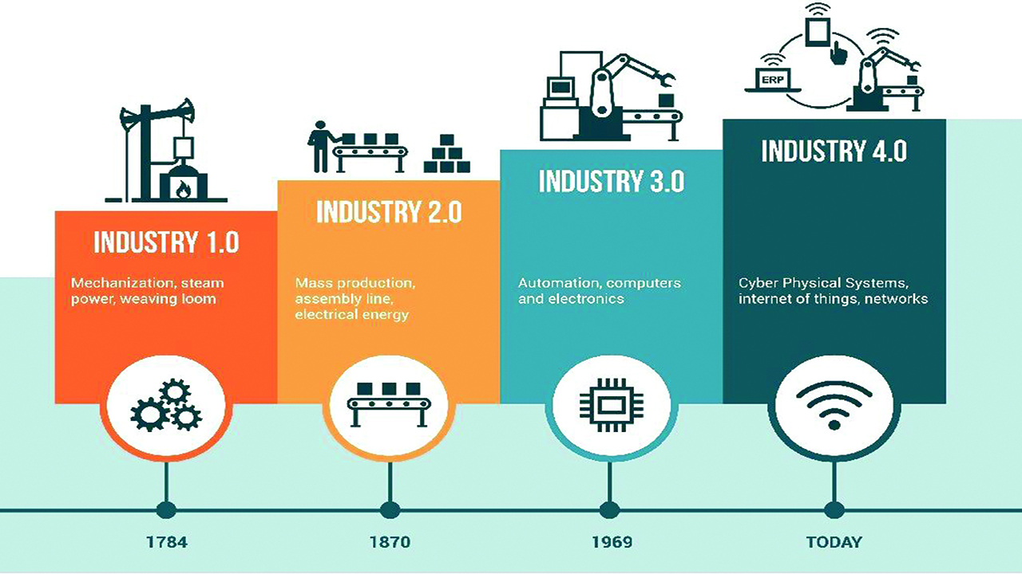
Politicization & commercialization
The Fourth Industrial Revolution

Slide 42
Ethics and Law, “legislation”
ETHICS:
Do we have to do every thing that science and technology offer us?
We ought to do... what is needed to ethically serve our patients.
LAW
Can the Law oblige doctors to cease reasonable treatment, so as to lead a patient to his/her death?
Can the Law impose “Reproductive Rights”,
including termination of pregnancy?

Slide 43
Conscientious objection - based “on the personal need not to act differently from one’s own ethical conviction”
The choice of objection, must be made with respect and humility, so it doesn’t end up being a reason for contempt or pride.
In these situations dialogue is paramount, “especially with those who hold different views”
Avoid condemnation

Slide 44
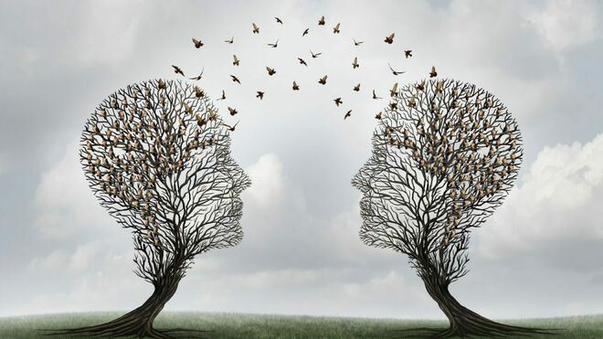
Today’s hospitals are temples of science and technology. They are not centered on the sick, but on other interests, including research, which do not benefit the individual...

Slide 45
Going against the tide
Often we have to live in “democratic disagreement,” exercising conscientious objection to practices which oppose Christian values and the Christian vision of humanity and life.

Slide 46
Living a coherent life could lead, in extreme cases, to the supreme witness of martyrdom, as the martyrs of nineteenth-century Korea demonstrated.
Or, nowadays, to lose your job

Slide 47
Is medicine as a vocation still possible today? Is medicine as a Christian vocation still possible today?
Yes

Slide 48
To cure and care for the people living in our world
Both the real ones and the cyborgs!
Notes:
Cyborg: a person whose physiological functioning is aided by or dependant on a mechanical or electronic device. Origin: 1960-65; cyb(ernetic) org(anism)

Slide 49
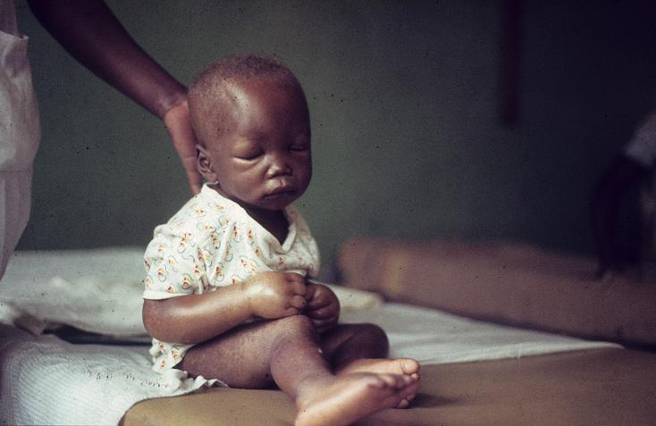
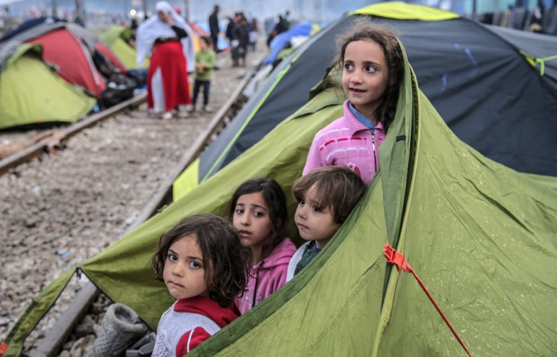
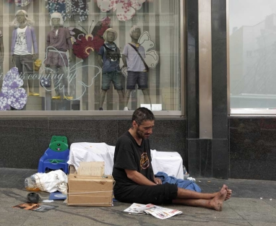
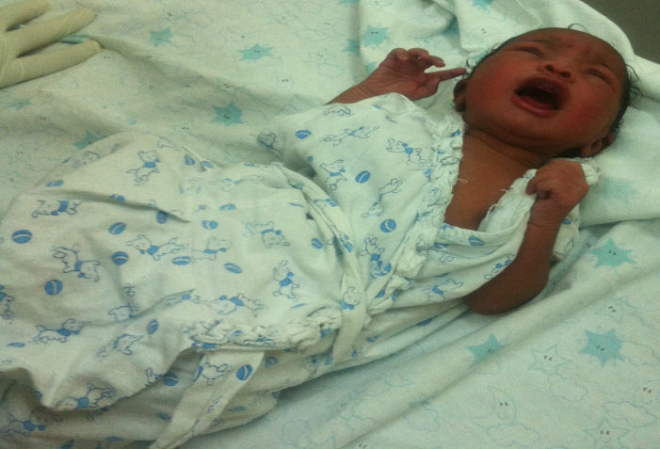
To take care of the most vulnerable... The poor, the refugees, the homeless, as well as those living in developing countries
Isiolo 2016
The poor you will always have with you and, whenever you have the desire, you can do good to them. (Mark 14, 7)

Slide 50
Dreaming is allowed!
“Go and do likewise.”, Luke 10,37
THANKS FOR LiSTENING

Slide 51
ANNEXES

Slide 52
AS A MEMBER OF THE MEDICAL PROFESSION: (Geneva’s Declaration October 2017) I SOLEMNLY PLEDGE to dedicate my life to the service of humanity; THE HEALTH AND WELL-BEING OF MY PATIENT will be my first consideration; I WILL RESPECT the autonomy and dignity of my patient; I WILL MAINTAIN the utmost respect for human life; I WILL NOT PERMIT considerations of age, disease or disability, creed, ethnic origin, gender, nationality, political affiliation, race, sexual orientation, social standing or any other factor to intervene between my duty and my patient; I WILL RESPECT the secrets that are confined to me, even after the patient has died; I WILL PRACTISE my profession with conscience and dignity, and in accordance with good medical practice; I WILL FOSTER the honour and noble traditions of the medical profession; I WILL GIVE to my teachers, colleagues, and students the respect and gratitude that is their due; I WILL SHARE my medical knowledge for the benefit of the patient and the advancement of healthcare; I WILL ATTEND TO my own health, well-being, and abilities in order to provide care of the highest standard; I WILL NOT USE my medical knowledge to violate human rights and civil liberties, even under threat; I MAKE THESE PROMISES solemnly, freely, and upon my honour.

Slide 53
M E D I C A L P R O F E S S I O N A L I S M I N T H E N E W M I L L E N N I U M : A P H Y S I C I A N C H A RT E R 2005 ABIM FOUNDATION - ACP FOUNDATION - EUROPEAN FEDERATION OF INTERNAL MEDICINE
Preamble: Professionalism is the basis of medicine’s contract with society
Fundamental Principles: Principle of primacy of patient welfare Principle of patient autonomy Principle of social justice
A Set of Professional Responsibilities: Commitment to professional competence Commitment to honesty with patients Commitment to maintaining appropriate relations with patients Commitment to patient confidentiality Commitment to improving quality of care Commitment to improving access to care Commitment to a just distribution of finite resources Commitment to maintaining trust by managing conflicts of interest Commitment to scientific knowledge Commitment to professional responsibilities

Slide 54
Summary
The practice of medicine in the modern era is beset with unprecedented challenges in virtually all cultures and societies.
These challenges center on increasing disparities among the legitimate needs of patients, the resources available to meet those needs, the increasing dependence on market forces to transform health care systems, and the temptation for physicians to forsake their traditional commitment to the primacy of patients’ interests.
To maintain the fidelity of medicine’s social contract during this turbulent time, we believe that physicians must reaffirm their active dedication to the principles of professionalism, which entails not only their personal commitment to the welfare of their patients, but also collective efforts to improve the health care system for the welfare of society.
This Charter on Medical Professionalism is intended to encourage such dedication and to promote an action agenda for the profession of medicine that is universal in scope and purpose.

